Slide 1
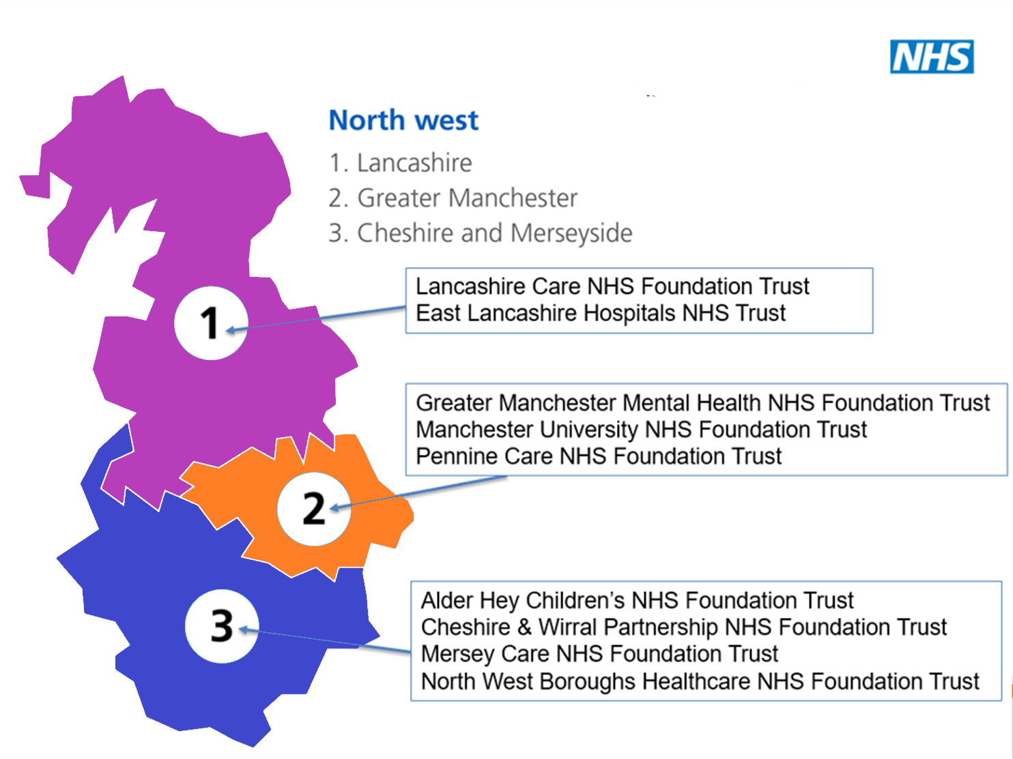

Slide 2
Lancashire
Lancashire & South Cumbria NHS Foundation Trust
East Lancashire Hospitals NHS Trust

Slide 4
Greater Manchester
Greater Manchester Mental Health NHS Foundation Trust
Manchester University NHS Foundation Trust
Pennine Care NHS Foundation Trust

Slide 6
Cheshire and Merseyside
Mersey Care NHS Foundation Trust
Alder Hey Children's NHS Foundation Trust
Cheshire and Wirral Partnership NHS Foundation Trust

