Slide 1

MRCPsych General Adult Psychiatry
Psychosis 4

Slide 2
Psychosis 4
Objectives
To develop an understanding of:
the course and prognosis of schizophrenia
risk factors for poor outcomes
the relevance of duration of untreated psychosis

Slide 3
Psychosis 4
Expert Led Session
Schizophrenia: Course & Prognosis

Slide 4
Overview
Historical view
Course
Prognosis
Risk factors for poorer outcomes
Duration of untreated psychosis
Treatment resistance
Physical Health
Suicide

Slide 5
Schizophrenia
Schizophrenia affects more than 21 million people worldwide¹
  Approx 220,000 people in England and Wales²
Affects around 1 in every 100 people over the course of their life³
In 2007 - accounted for approx 30% of total expenditure on adult MH & social care services²
Moderate/severe disability in 60% of cases²
Mortality is approx fifty percent above that of the general population²

Slide 6
Historical view
Kraepelin - dementia praecox (“premature dementia”)
– viewed as having a progressive downhill course, similar to forms of dementia, but starting earlier in life⁴
Bleuler – schizophrenia (reflecting observations of loose associations)
– recognition that some symptoms are chronic, but that patients don’t always show a downward course; chronic symptoms often less severe after the initial acute phase⁴

Slide 7
Course/Outcome
Overall outcome poor compared to other psychiatric disorders (except dementias)⁴
Follow up studies have shown considerable variation in long-term outcome⁵
People vary considerably in their pattern of symptoms and in the course of any remaining difficulties⁵
Risk factors interact with personality, temperament, and cognitive traits that influence its course⁴

Slide 8
Course/Outcome
Most people recover from the initial acute phase; only 14-20% recover fully
Approx 80% will relapse within 5 years of a treated first episode
  partly due to stopping medication
Others (3/4) improve but have recurrent relapses & some degree of ongoing disability
  timing related to stress, adversity, social isolation, treatment compliance
Smaller proportion have extended periods of remission without further relapses
In the longer term (up to 15 years) over half of those diagnosed will have episodic rather than continuous difficulties
(NICE⁵)

Slide 9
In summary…
For every 5 people with schizophrenia:
1 will get better within five years of their first obvious symptoms
3 will get better, but will have times when they get worse again
1 will have troublesome symptoms for long periods of time
(RCPsych³)

Slide 10
Remember
Some people who never experience complete recovery from their experiences still manage to sustain an acceptable quality of life if given adequate support and help⁵
“There is a subgroup of schizophrenia patients who, a few years after the acute phase, function adequately or experience periods of recovery for a number of years, without treatment”⁴

Slide 11
Predictors for poor odds of remission
Non-modifiable risk factors⁶
Male sex
Younger age at disease onset
Poor premorbid adjustment
Severe baseline psychopathology

Slide 12
Predictors for poor odds of remission
Modifiable risk factors⁶
Longer duration of untreated illness
Nonadherence to antipsychotics
Comorbidities (esp substance misuse)
Lack of early antipsychotic response
Lack of improvement with non-clozapine antipsychotics, predicting clozapine response

Slide 13
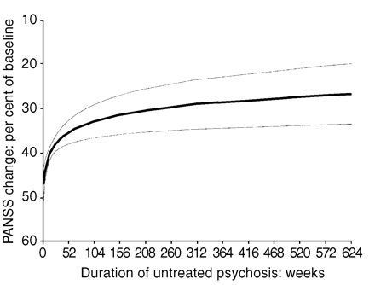
Duration of untreated psychosis
(⁷)
From: Drake et al. Causes and consequences of duration of untreated psychosis in schizophrenia. The British Journal of Psychiatry. 2000, 177 (6) 511-515
Notes:
http://bjp.rcpsych.org/content/177/6/511.long
Predicted impact of duration of untreated psychosis on the amount of improvement in PANSS score after 12 weeks of treatment (with 95% CIs)
NB y axis scale inverted

Slide 14
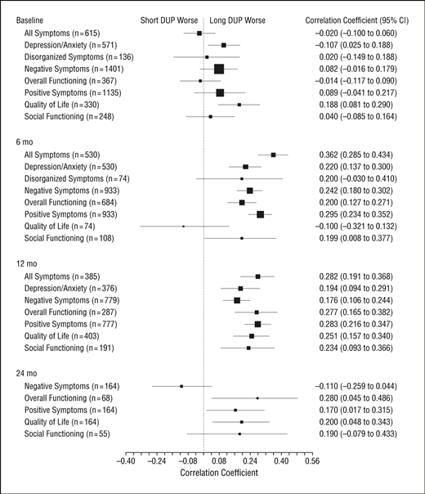
DUP – shorter term outcomes
(⁸)
From: Marshall M et al. Association Between Duration of Untreated Psychosis and Outcome in Cohorts of First-Episode Patients: A Systematic Review. Arch Gen Psychiatry. 2005;62(9):975-983.
Notes:
http://archpsyc.jamanetwork.com/article.aspx?articleid=1108403

Slide 15
DUP – shorter term outcomes
(⁸)
From: Marshall M et al. Association Between Duration of Untreated Psychosis and Outcome in Cohorts of First-Episode Patients: A Systematic Review. Arch Gen Psychiatry. 2005;62(9):975-983.

Slide 16
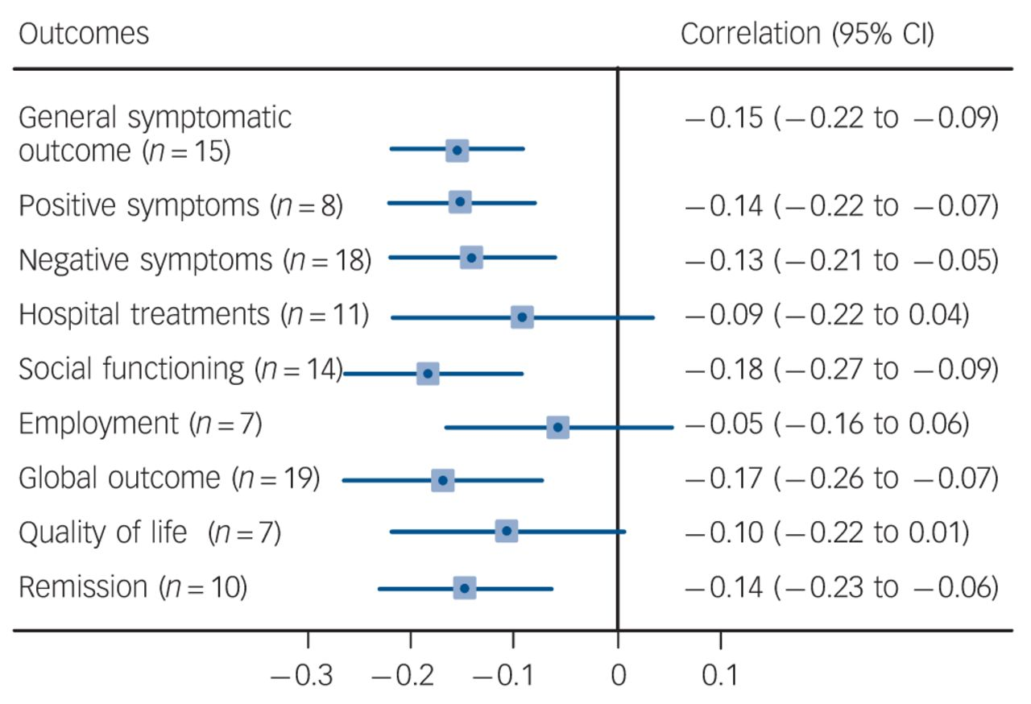
DUP – longer term outcomes
(⁹)
From: Penttilä M et al. Duration of untreated psychosis as predictor of long-term outcome in schizophrenia: systematic review and meta-analysis
The British Journal of Psychiatry, 2014, 205 (2) 88-94
Notes:
http://bjp.rcpsych.org/content/205/2/88
Negative correlation indicates that long DUP is associated with poor outcome (n, number of studies)

Slide 17
Treatment resistance
1/5 - 1/3 continue to have psychotic symptoms despite antipsychotic treatment^{10,11}
Clozapine only medication with evidence of efficacy in treatment resistance¹⁰

Slide 18
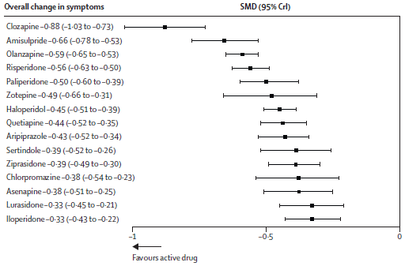
Efficacy of antipsychotics
(¹²) From: Leucht et al. Comparative efficacy and tolerability of 15 antipsychotic drugs in schizophrenia: a multiple-treatments meta-analysis. Lancet 2013; 382: 951–62.
Notes:
Forest plot for efficacy of antipsychotics drugs compared with placebo
Treatments are ranked according to their surface under the cumulative ranking (SUCRA) values.
SMD=standardised mean difference. CrI=credible interval.

Slide 19
Clozapine
60% show improvement with clozapine
Can take 6-12 months (or much longer to stabilise)
Prescription of clozapine is varied and underused
  1 study found mean no. antipsychotics before clozapine initiated = 9.2
  In North West studies showed 16 – 34 fold variation in prescribing practice
Adverse effects?
(Mistry et al¹³)

Slide 20
Physical Health
Males with schizophrenia die 20 years earlier & females 15 years earlier than the general population
Most premature deaths are due to physical disorders, including cardiovascular disorders, metabolic disorders (e.g. diabetes), COPD, cancers & infectious diseases.
Diabetes – 2-3 x risk of general population, but often missed
Other difficulties e.g. dental caries, sexual dysfunction, constipation and nocturnal enuresis also found
(NICE⁵)

Slide 21
Why?
Under recognised & undertreated in primary care
Nature of psychosis; insight
Lifestyle choices
Social stigma
Stress/distress
Side effects of treatment (antipsychotics → weight gain, diabetes, lipid abnormalities, galactorrhoea, tardive dyskinesia, prolonged QT)
Attitudes of healthcare staff
(NICE⁵)

Slide 22
Suicide
1/5 of premature deaths from suicide and accidents⁵
Lifetime risk of suicide in people with schizophrenia 4.9%¹⁴
Only consistent protective factor - delivery of/adherence to effective treatment¹⁴

Slide 23
Risk factors for suicide in Schizophrenia
Risk factor | Strong association | Weak association
Demographic factors | Young, male, unemployed, higher levels of education | Single (not married), rural
Illness-related factors | Depression, hopelessness, negative self-thoughts, anxiety, insomnia, self-devaluation, low self-esteem, guilty, PTSD | Treatment (in particular, second-generation antipsychotic) may be a protective factor against suicide
 | Increased positive symptoms (esp auditory hallucinations and delusions), low negative symptoms, higher level of mental suffering at baseline, mental disintegration, agitation/motor restlessness | Later age of onset Impact of duration of disease on suicide risk is inconclusive
 | Presence of insight
 | Presence of physical illnesses
Genetics | Positive family history
Previous suicide attempt/ideation | Strong correlation with history of suicide attempt/ideation
Substance abuse | Alcohol and drug abuse | Smoking
Life events |  | Potentially increased risk with history of increased childhood trauma
(¹⁴) From: Hor K & Taylor M. Suicide and schizophrenia: a systematic review of rates and risk factors. J Psychopharmacol. 2010 Nov; 24(supplement 4): 81–90.

Slide 24

Questions or Comments?

Slide 25
1. World Health Organization. Schizophrenia. 2015. http://www.who.int/mediacentre/factsheets/fs397/en/
2. Mentalhealth.org.uk. Mental Health Statistics: Schizophrenia. 2015. http://www.mentalhealth.org.uk/help- information/mental-health-statistics/schizophrenia- statistics
3. RCPsych. Schizophrenia. 2015. http://www.rcpsych.ac.uk/healthadvice/problemsdisord ers/schizophrenia.aspx
4. Jobe TH, Harrow M. Schizophrenia Course, Long-Term Outcome, Recovery, and Prognosis. Current Directions in Psychological Science. 2010;19:4220-225
5. National Collaborating Centre for Mental Health Commissioned by the National Institute for Health and Care Excellence. Psychosis and Schizophrenia in adults. The NICE Guideline on treatment and management. Updated Edition. NICE; 2014.
6. Carbon M & Correll CU. Clinical predictors of therapeutic response to antipsychotics in schizophrenia. Dialogues Clin Neurosci. 2014;16(4):505-24.
Drake et al. Causes and consequences of duration of untreated psychosis in schizophrenia. The British Journal of Psychiatry. 2000;177(6):511-515
Marshall M et al. Association Between Duration of Untreated Psychosis and Outcome in Cohorts of First-Episode Patients: A Systematic Review. Arch Gen Psychiatry. 2005;62(9):975-983.
9. Penttilä M et al. Duration of untreated psychosis as predictor of long-term outcome in schizophrenia: systematic review and meta- analysis. The British Journal of Psychiatry. 2014;205 (2):88-94
10. Miyamoto S, Jarskog LF, Fleischhacker WW. New therapeutic approaches for treatment- resistant schizophrenia: a look to the future. J Psychiatr Res. 2014;58:1-6
11. Dold M, Leucht S. Pharmacotherapy of treatment- resistant schizophrenia: a clinical perspective. Evid Based Ment Health. 2014;17(2):33-7
12. Leucht et al. Comparative efficacy and tolerability of 15 antipsychotic drugs in schizophrenia: a multiple- treatments meta-analysis. Lancet 2013; 382: 951–62.
13 Mistry H & Osborn D. Underuse of clozapine in treatment-resistant schizophrenia. Advances in Psychiatric Treatment. 2011; 17(4):250- 255
14. Hor K & Taylor M. Suicide and schizophrenia: a systematic review of rates and risk factors. J Psychopharmacol. 2010; 24(supplement 4): 81–90.
References

Slide 26
MCQs

Slide 27
Psychosis 4
MCQs
1. The chemical structure of Olanzapine is:
  A. Benzizoxazole
  B. Dibenzothiazepine
  C. Thienobenzodiazepine
  D. Butyrophenone
  E. Benzobutyramide

Slide 28
Psychosis 4
MCQs
1. The chemical structure of Olanzapine is:
  A. Benzizoxazole
  B. Dibenzothiazepine
  C. Thienobenzodiazepine
  D. Butyrophenone
  E. Benzobutyramide

Slide 29
Psychosis 4
MCQs
2. Which of the following genes are thought to be involved in the aetiology of Schizophrenia according to the current evidence?
  A. COMT
  B. DISC-1
  C. DTNBP-1
  D. GABRB-2
  E. All of the above

Slide 30
Psychosis 4
MCQs
2. Which of the following genes are thought to be involved in the aetiology of Schizophrenia according to the current evidence?
  A. COMT
  B. DISC-1
  C. DTNBP-1
  D. GABRB-2
  E. All of the above

Slide 31
Psychosis 4
MCQs
Which of the following is not a predictor of course and outcome in Schizophrenia?
  A. Sociodemographic status
  B. Features of initial clinical state and treatment response
  C. First rank symptoms at baseline
  D. Family history of psychiatric disorders
  E. Premorbid personality and functioning

Slide 32
Psychosis 4
MCQs
Which of the following is not a predictor of course and outcome in Schizophrenia?
  A. Sociodemographic status
  B. Features of initial clinical state and treatment response
  C. First rank symptoms at baseline
  D. Family history of psychiatric disorders
  E. Premorbid personality and functioning

Slide 33
Psychosis 4
MCQs
Which of the following scales is the most appropriate for assessment of extra-pyramidal side effects of antipsychotics?
  A. Barnes’ scale
  B. Brief Psychiatric Rating Scale
  C. Simpson-Angus Scale
  D. Positive and Negative Symptom Scale
  E. Unified Parkinson’s Disease Rating Scale

Slide 34
Psychosis 4
MCQs
Which of the following scales is the most appropriate for assessment of extra-pyramidal side effects of antipsychotics?
  A. Barnes’ scale
  B. Brief Psychiatric Rating Scale
  C. Simpson-Angus Scale
  D. Positive and Negative Symptom Scale
  E. Unified Parkinson’s Disease Rating Scale

Slide 35
Psychosis 4
MCQs
Who established antipsychotic effects of Chlorpromazine?
  A. John Cane and colleagues
  B. Jean Delay and Pierre Deniker
  C. Eugene Bleuler
  D. John Cade
  E. Arvid Carlsson

Slide 36
Psychosis 4
MCQs
Who established antipsychotic effects of Chlorpromazine?
  A. John Cane and colleagues
  B. Jean Delay and Pierre Deniker
  C. Eugene Bleuler
  D. John Cade
  E. Arvid Carlsson

Slide 37
Psychosis 4
Any Questions?
Thank you

