Slide 1

MRCPsych General Adult Module
Anxiety Disorders
Obsessive Compulsive Disorder (OCD)

Slide 2
Obsessive Compulsive Disorder (OCD)
Aims and Objectives
To develop an understanding of OCD (aetiology, epidemiology, natural history, neurobiology, genetics, diagnostic criteria, classification, psychopathology, clinical presentation, assessment, risks) and its management (pharmacological, psychological, social).
To develop an understanding of Randomized controlled trail and develop skills for critically appraising them.

Slide 3
Obsessive Compulsive Disorder (OCD)
To achieve this
Case Presentation
Journal Club
555 Presentation
Expert-Led Session
MCQs
Please sign the register and complete the feedback

Slide 4
Anxiety Disorders
Expert Led Session
Obsessive Compulsive Disorder

Slide 5
What is OCD?
Obsessive‑compulsive disorder (OCD) is characterized by distressing, intrusive obsessive thoughts and/or repetitive compulsive physical or mental acts.
It is thought that 1–2% of the population have OCD, (although some studies have estimated 2–3%)
characterised by the presence of either obsessions or compulsions, but commonly both.
can cause significant functional impairment and/or distress.

Slide 6
What is OCD?
An obsession is defined as an unwanted intrusive thought, image or urge that repeatedly enters the person's mind.
A compulsion is a repetitive behaviour or mental act that the person feels driven to perform.
- can either be observable by others, such as checking that a door is locked
Or
- covert/mental act that cannot be observed, such as repeating a certain phrase in one's mind.

Slide 7
Signs & Symptoms
Common obsessions include the following:
Contamination
Safety
Doubting one's memory or perception
Scrupulosity (need to do the right thing, fear of committing a transgression, often religious)
Need for order or symmetry
Unwanted, intrusive sexual/aggressive thought

Slide 8
Signs & Symptoms
Common compulsions include the following:
Cleaning/washing
Checking (checking locks, stove, iron, safety of children)
Counting/repeating actions a certain number of times or until it "feels right"
Arranging objects
Touching/tapping objects
Hoarding
Confessing/seeking reassurance
List making

Slide 9
History Continued
OCD is diagnosed primarily by presentation of the above sign and symptoms and a thorough history.
The age of onset and any history of tics (either current or past) should be established.
Elements that are covered when obtaining a patient’s history should also include details relating to the nature and severity of symptoms
Questions regarding the nature and severity of obsessive symptoms
  Have you ever been bothered by thoughts that do not make any sense and keep coming back to you even when you try not to have them?
  When you had these thoughts, did you try to get them out of your head? What would you try to do?
  Where do you think these thoughts were coming from?

Slide 10
History Continued
Questions regarding the nature and severity of compulsive symptoms
Has there ever been anything that you had to do over and over again and could not resist doing? (such as repeatedly washing your hands, counting up to a certain number, or checking something several times to make sure you had done it right)
What behaviour did you have to do?
Why did you have to do the repetitive behaviour?
How many times would you do it and how long would it take?
Did these thoughts or actions take more time than you think makes sense?
What effect did they have on your life?

Slide 11
History Continued
Common Comorbidities
Individuals with OCD frequently have other psychiatric comorbid disorders, prominently including Major Depressive Disorder and Alcohol and/or substance use disorders. Therefore, in taking a psychiatric history, the focus should be on identifying such comorbidities and seeking to elicit the following:
Mood and anxiety symptoms
Somatoform disorders, especially hypochondriasis and body dysmorphic disorder
Eating disorders
Impulse control disorders, especially kleptomania and trichotillomania
ADHD

Slide 12
History Continued
Childhood-onset OCD may have a higher rate of comorbidity with Tourette disorder and ADHD.
The co-occurrence of schizophrenia and OCD is problematic for a variety of reasons.
Not infrequently, individuals with schizophrenia do seem to have significant OC symptoms (sometimes ironically, caused or exacerbated by the use of the very effective antipsychotic clozapine, whereas adjunctive antipsychotics may lessen treatment-resistant OC symptoms in those who do not have schizophrenia).

Slide 13
History Continued
When OC symptoms are present in someone who has schizophrenia, they may meet criteria for a diagnosis of OCD, but such patients often respond poorly to the usual OCD treatments, and perhaps OCD in schizophrenia has a different pathophysiology.
Consider the following:
Family history of OCD
Tourette disorder & Tics
ADHD, and other psychiatric diagnoses
Current or past substance abuse or dependence
Antecedent infections, especially streptococcal and herpetic infection

Slide 14
History Continued
Interpersonal relationships
OCD symptoms can interact negatively with interpersonal relationships, and families can become involved with the illness in a counterproductive way.
For example, a patient with severe doubting obsessions may constantly ask reassurance for irrational fears from family members and others; constantly providing this can inhibit the patient from making attempts to work on their behavioural disturbances).
On Physical Examination, Skin findings in OCD may include the following:
Eczematous eruptions related to excessive washing
Hair loss related to trichotillomania or compulsive hair pulling
Excoriations related to neuro-dermatitis or compulsive skin picking

Slide 15
Aetiology of OCD
Neurochemical - Dysregulation of the 5HT system, 5HT/DA interaction
Immunological - Cell-mediated autoimmune factors (eg.against basal ganglia peptides)
Imaging - CT & MRI; Bilateral reduction in caudate size.
PET/SPECT; hyper-metabolism in orbitofrontal gyrus and basal ganglia (caudate nuclei) that normalises after successful treatment (either pharmacological or psychological)
Genetic - Suggested by family and twin studies (3 – 7% of 1st degree relatives affected, MZ 50 – 80%, DZ 25%)
Psychological - Defective arousal system &/or inability to control unpleasant internal states.
Obsessions are conditioned (neutral) stimuli, associated with an anxiety provoking agent. Compulsions are learned (& reinforced) as they are a form of (anxiety reducing) avoidance behaviours.

Slide 16
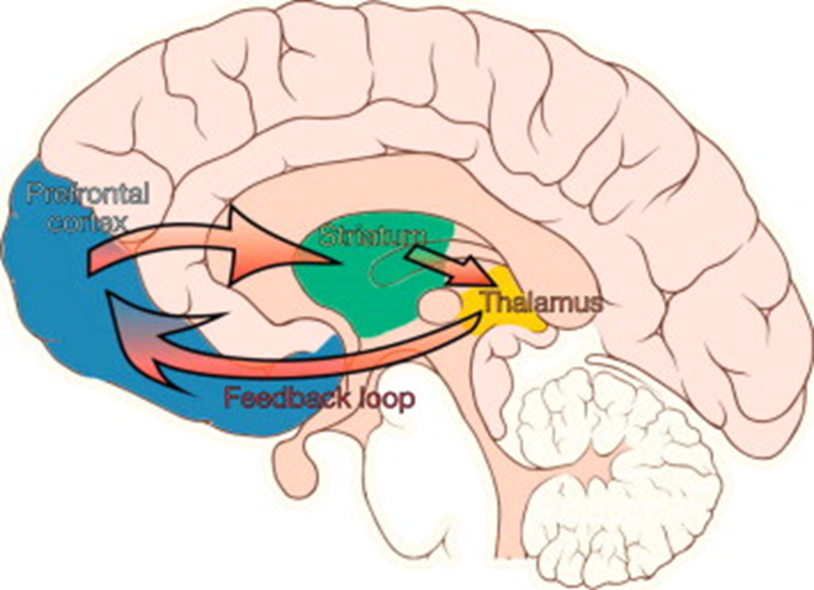
Aetiology of OCD
https://youtu.be/FFaZOlDAJHk
Notes:
The contemporary neurobiological explanation for OCD has focused on aberrant functioning of cortico–striatal–thalamic–cortical (CSTC) circuits. These circuits are functionally distinct neural ‘loops,’ originating from specific cortical areas that are also the site of feedback projections from the thalamus. Several different CSTC circuits have been identified, each arising from specific frontal cortical areas and being associated with either emotional, cognitive, or motor inputs. Evidence has shown that in individuals with OCD, these circuits are hyperactive at rest and during episodes of symptom provocation; however, normalization of activity has been observed following treatments (psychopharmacological, behavioural, and psychosurgical).
These neuronal circuits continue from cortical areas and pass through the basal ganglia (including the striatum) through either ‘direct’ or ‘indirect’ pathways, with a final projection through to the thalamus (Figure). The ‘direct’ and ‘indirect’ basal ganglia pathways have, through glutamatergic and GABAergic neurotransmission, opposing actions on the thalamus and in turn on the feedback to the frontal cortex. The ‘direct’ pathway results in a disinhibition of thalamic activity through two inhibitory neuronal connections (thereby increasing both thalamic and frontal cortical activity). In contrast, the ‘indirect’ pathway has three inhibitory connections that result in net inhibition of the thalamus and frontal cortex. The ‘direct’ and ‘indirect’ pathways appear to work antagonistically to modulate thalamic and cortical activation, with an imbalance between the pathways being theorized as a contributing pathophysiological factor in OCD.

Slide 17
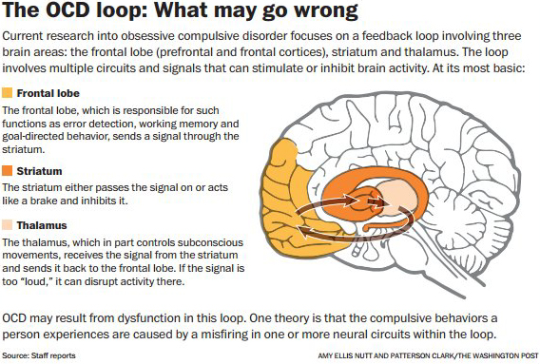

Slide 18
Investigations
Functional MRI and PET scanning have shown increases in blood flow and metabolic activity in the orbitofrontal cortex, limbic structures, caudate, and thalamus, with a trend toward right-sided predominance.
  In some studies, these areas of over-activity have been shown to normalize following successful treatment with either SSRIs or CBT. These imaging modalities, while of value for research, are not indicated for normal workups.
Yale-Brown Obsessive Compulsive Scale (Y-BOCS) is an important tool in defining the range and severity of symptoms and monitoring the response to treatment.
  - Consists of 10 items, including 5 for obsessions and 5 for compulsions, each of which is scored 0-4 (total score = 0-40).
  - (For obsessions and compulsions, these items rate time spent, interference with functioning, distress, resistance, and control)

Slide 19
Investigations
Mental State Examination (MSE)
  The patient should be evaluated for orientation, memory, disturbances of mood and affect, presence of hallucinations, delusions, suicidal and homicidal risk, and judgment (including whether insight into the irrational nature of their symptoms is present).
  Evaluate all patients with OCD for the presence of Tourette or Tic disorder, as these comorbid diagnoses may influence treatment strategy.
  The findings on neurologic and cognitive examination should otherwise be normal. Focal neurologic signs or evidence of cognitive impairment should prompt evaluation for other diagnoses.

Slide 20
Differential Diagnosis
Common pitfall in the treatment of OCD is a failure to make the diagnosis.
Clinicians should be familiar with the diagnostic criteria and consider OCD in their differentials when evaluating tics, mood and anxiety disorders, or other compulsive behaviors, such as trichotillomania or neuro-dermatitis.
Another common pitfall is the failure to identify the comorbid diagnoses frequently encountered in patients with OCD.
These can include the following:
Major depressive disorder Panic disorder
Body dysmorphic disorder Generalized anxiety disorder
Social phobia and simple phobia ADHD
Tourette syndrome Other tic disorders
Trichotillomania Neuro-dermatitis
Idiopathic torticollis Substance abuse
Eating disorders

Slide 21
Differential Diagnosis Continued
Identification of these diagnoses guides treatment interventions and identifies patients who are at higher risk for suicide or self-harm.
Not surprisingly, patients with OCD have a significant risk for suicide, which increases with the severity of symptoms and the number of concurrent psychiatric diagnoses.
Persons with OCD often do not seek treatment.
Many individuals with OCD delay for years before obtaining an evaluation for obsessive-compulsive (OC) symptoms.
Patients with OCD often feel shame regarding their symptoms and put great effort into concealing them from family, friends, and health care providers.

Slide 22
Treatment & Management Overview
OCD is a chronic illness that usually can be treated in an outpatient setting.
The mainstays of treatment of OCD include the use of serotoninergic antidepressant medications (SSRI’s mainly)
Behavioural therapy (exposure and response prevention and some forms of CBT), education and family interventions,
In extremely refractory cases, neuro-surgery.
Patients who have achieved remission of symptoms with behavioural therapy alone may never require medication and may instead need only to return to therapy if they have an exacerbation of their illness.
Patients treated with a combined approach; these can discontinue medication, maintaining a remission with behavioural interventions alone. However, many patients require ongoing medication to prevent relapse.
Consider hospitalization for a patient with OCD if a suicide risk exists or if the individual’s symptoms are sufficiently severe to impair the patient's ability to care for himself/herself safely at home. If inpatient care is necessary, admitting the patient to a psychiatric unit whose staff is familiar with OCD and behavioural therapy is preferable.

Slide 23
Treatment & Management
Pharmacological Rx
First-line pharmacologic treatments - SSRI’s (Fluoxetine, Fluvoxamine, Sertraline, Paroxetine, Citalopram, Escitalopram)
Tricyclic antidepressant [TCA] (Clomipramine) with 5-HT and NE reuptake inhibition.
Possible alternatives include Venlafaxine, a serotonin norepinephrine reuptake inhibitor (SNRI).
All of these are commonly used to treat OCD
Unlike in the case of major depression, complete or near-complete remission of OCD symptoms is rare with only serotonergic antidepressant treatment. More typically, perhaps half of patients may experience symptom reductions of 30-50%, as measured by the Y-BOCS, with many other patients failing to achieve even this degree of relief.
Doses above those needed for treatment of depression may be more effective for some patients.
A therapeutic dose for 6-10 weeks may be required to observe a clinical response.
Response tends to be slow and continue for at least 12 weeks unlike the use of these same antidepressants in the treatment of major depressive episodes, where responses are more often seen somewhat earlier.

Slide 24
Treatment & Management
Psychotherapy Rx
Behavioural therapy is a first-line treatment that should be undertaken with a psychotherapist who has specific training and experience
Exposure and response (or ritual) prevention (ERP) is the important and specific core element in behavioural therapy for OCD.
The patient rank orders OCD situations he or she perceives as threatening, and then the patient is systematically exposed to symptom triggers of gradually increasing intensity, while the individual is to suppress his or her usual ritualized response.
When a patient does not respond in the face of a potent trigger, extinction of the response can take place.
ERP is now usually administered as part of a broader program of CBT specifically designed for OCD.

Slide 25
Treatment & Management
Other elements of CBT that are used include identifying and challenging the cognitive distortions of OCD symptoms
(e.g, intolerance of uncertainty, black-and-white thinking, focusing on unlikely extreme possibilities instead of viewing the future in a balanced manner, ascribing over importance to thoughts, excessive concern about the importance of one's thoughts, inflated sense of responsibility).
After making the patient aware of his or her irrational thoughts, the therapist works to have the patient counter them with more rational thoughts and do cost/benefit analyses regarding performing his or her rituals.
Meditation and relaxation techniques may be useful, but not during active ERP
Psychodynamic psychotherapy alone has generally not been found to be helpful in ameliorating OCD symptoms. It may, however, be useful in working on a patient's resistance to accepting recommended treatments or in helping the patient to appreciate the interpersonal effects that his or her OCD symptoms are having on others.

Slide 26
Treatment & Management
(Rx Resistant Strategies)
Strategies should always include an assessment of comorbid diagnoses, medication compliance, drug dose, and duration of therapy.
The presence of a comorbid diagnosis that has not been addressed, such as depression or panic disorder, can interfere with clinical recovery,
Targeted interventions might include, for example, lithium or antipsychotic augmentation or ECT for depression.
Interventions for patients with treatment resistance include the following:
  Change or increase in medication (e.g, increase dose or prescribe different SSRI or clomipramine)
  More intensive CBT

Slide 27
Treatment & Management
(Rx Resistant Strategies)
Surgical Rx
Neurosurgical treatment of OCD is performed at a very limited number of centres and is reserved for patients with severe and refractory symptoms.
The most common small series use a specific small lesion (e.g, cingulotomy) or deep brain stimulation. Current clinical trials are also exploring the application of transcranial magnetic stimulation (TMS), a non-invasive treatment, for OCD.
One surgical technique involves the stereotactic placement of bilateral lesions in the anterior cingulate cortex.
A deep brain stimulation technique consists of implanting a device to electrically stimulate the sub-thalamic nucleus.

Slide 28

Questions or Comments?

Slide 29
MCQs

Slide 30
OCD
MCQs
The lifetime risk of OCD is:
A. 2.1%
B. 1 %
C. 0.5 %
D. 5 %

Slide 31
OCD
MCQs
The lifetime risk of OCD is:
A. 2.1%
B. 1 %
C. 0.5 %
D. 5 %

Slide 32
OCD
MCQs
2. Which of the following it TRUE about OCD?
A. There is evidence of increased volume of basal ganglia structures
B. Meta-analyses of brain imaging studies shows consistent findings
  C. Studies have found an increase in volume of orbitofrontal cortex
D. Anterior cingulate area volume always remains normal

Slide 33
OCD
MCQs
2. Which of the following it TRUE about OCD?
A. There is evidence of increased volume of basal ganglia structures
B. Meta-analyses of brain imaging studies shows consistent findings
  C. Studies have found an increase in volume of orbitofrontal cortex
D. Anterior cingulate area volume always remains normal

Slide 34
OCD
MCQs
NICE recommends:
A. CBT including exposure and response prevention in OCD with mild functional impairment
B. Choice of monotherapy with an SSRI or intensive CBT alone for OCD with moderate functional impairment
C. Use of combination therapy after inadequate response at 12 weeks
D. All of the above

Slide 35
OCD
MCQs
NICE recommends:
A. CBT including exposure and response prevention in OCD with mild functional impairment
B. Choice of monotherapy with an SSRI or intensive CBT alone for OCD with moderate functional impairment
C. Use of combination therapy after inadequate response at 12 weeks
D. All of the above

Slide 36
OCD
MCQs
4. NICE recommends consideration of in-patient treatment in OCD when there is:
A. Risk of suicide
B. Severe self-neglect
C. Reversal of normal night/day patterns making attendance for daytime therapy impossible
D. A, B and C
E. Only A and B

Slide 37
OCD
MCQs
4. NICE recommends consideration of in-patient treatment in OCD when there is:
A. Risk of suicide
B. Severe self-neglect
C. Reversal of normal night/day patterns making attendance for daytime therapy impossible
D. A, B and C
E. Only A and B

Slide 38
OCD
MCQs
All of the following statements about the CBT model for OCD is true EXCEPT:
A. According to the model, intrusive thoughts are universal, with a content indistinguishable from that of clinical obsessions
B. Avoidance is not a part of the definition of OCD
C. Excessive attentional bias on monitoring intrusive thoughts is specific to OCD
D. Rumination covers both the obsession and any accompanying mental compulsion
E. Thought-action fusion is also known as magical thinking

Slide 39
OCD
MCQs
All of the following statements about the CBT model for OCD is true EXCEPT:
A. According to the model, intrusive thoughts are universal, with a content indistinguishable from that of clinical obsessions
B. Avoidance is not a part of the definition of OCD
C. Excessive attentional bias on monitoring intrusive thoughts is specific to OCD
D. Rumination covers both the obsession and any accompanying mental compulsion
E. Thought-action fusion is also known as magical thinking

Slide 40
OCD
Any Questions?
Thank you.

