Slide 1

MRCPsych General Adult Psychiatry
Bipolar 4

Slide 2
Bipolar 4
Objectives
To develop an understanding of:
the course and prognosis of Bipolar disorder.
risk factors for poor outcomes.

Slide 3
Bipolar 4
Expert Led Session
Bipolar Affective Disorder:
Course & Prognosis

Slide 4
This presentation is based on an APT article:
Saunders KEA, Goodwin GM (2010). The course of bipolar disorder.
Advances in Psychiatric Treatment. 16 (5) 318-328.
The paper summarises dozens of articles which are referenced in the original for personal study.

Slide 5
What constitutes Bipolar?
This effects how we think about course, treatment and prognosis
    Studies have generally only dealt with traditional Manic-Depression (Bipolar 1)
    There is less information about other types
We must be clear which concept is meant when answering patients/in exam
    Prevalence is 1% (RCPsych – using conventional concept)
Notes:
Ref: http://www.rcpsych.ac.uk/healthadvice/problemsdisorders/bipolardisorderkeyfacts.aspx

Slide 6
Time course & intensity
Patients generally have further episodes
    Only 16% have definitive recovery
    Relapsing/remitting pattern
    Length of episodes varies greatly
        Mania mean episode average - 6 weeks
        Depression - 11 weeks
        Mixed affective state - 17 weeks

Slide 7
Time Course & intensity
x2 frequency over uni-polar
Time between cycles shortens for first three, then stabilises
Risk of suicide 1% annually (Baldessarini 2006)
Polarity of onset may convey prognostic advantages:
    unipolar mania at presentation = best prognosis.

Slide 8
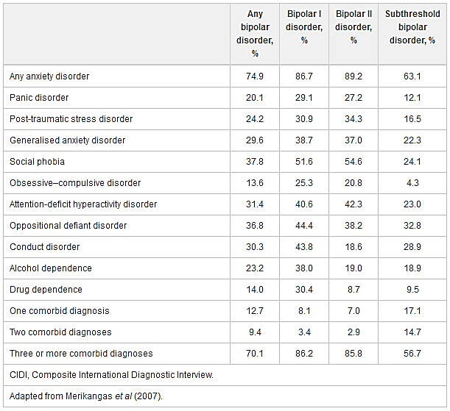

Slide 9
Types & changes in type
    40% depressed on 1st presentation
    Switch to bipolar higher in the young
        1% per year >30 y/o
    Conversion from Bipolar II just 7.5% in 10 years
        Course is similar but without full manic episodes (>4 days, etc)
    Rapid cycling (>4 episodes/yr) affects 12-24%

Slide 10
Treatment response
Aim is to reduce frequency and intensity
    Complete remission is unlikely
30-50% respond to lithium/anticonvulsant when in the manic phase
    Similar rate with atypical antipsychotics
30% respond to lithium/anticonvulsant in depression
    50% with lamotrigine
    >50% with quetiapine

Slide 11
Inter-episode symptoms
Sub-syndromal 15% of the time and minor symptoms for a further 20% of the time
Cognitive functioning can be deficient
    Reduced general quality of life

Slide 12
Physical comorbidities
Poor glucose regulation more common
Up to 35% obese
Thyroid disorders 9% (even in lithium naïve)
Migraine more common

Slide 13
Pregnancy
Relapse generally said to be 50%
    27% of women with bipolar admitted in 1st year post-partum
Non-concordance increases relapse

Slide 14
Mortality
SMR overall = 1.6
For suicide risk in bipolar SMR = 12.28
Medication reduces mortality
Lithium shown to decrease suicide

Slide 15
Key Points
Age at onset is late teens to twenties on average
40% of individuals are initially diagnosed with unipolar depression
Bipolar I disorder remains a relatively rare, frequently psychotic disorder: significant inter-episode cognitive impairment may exist in the absence of an affective episode
Bipolar II disorder is a stable diagnosis, now made more frequently and associated with a chronic course in which depression is usually the predominant polarity

Slide 16
Key Points 2
Bipolar-spectrum diagnoses reflect the prevalence of mild elated states but carry uncertain implications for treatment
Long treatment delays are common (1/3 wait 10 years)
Childbirth is associated with high rates of relapse

Slide 17

Questions or Comments?

Slide 18
MCQs

Slide 19
Bipolar 4
MCQs
1. Using the broadest definition, prevalence of bipolar spectrum disorders in the general population has been estimated as high as:
  0.8%
  1.2%
  3.9%
  8.3%
  10.4%

Slide 20
Bipolar 4
MCQs
1. Using the broadest definition, prevalence of bipolar spectrum disorders in the general population has been estimated as high as:
  0.8%
  1.2%
  3.9%
  8.3%
  10.4%

Slide 21
Bipolar 4
MCQs
2. Age at onset of bipolar disorder:
A. Has little prognostic relevance
B. Is not a heritable trait
C. Has been observed to be higher in more recent studies
D. Is higher in women than men
E. Has implications for clinical course

Slide 22
Bipolar 4
MCQs
2. Age at onset of bipolar disorder:
A. Has little prognostic relevance
B. Is not a heritable trait
C. Has been observed to be higher in more recent studies
D. Is higher in women than men
E. Has implications for clinical course

Slide 23
Bipolar 4
MCQs
3. Individuals with bipolar disorder:
A. Rarely receive a diagnosis of unipolar depression
B. Have longer episodes of mania than depression
C. Commonly have psychiatric co-morbidities
D. Have fewer depressive episodes than those with unipolar depression
E. Show poorer prognosis if they have predominantly manic episodes

Slide 24
Bipolar 4
MCQs
3. Individuals with bipolar disorder:
A. Rarely receive a diagnosis of unipolar depression
B. Have longer episodes of mania than depression
C. Commonly have psychiatric co-morbidities
D. Have fewer depressive episodes than those with unipolar depression
E. Show poorer prognosis if they have predominantly manic episodes

Slide 25
Bipolar 4
MCQs
4. When compared with bipolar I disorder, bipolar II disorder:
A. Is associated with better inter-episode functioning
B. Is similar and frequently develops into bipolar I disorder
C. Is associated with fewer affective episodes overall
D. Has a less chronic course
E. Has a significantly higher age at onset

Slide 26
Bipolar 4
MCQs
4. When compared with bipolar I disorder, bipolar II disorder:
A. Is associated with better inter-episode functioning
B. Is similar and frequently develops into bipolar I disorder
C. Is associated with fewer affective episodes overall
D. Has a less chronic course
E. Has a significantly higher age at onset

Slide 27
Bipolar 4
MCQs
5. Regarding the treatment of bipolar disorder:
A. Delays in initiating treatment are rare
B. The vast majority of patients respond to lithium or an anticonvulsant treatment when in a manic phase
C. Quetiapine leads to remission in over 50% of patients in the depressive phase
D. There are a number of well-tolerated treatments that are effective in all phases of the illness
E. The majority of patients are maintained on monotherapies

Slide 28
Bipolar 4
MCQs
5. Regarding the treatment of bipolar disorder:
A. Delays in initiating treatment are rare
B. The vast majority of patients respond to lithium or an anticonvulsant treatment when in a manic phase
C. Quetiapine leads to remission in over 50% of patients in the depressive phase
D. There are a number of well-tolerated treatments that are effective in all phases of the illness
E. The majority of patients are maintained on monotherapies

Slide 29
Any Questions?
Thank you

