Slide 1

Intellectual Disability (ID)
Behavioural Issues in Intellectual Disability

Slide 2
Behavioural Issues in
Intellectual Disability
Aims and Objectives (from handbook)
• Understanding challenging behaviour and awareness of methods of recording/ assessing
• Aetiology of challenging behaviours
• Management options

Slide 3
Behavioural Issues in ID
To achieve this
Case Presentation
Journal Club
555 Presentation
Expert-Led Session
MCQs
Please sign the register and complete the feedback

Slide 4
Behavioural Issues in Intellectual Disability
Expert Led Session
Intellectual Disability and Challenging Behaviour
Dr Olutu

Slide 5
Behavioural Issues in ID
Be able to define challenging behaviour (CB) in mental health/intellectual disability
Understand of the different types of challenging behaviour
Gain a knowledge of the causes of, and maintaining factors for challenging behaviour
Understand the behavioural, psychological & pharmacological approaches to managing patients with challenging behaviour.

Slide 6
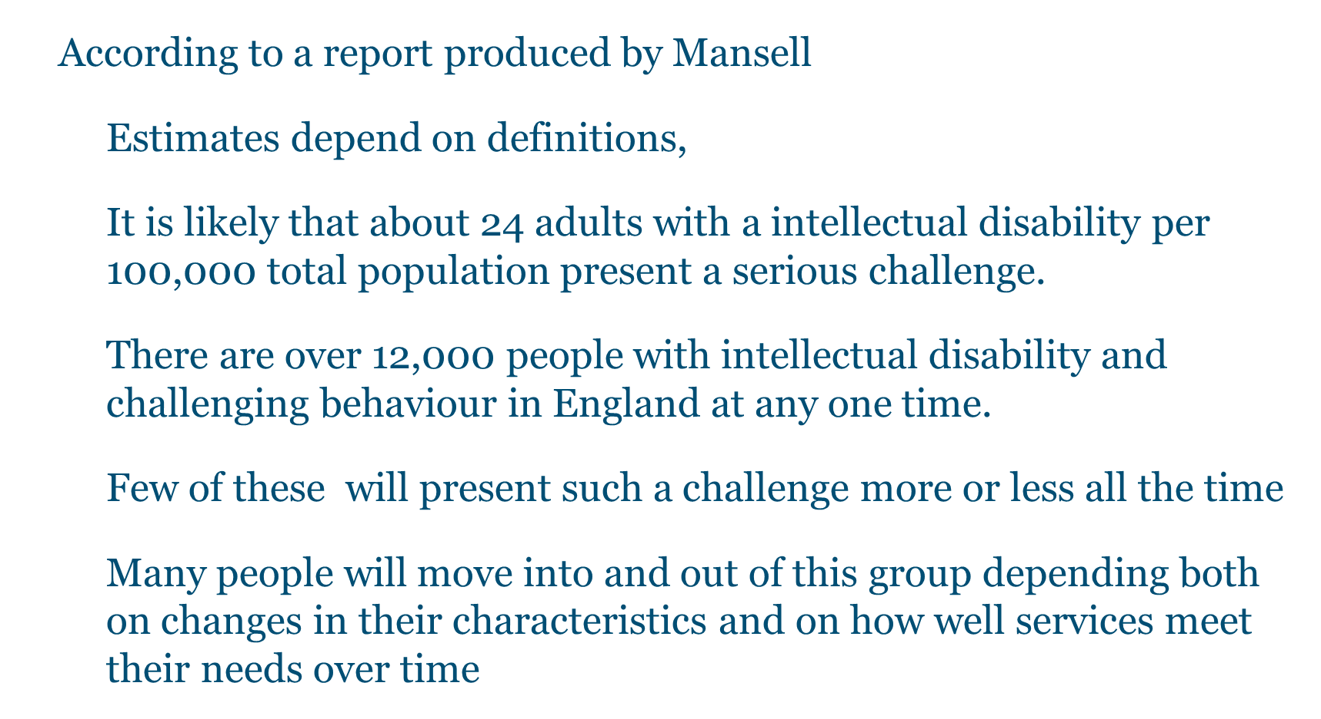
Epidemiology

Slide 7
Challenging Behaviour – concepts 1
The most widely used, formalised definition has been that of Emerson:
‘culturally abnormal behaviour of such an intensity, frequency or duration that the physical safety of the person or others is likely to be placed in serious jeopardy, or behaviour which is likely to seriously limit use of, or result in the person being denied access to, ordinary community facilities’. (Emerson, 1995)
The RCPsych have adopted the term challenging behaviour to serve as a reminders that these behaviours should be seen as a challenge to services rather than a manifestation of psychopathological processes
challenging behaviour is a socially determined concept and should not be misused as a diagnostic label.

Slide 8
Challenging Behaviour – concept 2
The RCPsych have adopted a modified definition that builds on that of Emerson:
  Behaviour can be described as challenging when it is of such an intensity, frequency or duration as to threaten the quality of life and/or the physical safety of the individual or others and is likely to lead to responses that are restrictive, aversive or result in exclusion ¹.
  Challenging Behaviour: a unified approach - Clinical and service guidelines for supporting people with learning disabilities who are at risk of receiving abusive or restrictive practices – Royal College of Psychiatrists , BPS and RCSALT - College Report CR144, June 2007
Notes:
1. Quality of life and physical safety of the person and those around them is a focal concept of this definition. It has also moved from thinking in terms of the qualitative aspects of the behaviour of the person, to those of the responses of individuals and services

Slide 9
Implications of new definition
Thus the prevalence of challenging behaviour can be conceptualised within such parameters as:
  No. of individuals excluded from local services
  No. of individuals in ‘out of area’ placements
  No. of individuals not receiving day services, employment
  Opportunities, education, respite or home support
  Service responses involving
      Seclusion; restraint; locked doors; abuse
  Clinical responses involving
Inappropriate prescribing of drug treatments; punitive and aversive behavioural interventions; risk avoidance rather than risk management¹²
Notes:
1. The label of CB becomes less appropriate once the consequences and the responses of others change to being non-punitive, non-restrictive and socially enabling rather than restricting.
2. The nature and even the severity and frequency of the behaviour may remain unchanged and yet it ceases to be seen as challenging when carers, professionals and services are able to respond in positive, inclusive and enabling ways.
Example or analogy Management of DM

Slide 10
Case Scenario
Paul is a 25 year old man with mild intellectual disability living with James in supported accommodation.
Every time Sarah (carer) attends to James, Paul starts hitting the walls and shouts
Notes:
Groupings of 2 or 3 – discuss relevant factors or brain storming

Slide 11
Aetiological Factors
Physical: discomfort, pain, malaise, physiological disturbance (e.g. Thyroid disorders)
Mental illness: Mood disorders, psychosis, anxiety, OCD
Neuropsychiatric disorders: Epilepsy, Gilles de la Tourette syndrome, attention-deficit hyperactivity disorder (ADHD), dementia
Pervasive developmental disorders: autism
Phenotype-related behaviours: Prader-Willi syndrome, Lesch-Nyhan syndrome, Williams syndrome
Psychological trauma: reaction to abuse or loss
Communication difficulties: Hearing loss, unclear communication, insufficient vocabulary or means of expression, difficulties understanding communication of others

Slide 12
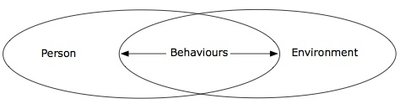
Assessment & Intervention
3 Elements need to be considered (Diagram above)
Individual factors:
  Degree and nature of intellectual disability; Sensory or motor disabilities; Mental health problems; Physical problems, including pain and/or discomfort; Communication difficulties, personal history of relationships and experiences.
Environmental factors will include the characteristics of services:
  Number of staff; Training and experience of staff; Consistency of staff provision and approach; The working relationship with the client; Working relationship between staff; Quality of the material environment; Opportunities available; Ability of the service to understand and respond to unique needs of individuals
A poor fit between the individual’s needs and their environment may result in limited opportunities to:
  Gain social attention; Escape from or avoid excessive demands; Gain access to preferred activities or objects; Gain alternative forms of sensory feedback; Reduce arousal and anxiety by other means; Exert choice or control over environment; Understand and communicate with the person.

Slide 13
Assessment – 1
Purpose:
  Collect enough information to lead to a coherent formulation or diagnosis
  Lead to an intervention plan which fits the person and their environment, and leads to an improvement in their quality of life
  Establish a baseline that enables subsequent evaluation of effectiveness.
Focus of the assessment:
  Determined by the impact of the behaviour on the individual and those around them
  Degree of physical harm to the person and others
  Risk of loss of access to opportunities for development and participation
  Levels of distress being experienced by the person and others
Capacity and motivation for change in the person and in their environment
Notes:
process of collecting and evaluating relevant information about the person, the social, interpersonal and physical environment, as well as the behaviour that is challenging. Information about the person should include medical and psychological/psychiatric factors.
The British Psychological Society’s clinical practice guidelines on challenging behaviour (British Psychological Society, 2004) and the report on the use of medication for the management of behaviour disorders among adults with a intellectual disability (Deb et al, 2006) provide detailed frameworks for the assessment of CBs. In summary, an assessment should address both the individual and their behaviour in the context of1. underlying medical and organic factors (including medical examination and investigations)
2. psychological and psychiatric factors
3. social and environmental factors
4. the interaction of these factors.

Slide 14
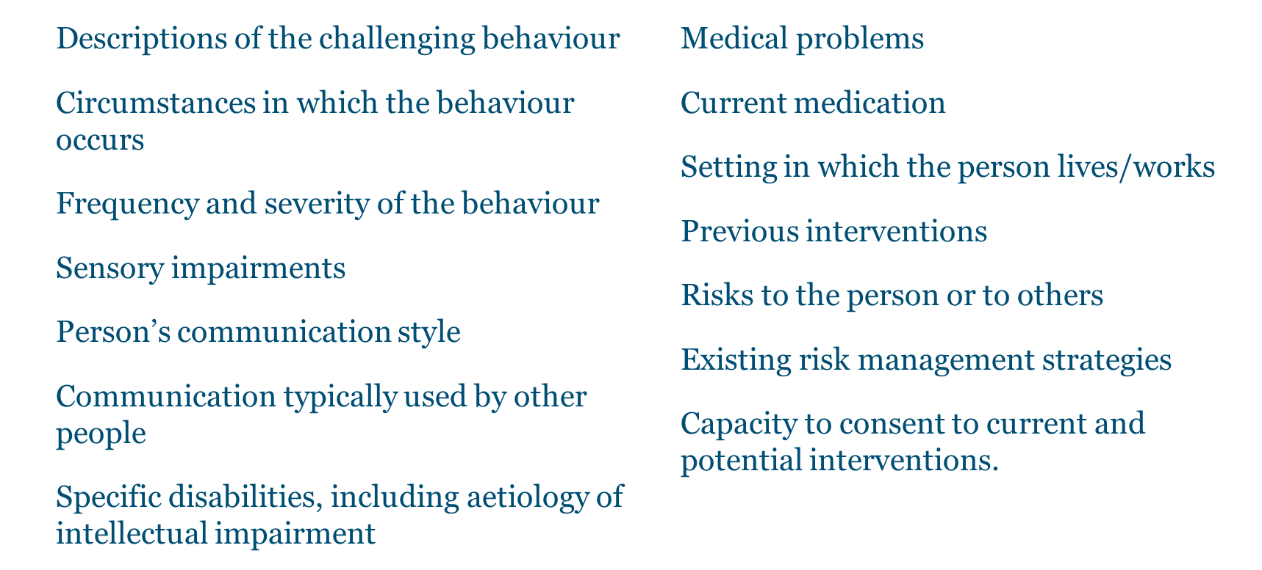
Assessment – 2
Pre- assessment information should include

Slide 15
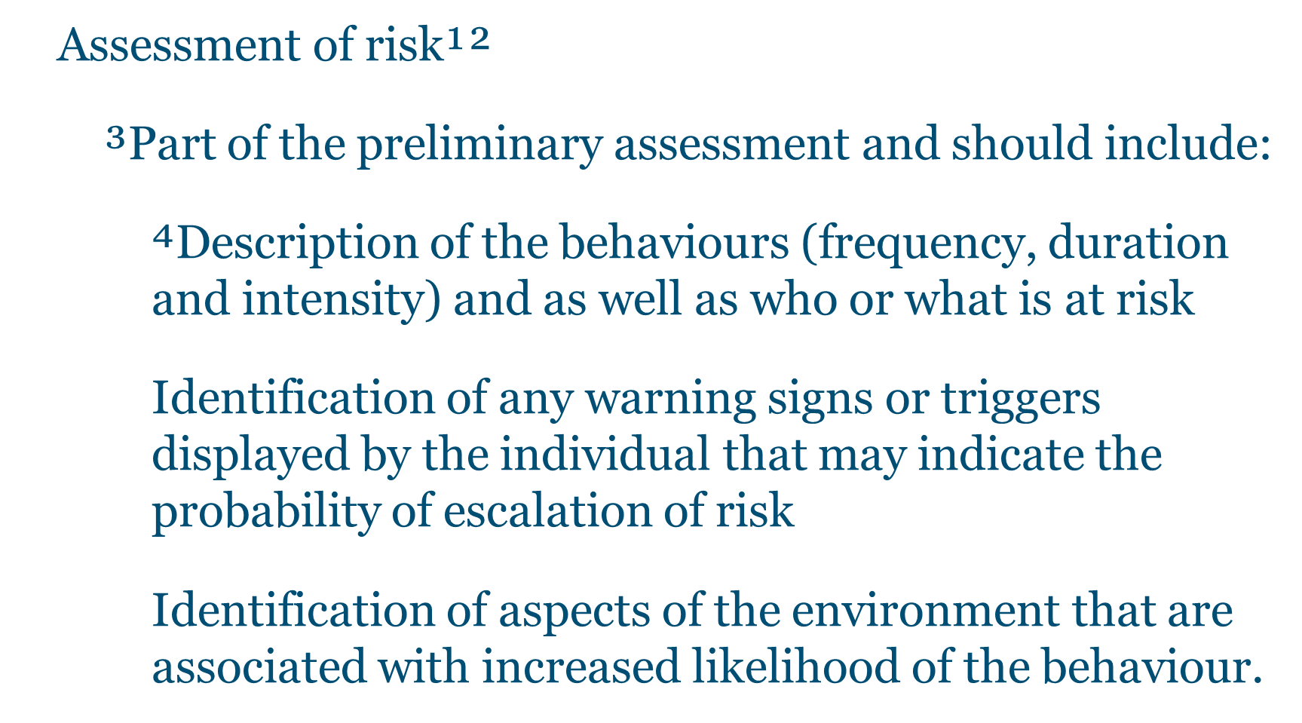
Assessment – 3
Notes:
1. risks of physical harm to others and/or to the individual
2. risks to loss of the various elements that make up quality of life (rights, choice, independence, citizenship, participation, inclusion etc.)
3. risk assessment should constitute a specific, documented component of the process.
4. There should be an agreed multidisciplinary and multi-agency framework for description and evaluation of risk

Slide 16
Measuring Behaviour – 1
Three key dimensions:
Frequency - How often it occurs (e.g. rate per hour/day)
Duration - How long it lasts
Intensity - How serious it is (a qualitative judgement)
Notes:
The starting point for measuring behaviour is to arrive at a definition of what constitutes an incident (e.g. is each kick going to be counted as an incident or is the outburst from the point the person first hits out until they subsequently calm down). There are no hard or fast rules about this some service users can hit out impulsively and there is no build up/ calming down process others there is a definite pattern from start to finish. Whatever you decide on make sure this consensus is written down and shared with everyone who is involved in measuring the behaviour.The key with recording frequency is to quickly establish whether it is a high or low frequency behaviour. Ask the question how often does the behaviour happen:- At least once a day- Once a week- Once a month
Behaviours that happen at least once a day would be likely to be classed as high frequency and need to be recorded carefully (tick charts might be preferable so that the number of incidents per hour/ day can be quickly seen).
Behaviours that happen less than once a day are generally considered low frequency. The key here is to gather the detail about individual incidents (it shouldn’t be as hard to get accurate data on how often it occurs but the detail on individual incident is needed to help decide on the purpose of the behaviour).
Recording duration of incidents come back to your original definition of an incident. If you definition relates to individual kicks it might only be a couple of seconds. If on the other hand you are recording incidents from the initial build up to eventual calming down it might range from minutes to a few hours.
Recording intensity is best done with use of some sort of scale as there is always a qualitative element as to how serious something might be.A simple scale might be thus:0= no harm1= causes physical pain but no bruises/ broken skin2= causes physical pain and minor bruises/ broken skin that require minor first aid3= causes physical pain and more serious injuries that require medical treatment4= causes major injuries that require hospitalisation

Slide 17
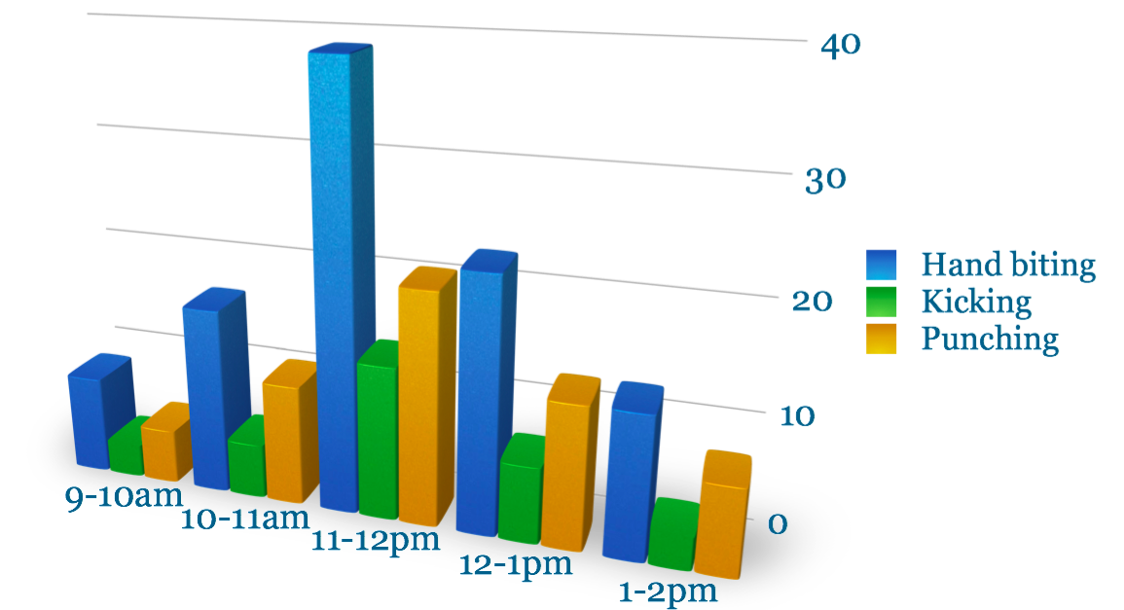
Measuring Behaviour – 2
Notes:
Ask the students to interpret this frequency chart:- Which behaviour is happening most often- Which behaviour happens the least- During which time interval is this behaviour happening most often- What is the overall trend in the graph

Slide 18
Assessing Behaviour – 1
The ABC model of behaviour:
  Antecedent - Observable events happening before the behaviour being assessed occurs.
  Behaviour - The behaviour being assessed.
  Consequence - Observable events happening after the assessed behaviour occurs.
Notes:
The ABC model can be summarised by the following case example:Bill’s carer asks him to help wash up the dishes after dinner.Bill pushes his carer away with his arms.The carer decides not to continue to ask Bill to do the washing up.Hence Bill’s carer asking him to do the washing up acts as the antecedent to Bill’s pushing behaviour.The consequence for Bill is that his carer removes the demand to help wash up the dishes.Reinforcement is occurring here, Bill pushes out at his carer the reinforcer is the removal of the demand to help with the dishes.If this pattern occurs repeatedly over time asking Bill to do the dishes will act as a trigger to his pushing behaviour.His carers would thus need to consider if doing the dishes was an essential task for Bill to be involved in (if not don’t ask him to help then the pushing behaviour won’t result- if it is an essential task they would then have to consider how best to present the task e.g. is it the right time for Bill, does he need more help to do the task, could we make it more enjoyable for him, can we add a reinforcer at the end such as a trip to the pub).

Slide 19
Assessing Behaviours – 2
Used for low frequency behaviours.
Requires detailed information as soon after the incident as possible.
Can quite quickly identify common functions for CBs.
Does not consider the effects of thoughts and feelings on peoples’ behaviour.
Notes:
ABC charts are used quite widely in services and are tools for teasing out the antecedents and consequences to someone’s behaviour as well as giving clues to the potential reinforcers at play.Use of detailed ABC recording charts are most appropriate for low frequency behaviours where there is time for staff reflection on an incident and sufficient time to complete a detailed record of what happened before, during and after. These forms are often badly completed with staff putting in blanket statements such as the behaviour happened for no reason or there was nothing going on before the incident (which is rarely the case in practice).With training and support care staff can become better at recording what goes on. At this stage all we are asking them to do is write down what they see happening (and not to interpret it- leave this to the behaviour specialist or someone who is trained in this function).Writing ABC/ incident forms down as soon after the behaviour occurs helps to improve the reliability of such information being reported before it is forgotten.The other key here is to note that 10-20 well filled in forms will quite quickly reveal trends for a behaviour (i.e. what normally happens before and after) which leads to clues about the function.The reality in services is often 100 badly filled out forms with staff recording ABC’s on an ongoing basis without there being an end result. Stress the importance of well filled out forms along with analysis and a report about the function of the person’s behaviour. This can be reviewed yearly to see if the functions remain the same- in practice this is usually the case for a large number of people with LD (they are trying to communicate quite basic needs and as long as they have those needs without an effective means to get these needs met challenging behaviour will continue to occur to some extent).One last point about ABC charts is the limitation in that they don’t take into account how people’s thoughts and feelings effect their behaviour. Thoughts and feelings are subjective in nature and as such cannot be observed- i.e. you can see someone crying but only infer that they are sad or upset. In this instance further assessment perhaps from a psychological perspective may be of help in developing a formulation about an individuals behaviour.

Slide 20
Assessment of function of behaviour – 1
Functional Assessment
  Specific behaviour-analytic procedure, where structured observation and other methods of assessment (interviews or use of standardised questionnaires) are employed to generate hypotheses about the challenging behaviour, antecedents and consequences which may be reinforcing it.
Functional assessment and functional analysis are used interchangeably by some clinicians.
Functional assessment - more inclusive term that refers to a range of approaches to establish the function of the behaviour
Functional analysis - more structured techniques that may include manipulating antecedents and consequences in order to establish their functional relationships (E.g. analogue assessment, Iwata et al, 1990).
Notes:
It is essential that an assessment attempts to establish the function of CBs, in order to determine the correct basis for an intervention

Slide 21
Assessment of function of behaviour – 2
Evidence-base supports the use of functional analysis for interventions where the primary focus is the reduction/elimination of severe CBs in people with moderate, severe or profound intellectual disability. (Scotti et al, 1991; Didden et al, 1997; Ager & O’May, 2001).
Functional analysis should follow three stages (Horner, 1994; Repp, 1994; Toogood & Timlin, 1996)
  Stage 1 – hypothesis development¹
  Stage 2 – hypothesis testing²
  Stage 3 – hypothesis refining³
Notes:
1. interviews or rating are used to generate hypotheses or rule out areas for further investigation
2. direct observation and more detailed interviews are used to assess the accuracy of the hypotheses and identify contextual factors
3. either experimental analysis is used to refine the working hypothesis or there is a direct move to intervention that are used to check the accuracy of the hypothesis about the function of the behaviour.

Slide 22
Assessment of Physical Disorders
The Role of physical disorders should be actively considered and commonly include:
  Headaches and migraine
  Cerebrovascular and epilepsy-related events
  Earache and toothache
  Eyesight disorders
  GI related pain: gastro-oesophageal reflux, colic, peptic ulcers and constipation
  UTI and prostatism
  Bone and joint pain
  Neoplasms
Wounds and fractures.
Notes:
referral for further assessment and investigations should be supported where necessary

Slide 23
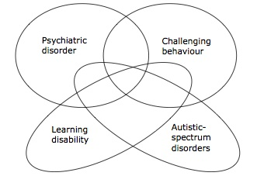
Assessment of Psychiatric Disorders
Xenitidis et al (2001) presented schematically the relationship between challenging behaviour and psychiatric disorders across the spectrum of intellectual ability.
This indicates that not all people with a intellectual disability will show behaviour that is challenging and vice versa
Overlap between autism and psychiatric disorder, but neither necessarily leads to behaviour that is challenging

Slide 24
Formulation
Formulation is best regarded as an hypothesis about the nature of the presenting problem and its development¹.
It has 2 main functions
  To guide clinical intervention within an explicit rationale
  To aid the establishment of criteria for evaluation of the intervention.
Formulation is a component of both psychological and psychiatric interventions.
No one single ‘correct’ way to carry out a formulation; method and form will depend upon the context, the theoretical model being utilised, and the particular purpose of the formulation (Harper & Moss, 2003)
Notes:
1. contains informed ‘ideas’ about causal or functional relationships between variables / events and the central problem

Slide 25
Interventions – 1
The delivery of individualised support is to be done within a Positive Behaviour Support Framework¹ (Carr et al, 2002)
Positive behavioural support integrates the following components into a cohesive approach:-
  Comprehensive lifestyle change; a lifespan perspective; ecological validity; stakeholder participation; social validity; systems change; multi-component intervention; emphasis on prevention; flexibility in scientific practices; multiple theoretical perspectives.
Notes:
1. This has emerged from 3 sources:- Applied behaviour analysis- The normalisation/inclusion movement- Person-centred values

Slide 26
Interventions – 2
¹Interventions should be person-centred.
Multi-agency and multidisciplinary involvement should occur in close partnership with families and other carers.
Detailed information concerning the nature and outcome of previous interventions should be obtained and taken into account.
²Therapeutic modalities may be delivered in combination (e.g. medication and family therapy). Depending on the findings of the risk assessment described above, the therapeutic interventions may need to take place in an environment in which safety and security can be offered.
Notes:
1. While the detailed assessment and formulation process outlined above should result in clear intervention strategies, these must be tailored to the individual, their personal characteristics, environment and available resources for support.
2. Whenever possible, interventions should be introduced one at a time in order to enable clearer evaluation of outcome.

Slide 27
Interventions – 3
Within the positive behavioural support framework plan should include both proactive strategies¹ and reactive plans²(Allen et al, 2005).
Proactive strategies - expected to reduce the frequency, intensity or duration of the challenging behaviour by either
  Adjusting aspects of the environment in order that they are more supportive, or
  Attempting to address individual factors such as skills and tolerances via systematic skills building, or
  Addressing physical health problems via medical intervention.
Reactive strategies - deals with specific incidents
  early intervention when signs are present that challenging behaviour may be about to occur.³ The aim is to diffuse the situation in to prevent escalation
  Physical management of the individual in order to ensure the safety of all those involved. 䒌
Notes:
1. for reducing the likelihood of the occurrence of the behaviour
2. for managing the behaviour when it does occur
3. identification of environmental triggers known to be associated with the behaviour and behavioural precursors that might indicate that the individual may be becoming agitated
4. This would be a last resort and thus a relatively rare occurrence and be in keeping with the relevant legal frameworks and principles of good practice reported elsewhere in this document.

Slide 28
Psychotherapeutic
Interventions
Aetiology of challenging behaviour may relate to psychological trauma e.g. past or ongoing history of abuse, losses or bereavement (Hollins & Esterhuyzen, 1997), problems in sexuality and intimate relationships, intra-familial and inter- and/or intra-personal conflict.
CBT¹
Psychodynamic approaches² (Hollins & Sinason, 2000; Beail, 2003; Wilner, 2005). ³
Group analytic approach⁴ (Xenitidis, 2005)
Family, systemic or group analytic models⁵
Notes:
1. approaches either individually or in groups used for anxiety, anger, aggression and offending
2. may be effective in reducing psychological distress and interpersonal problems and increasing self-esteem as well as reducing offending behaviour
3. Although much of the current evidence-base relates to people with mild learning disabilities, many clinicians are adapting cognitively based interventions in order to make them more available to people with more significant learning disabilities.
4. used extensively in generic forensic mental health settings and has also been applied with offenders with learning disabilities in secure settings .
5. Families and carers can encounter personal and interpersonal stressors and conflicts that may benefit from psychotherapeutic intervention and support

Slide 29
Communication Intervention
Communication-focused approaches to challenging behaviour reported in the literature (Bradshaw, 1998; Brown, 1998; Chatterton, 1998; Dobson et al, 1999; Thurman, 2001).
May include interventions to:
  Increase the communication skills of individual by increasing the effectiveness of existing communication skills¹, teaching more ways of communicating²
  Increasing skills of the communication partners by improving recognition and understanding, provide appropriate models of communication, use of signs, symbols and objects, in addition to spoken communication
  Improve the wider communication environment by promoting good listening environments³, providing individuals with opportunities to take part in a range of communication acts⁴ increasing the amount of good quality communication
Notes:
1 Clarity
2 additional vocabulary, signs or symbols
3 (e.g. reducing distractions and background noise)
4 (e.g. to ask questions, comment etc.)

Slide 30
Positive Programming
This consists of system where interventions are delivered through mediators skilled in positive manner, organised and supported in a way so they can support individuals positively
An approach is active support (Jones et al, 1999) includes activity planning, support planning and training for providing effective assistance

Slide 31

Physical/medical Interventions
challenging Behaviour can be due to an underlying medical condition (e.g. chest infection, dehydration, epilepsy) that requires medication or other physical treatment.
This should be addressed promptly

Slide 32
Psychopharmacological interventions
Little evidence base of it’s effectiveness in CBs
Appropriate form of treatment if underlying cause of challenging behaviour is as a consequence of a mental illness
Medication if considered should be an integral part of a comprehensive intervention strategy and should be regarded as adjunctive or complementary to other non-drug interventions planned and delivered by various members of the MDT (Deb et al, 2006)
Notes:
Pharmacological treatment in people who present challenging behaviour should only be initiated following a thorough process of assessment, diagnosis and formulation that has clearly established either
- that an identifiable psychiatric disorder is present or- that there are significant psychiatric symptoms and- these are an aetiological or contributory factor in the behaviour which is presenting a challenge and
- the medication proposed can be expected to improve the psychiatric disorder or symptoms identified (if the medication is not licensed for the disorder then there must be an established literature giving a rationale for the proposed medication).
Other factors to be taken into account should include
- inadequate response to other non-drug interventions
- likely speed of response to different interventions
- significant risk or evidence of harm and/or distress to the individual
- significant risk or evidence of harm and/or distress to others
- high frequency and/or severity of behaviour problems
- good response to previous drug interventions
- possibility of greater effectiveness of, or enhanced ability to deliver, other interventions as a result of drug treatment.

Slide 33
Psychopharmacological interventions-2
Prior to initiating medication in discussion with patient, family, carer and MDT the following should be noted
  The range of Mx options that has been considered
  The Medication the patient is already prescribed
  Any past adverse reactions to medication
  Clear rationale for the proposed drug treatment
  Likely effectiveness of the proposed treatment
  Clear, objective method of assessment of outcome and SEs
  Capacity and consent discussed and recorded
  Is Tx in the best interests of the individual?
  Is Tx and its implementation consistent with relevant legal frameworks?
  Is the dose and planned duration of Tx within BNF and other good practice prescribing guidelines and dose recommendations? ¹
Notes:
medication tx plan must be written that explicitly addresses the ff
- the name of the medication and who is to prescribe it
- how the dose should be titrated, and over what period of time - whether physical examination and investigations are needed prior to treatment and as part of the ongoing monitoring - potential adverse effects, including effects on quality of life of the individual and their carers, how these adverse effects should be monitored and what action should be taken if they should occur.
Local policies may dictate either use of a shared care protocol (SEP) or the use of off label prescribing documentation

Slide 34
Psychopharmacological interventions-3
Urgent intervention for the protection of the individual or of others may be required.
Follow established ‘rapid tranquillisation policy’ (NICE 2005) or (Maudsley Prescribing Guidelines - Taylor et al, 2001)
Modified if necessary to take account of increased vulnerability of people with intellectual disability to adverse effects of medication.

Slide 35
Evaluation
Ethical obligation to measure the impact of interventions on the target behaviour,
Routine evaluation for their effectiveness¹
Repeat baseline measures taken at the start of an intervention and look for any evidence of change.
As a minimum, evaluation should consider
  Severity, frequency and duration of the target challenging behaviour
  Person’s quality of life and range of activities or opportunities
  Person’s development of positive skills and abilities
  Person’s well-being and satisfaction with the intervention
  Well-being and satisfaction of carers or family members in close contact with the person.
Adverse effects of the intervention should also be carefully monitored.
Always consider withdrawal of medication if part of overall intervention plan
Specific evaluation of those factors that he or she is attempting to change.
Review of the initial formulation.
Work on relapse prevention²
Notes:
1. This evaluation should be planned at the point of initiation of the intervention. There is evidence to suggest that those that are more thoroughly evaluated are more likely to demonstrate a positive outcome (Scotti et al, 1991; Didden et al, 1997).
2. with people with learning disabilities is at a very early stage but the literature suggests that relapse is a very real problem, ‘patterns of severe challenging behaviour do not simply disappear’ (Anderson et al, 1993).

Slide 36
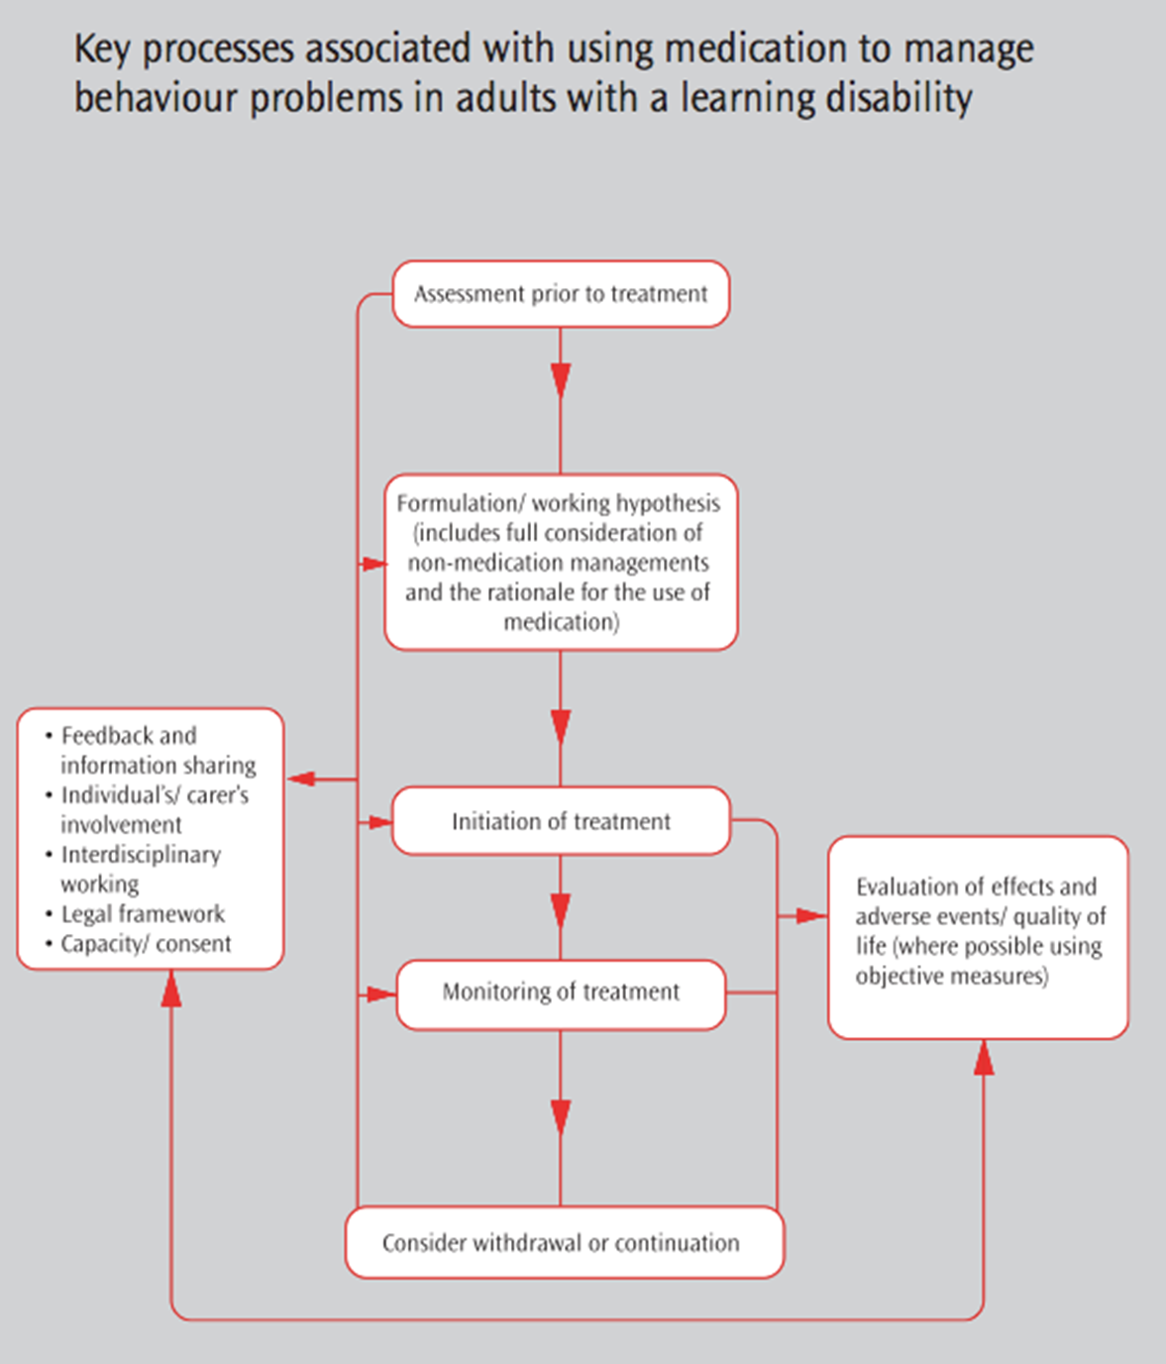

Slide 37
ID – session 3
MCQs
Causes of challenging behaviour in a person with intellectual disability:
  A. Pain
  B. Overstimulation
  C. Under stimulation
  D. Wanting attention
  E. All of the above

Slide 38
ID – session 3
MCQs- Answers
Causes of challenging behaviour in a person with intellectual disability:
  A. Pain
  B. Overstimulation
  C. Under stimulation
  D. Wanting attention
  E. All of the above
Notes:
A person with ID can present with challenging behaviour in all of the above – note issues of communication and how challenging behaviour can be a form of this

Slide 39
ID – session 3
MCQs
2. The following statements are true of factors increasing challenging behaviours in a person with learning disability except which option?
Undetected physical illness
Communication problems
Underlying mental illness
Environmental issues
Problem solving ability

Slide 40
ID – session 3
MCQs Answers
2. The following statements are true of factors increasing challenging behaviours in a person with learning disability except which option?
Undetected physical illness
Communication problems
Underlying mental illness
Environmental issues
Problem solving ability
Notes:
People with learning disabilities have poor problem-solving abilities and were coping strategies – it is noted that this is a negative question and therefore less popular within the MRCPsych exam

Slide 41
ID – session 3
MCQs
3. Inappropriate behaviours may be maintained by reinforcement from others. Which of the following is a process that helps to identify factors maintaining that behaviour?
A. Functional analysis
B. Statistical analysis
C. Procedural analysis
D. Behavioural analysis
E. Goffman analysis

Slide 42
ID – session 3
MCQs Answers
3. Inappropriate behaviours may be maintained by reinforcement from others. Which of the following is a process that helps to identify factors maintaining that behaviour?
A. Functional analysis
B. Statistical analysis
C. Procedural analysis
D. Behavioural analysis
E. Goffman analysis
Notes:
Answer: A
Use of operant conditioning principles to understand what reward or other reinforcing factors are involved in maintaining behaviours

Slide 43
ID – session 3
MCQs-EMI
Match each of the following psychological strategies to their possible effects:
A. Proactive Strategies
B. Positive Programming
C. Focused Support
D. Reactive Strategies
1. Systematic instructions given for greater skills and competence development which improves social integration
2. To produce rapid results and reduce reactive strategies
3. Designed to manage the behaviours at the time they occur
4. To produce change over time.

Slide 44
ID – session 3
MCQs-EMI Answers
Match each of the following psychological strategies to their possible effects:
A. Proactive Strategies
B. Positive Programming
C. Focused Support
D. Reactive Strategies
1. Systematic instructions given for greater skills and competence development which improves social integration-B
2. To produce rapid results and reduce reactive strategies
3. Designed to manage the behaviours at the time they occur
4. To produce change over time.
Notes:
Positive programming: teachers new skills, this includes general skills, domestic skills, academic and other skills

Slide 45
ID – session 3
MCQs-EMI Answers
Match each of the following psychological strategies to their possible effects:
A. Proactive Strategies
B. Positive Programming
C. Focused Support
D. Reactive Strategies
1. Systematic instructions given for greater skills and competence development which improves social integration
2. To produce rapid results and reduce reactive strategies-C
3. Designed to manage the behaviours at the time they occur
4. To produce change over time.
Notes:
Focused support is preventative strategies this reduces/eliminates the need for reactive strategies

Slide 46
ID – session 3
MCQs-EMI Answers
Match each of the following psychological strategies to their possible effects:
A. Proactive Strategies
B. Positive Programming
C. Focused Support
D. Reactive Strategies
1. Systematic instructions given for greater skills and competence development which improves social integration
2. To produce rapid results and reduce reactive strategies
3. Designed to manage the behaviours at the time they occur-D
4. To produce change over time.
Notes:
Reactive strategies are for rapid and safe situational management. Their purpose is to reduce episodic severity of a situation

Slide 47
ID – session 3
MCQs-EMI Answers
Match each of the following psychological strategies to their possible effects:
A. Proactive Strategies
B. Positive Programming
C. Focused Support
D. Reactive Strategies
1. Systematic instructions given for greater skills and competence development which improves social integration
2. To produce rapid results and reduce reactive strategies
3. Designed to manage the behaviours at the time they occur
4. To produce change over time.-A
Notes:
Proactive Strategies our simple, effective, positive strategies that are in place before problem behaviour arises and therefore they are preventative

Slide 48
Intellectual Disability – session 3
Any Questions?
Thank you.
(please complete the feedback)

