Slide 1

MRCPsych General Adult Module
Anxiety Disorders
Post Traumatic Stress Disorder

Slide 2
Post Traumatic Stress Disorder
Aims and Objectives
To develop an understanding of PTSD (aetiology, epidemiology, natural history, neurobiology, genetics, diagnostic criteria, classification, psychopathology, clinical presentation, assessment, risks) and its management (pharmacological, psychological, social).
To develop an understanding of Meta-analyses and Systematic Reviews and develop skills for critically appraising them.

Slide 3
Post Traumatic Stress Disorder
To achieve this
Case Presentation
Journal Club
555 Presentation
Expert-Led Session
MCQs
Please sign the register and complete the feedback

Slide 4
PTSD – A brief history
American Civil War – Irritable heart
WW1 – Shell shock / Effort syndrome
  13000 ‘Cases’ of shell shock.
  Increased to 200000 by 1918
  307 soldiers executed for cowardice
Vietnam War – brought in concept of PTSD
Gulf War – Gulf war syndrome
1980 - the American Psychiatric Association added PTSD to DSM-III

Slide 5
PTSD - Definition
An anxiety disorder precipitated by an experience of intense fear or horror while exposed to a traumatic (especially life-threatening) event.
The disorder is characterised by intrusive recurring thoughts or images of the traumatic event; avoidance of anything associated with the event; a state of hyperarousal and diminished emotional responsiveness.
These symptoms are present for at least one month

Slide 6
PTSD – Diagnostic Criteria
Criterion A: stressor
Exposure to a stressor
Criterion B: re-experiencing
Persistent remembering of the stressor in one of:
Intrusive flashbacks
Vivid memories or recurring dreams
Experiencing distress when reminded of the stressor
Criterion C: avoidance
Actual or preferred avoidance of circumstances resembling or associated with the stressor (not present before the stressor).
Criterion D: hyperarousal (either D1 or D2)
D1: Inability to recall
D2: Two or more of:
Sleep problems
Irritability
Concentration problems
Hypervigilance
Exaggerated startle response
Criterion E: time
Onset of symptoms within six months of the stressor.

Slide 7
PTSD – Differences between ICD and DSM diagnosing criteria
Criterion A: stressor
DSM V includes subjective stress
Criterion C: avoidance
DSM V includes emotional numbing and avoidance symptoms
Criterion D: hyperarousal
DSM V – any two symptoms from D1 and D2
Criterion E: time
DSM V – specifies symptoms to be presemt for over a month.
Avoidance - avoid thoughts, feelings, or conversations about the traumatic event. Avoid places or people that remind of the traumatic event.
Numbing - Loss of interest in once pleasurable activities, feeling distant from others, experiencing difficulties having positive feelings

Slide 8
PTSD – Formal Assessment Tools
IES - R
Clinician Administered PTSD Scale (CAPS)
  developed by National Center for PTSD
  requests information about the frequency and intensity of the core PTSD symptoms and common associated symptoms.
Treatment Outcome PTSD scale (TOP – 8)
  It is shorter, is easier to use, and is highly correlated with the CAPS.
Structured Interview for PTSD (SI-PTSD)
PTSD Symptom Scale Interview (PSS-I)

Slide 9
PTSD - Epidemiology
Prevalence –
  Military - 4.8%¹
  General population –
    25–30% of people experiencing a traumatic event may go on to develop PTSD.
    2.6% in men
    3.3% in women²
1 in 5 firefighters.
1 in 3 teenage survivors of car crashes.
1 in 2 female rape victims.
2 in 3 prisoners of war.
Iversen et al. The prevalence of common mental disorders and PTSD in the UK military: using data from a clinical interview-based study BMC Psychiatry 2009, 9:68
McManus et al. Adult Psychiatric Morbidity in England, 2007 - Results of a household survey, The NHS Information Centre for health and social care

Slide 10
Modern day PTSD
Referrals to victim support in UK

Slide 11
PTSD – Risk Factors
All – Past psychiatric history, neuroticism
Military:
  Duration of combat exposure / trauma experienced up close.
  Poor social support.
  Bullying
  Lower rank
  Low educational attainment.
  History of childhood adversity.
Females
  Twice as likely to develop PTSD as men.
  Women were more vulnerable to PTSD after disasters and accidents, followed by loss and non-malignant diseases.
  1-2% of women suffer from PTSD postnatally³.
3. Anderson et al. Risk factors for developing post-traumatic stress disorder following childbirth: a systematic review. Acta Obstet Gynecol Scand. 2012

Slide 12
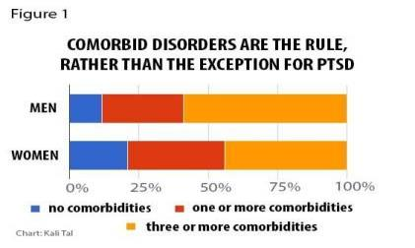
PTSD – Comorbidity
Depressive disorder
Substance misuse and dependence
Anxiety disorder
Bi-polar disorder
Note: patients with PTSD are known to have poor compliance with medication⁴.
4. Kronish et al. Post-traumatic stress disorder and medication adherence: results from the Mind Your Heart Study. J Psychiatr Res. 2012 Dec;46(12):1595-9.
5. Chart - Kessler & Sonnega, et al. Arch Gen Psychiatry. 1995;52(12):1048-1060.

Slide 13
PTSD – Aetiology : Theories
Neurobiology –
Structural brain imaging - reduced volume of the hippocampus, prefrontal lobe and anterior cingulate.
Functional brain imaging suggests excessive amygdala activity and reduced activation of the prefrontal cortex and hippocampus
Neurochemical
Genetic
Neuroendocrine
Increased dopamine,
Increased NA,
Decreased 5HT in dorsal and median raphe.
polymorphism in the DA transporter gene
excess of the SLC6A39 repeat allele
hypocortisolism
Sustained raised CRH
Increased T3:T4
Nemeroff CB. Post-traumatic stress disorder: the neurobiological impact of psychological trauma. Dialogues in Clinical Neuroscience 2011;13(3):263-278.

Slide 14
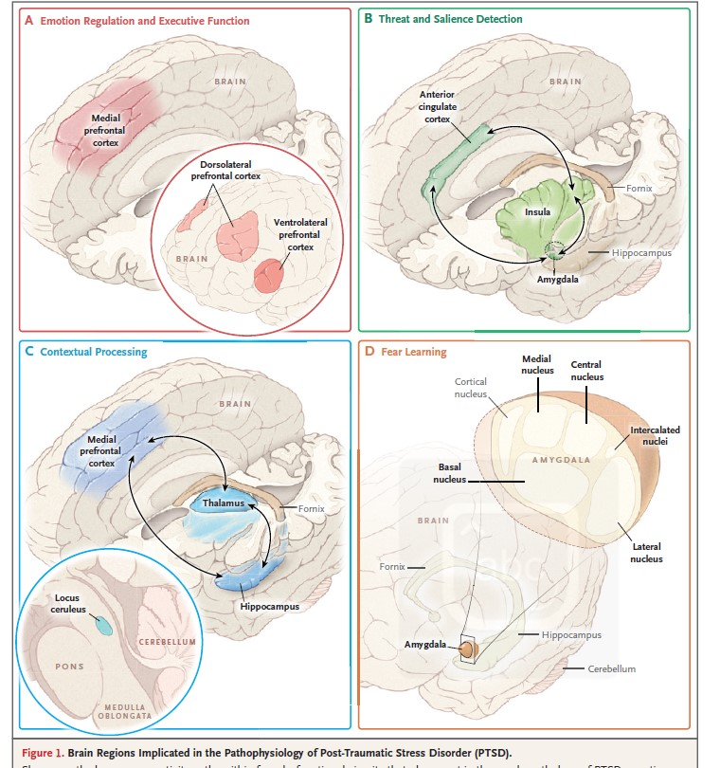
Brain Regions Implicated in the Pathophysiology of Post-Traumatic Stress Disorder (PTSD).
Shown are the known connectivity paths within four dysfunctional circuits that play a part in the psychopathology of PTSD:
Emotion regulation and executive function,
Threat detection,
Contextual processing,
Fear learning.

Slide 15
PTSD – Psychodynamic Theory
Subjective meaning of a stressor may determine its traumatogenicity
Traumatic events may resonate childhood traumas
Common defenses
  Denial
  Minimisation
  Splitting
  Projective identification
  Dissociation
  Guilt
Object relatedness – projection and interojection

Slide 16
PTSD – Cognitive Theory
Mowrer’s two factor conditioning theory
Traumatic stimuli
Fear and Arousal
Stimulus generalisation by classical conditioning
Avoidance
Negative re-enforcement by operant conditioning
Maintains problem

Slide 17
PTSD – Differential Diagnoses
Acute stress disorder
  In general, the symptoms of acute stress disorder must occur within four weeks of a traumatic event and come to an end within that four-week time period.
  If symptoms last longer than one month and follow other patterns common to PTSD, the diagnosis may change from acute stress disorder to PTSD.
OCD
  Both have recurrent, intrusive thoughts as a symptom
  Thoughts present in obsessive-compulsive disorder do not usually relate to a past traumatic event.
Adjustment disorder
  Similar to adjustment disorder because both are linked with anxiety that develops after exposure to a stressor.
  With PTSD, this stressor is a traumatic event.
  With adjustment disorder, the stressor does not have to be severe or outside the “normal” human experience.
Other comorbid conditions are also differentials

Slide 18
PTSD - Treatment
If co-morbid depression – treat PTSD first
Substance misuse addressed before PTSD
Education – patient and carers
  Symptoms of PTSD
  Common reactions to trauma
  Giving up behaviours that continue avoidance
First line - psychological

Slide 19
PTSD - Treatment
Evidence for treatment
Produced by the National Center for PTSD, U.S. Department of Veterans Affairs | February 2011
Treatment | Effect size (effect size of 0.8 is considered large. Everyone would notice it. ) | Confidence interval
Prolonged exposure | 1.91 | 1.52 – 2.3
EMDR | 1.89 | 1.07 – 2.71
Cognitive processing Therapy | 1.81 | 1.41 – 2.21
SSRI | 1.64 | 1.13 – 2.16
http://www.ptsd.va.gov/Public/understanding_TX/CourseList/Course_NCPTSD_Treatment_1435/assets/00015006.PDF

Slide 20
PTSD – Treatment Psychological
Debriefing
Self help
Trauma focused CBT
  Exposure therapy
    Imaginal exposure - flooding
    In vivo exposure – visiting trauma site
  Cognitive restructuring
    make sense of the bad memories - people remember the event differently than how it happened.
    May feel guilt or shame about what is not their fault
  Stress inoculation training
    Relaxation methods

Slide 21
PTSD – Treatment EMDR
Even the most enthusiastic supporters of EMDR have not agreed on how the therapy works!
Incorporates many different interventions,
  imaginal exposure (under conditions of divided attention)
  free association,
The main intervention requires the patient to recall trauma-related memories while focusing on external oscillatory stimulation.
  Stimulation is induced by the therapist moving a finger from side to side across the patient's field of vision, which induces eye movements.
  24 eye moments = 1 set
  Sets of eye movements are induced until distress is reduced.

Slide 22
EMDR
A few years ago I underwent EMDR. I was sceptical, of course. At this point in time, however, I see that it saved my marriage, my sanity and my relationship with my children. I was suffering from PTSD after experiencing much loss and never even realized that's what stood in the way of a healthy life. It's a wonderful treatment and more people should be informed about it. I was lucky to run across it by accident.
Thank you,
J.M.
I was a member of the Canadian Army for over 20 years. I suffered from OSI (operational stress injury), depression, and the loss of my daughter and wife killed by a drunk driver. For over a year of treatment and work on my part I have finally found some peace of mind, My anger and depression had lowered to a manageable level. Today, I see the light at the end of the tunnel.... I know that this treatment EMDR is by far the best I ever received in the mental health field, and the great thing is no meds.
Thank you, G.C.

Slide 23
PTSD – Treatment Medication
First line
SSRI : Sertraline
Paroxetine
(not commonly used)
Second line:
Venelafaxine
Mirtazepine
Trazodone
TCA
Antipsychotics
Third line – minimal evidence
Topiramate
MAOIs
Carbamezapine
Lamotrigine
Minimal evidence for Risperidone
Alpha1 receptor antaonist
Propanolol
For somatic symptoms
Prazosin
Phenelzine
chlomipramine

Slide 24
NICE guidelines outline
Symptoms present for more than 3 months after trauma:
1st line- EMDR or trauma-focused CBT.
Drug treatment : not routine 1st line
Paroxetine or Mirtazapine (general use)
Amitriptyline or Phenelzine (under specialist care)

Slide 25
PTSD - Prognosis
Untreated – 30% of patients recover completely
With treatment
  After 1 year
    50% of patients recover completely (66%)
    30% have mild symptoms
    10% have moderate symptoms
    10% have same symptoms or become worse

Slide 26
PTSD - Prognosis
Positive prognostic factors | Negative prognostic factors
Robust premorbid personality | Children
Above average cognitive ability | Very old
Good social skills | Past psychiatric history personality disorder anxiety disorder
Strong social support | Female
Absence of past psychiatric/medical history
Absence of alcohol / substance misuse/dependency
Optimism
Environmental stability
Less severe trauma Early intervention Minimal duration of trauma Trauma not experienced up close

Slide 27
Post Traumatic Stress Disorder
MCQs
1. Which of the following psychological interventions can be effective for the treatment of post-traumatic stress symptoms in children and young people who have been sexually abused?
A. Psychodynamic psychotherapy
B. CAT
C. Trauma focused CBT
D. IPT
E. Single episode debrief

Slide 28
Post Traumatic Stress Disorder
MCQs
1. Which of the following psychological interventions can be effective for the treatment of post-traumatic stress symptoms in children and young people who have been sexually abused?
A. Psychodynamic psychotherapy
B. CAT
C. Trauma focused CBT
D. IPT
E. Single episode debrief

Slide 29
Post Traumatic Stress Disorder
MCQs
2. Which antidepressant is licensed for the treatment of PTSD?
A. Sertraline
B. Mirtazapine
C. Venlafaxine
D. Amitriptyline
E. Moclobemide

Slide 30
Post Traumatic Stress Disorder
MCQs
2. Which antidepressant is licensed for the treatment of PTSD?
A. Sertraline
B. Mirtazapine
C. Venlafaxine
D. Amitriptyline
E. Moclobemide
And paroxetine

Slide 31
Post Traumatic Stress Disorder
MCQs
3. Which of the following is NOT a DSM V symptom of PTSD?
A. Persistent negative beliefs about oneself
B. Persistent pain
C. Self-destructive or reckless behaviour
D. Constricted affect
E. Marked diminished interest in (pre-traumatic) significant activities

Slide 32
Post Traumatic Stress Disorder
MCQs
3. Which of the following is NOT a DSM V symptom of PTSD?
A. Persistent negative beliefs about oneself
B. Persistent pain
C. Self-destructive or reckless behaviour
D. Constricted affect
E. Marked diminished interest in (pre-traumatic) significant activities

Slide 33
Post Traumatic Stress Disorder
MCQs
4. Which of these statements is true regarding acute stress reaction and PTSD?
A. Acute stress disorder only occurs in the elderly population and children
B. Acute stress disorder describes symptoms in someone who was not present at an incident, while PTSD takes place only in those who were present
C. PTSD is not diagnosed until after 4 weeks following the traumatic event
D. Acute stress disorder and PTSD can be diagnosed at any time after the stressful event
E. All acute stress disorder patients develop PTSD

Slide 34
Post Traumatic Stress Disorder
MCQs
4. Which of these statements is true regarding acute stress reaction and PTSD?
A. Acute stress disorder only occurs in the elderly population and children
B. Acute stress disorder describes symptoms in someone who was not present at an incident, while PTSD takes place only in those who were present
C. PTSD is not diagnosed until after 4 weeks following the traumatic event
D. Acute stress disorder and PTSD can be diagnosed at any time after the stressful event
E. All acute stress disorder patients develop PTSD

Slide 35
Post Traumatic Stress Disorder
MCQs
5. Which of the following is recommended as first line treatment for PTSD in adults?
A. Mirtazapine
B. EMDR
C. Phenelzine
D. Psychodynamic psychotherapy
E. Sertraline

Slide 36
Post Traumatic Stress Disorder
MCQs
5. Which of the following is recommended as first line treatment for PTSD in adults?
A. Mirtazapine
B. EMDR
C. Phenelzine
D. Psychodynamic psychotherapy
E. Sertraline

Slide 37
Post Traumatic Stress Disorder
References
Iversen et al. The prevalence of common mental disorders and PTSD in the UK military: using data from a clinical interview-based study BMC Psychiatry 2009, 9:68
McManus et al. Adult Psychiatric Morbidity in England, 2007 - Results of a household survey, The NHS Information Centre for health and social care
Anderson et al. Risk factors for developing post-traumatic stress disorder following childbirth: a systematic review. Acta Obstet Gynecol Scand. 2012
Kronish et al. Post-traumatic stress disorder and medication adherence: results from the Mind Your Heart Study. J Psychiatr Res. 2012 Dec;46(12):1595-9.
Chart - Kessler & Sonnega, et al. Arch Gen Psychiatry. 1995;52(12):1048-1060.
Shalev et al. N Engl J Med 2017;376:2459-69.

Slide 38
Post Traumatic Stress Disorder
Any Questions?
Thank you.

