Slide 1

Substance Misuse Module
Diagnosis & Treatment of People with Alcohol Problems

Slide 2
Insert name of the LEP
Aims and Objectives (from handbook)
Assessment, diagnosis and treatment of people with alcohol problems
To develop awareness of complications associated with alcohol use
To understand some of the practical aspects of managing people with alcohol problems
To gain awareness of local provisions and guidelines

Slide 3
Insert name of the LEP
To achieve this
Case Presentation
Journal Club
555 Presentation
Expert-Led Session
MCQs
Please sign the register and complete the feedback

Slide 4
Insert name of the LEP
Expert Led Session
Alcohol Dependence
P Horgan
Consultant in Substance Misuse, Cumbria

Slide 5
Overview
Pharmacology / Neuropharmacology
Classification
Assessment
Epidemiology
Health Consequences
Treatment issues

Slide 6
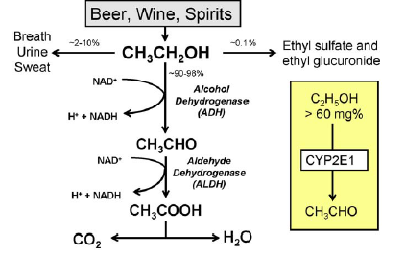
Metabolism oxidative and non-oxidative pathways
Jones, A. W. (2010). Evidence-based survey of the elimination rates of ethanol from blood with applications in forensic casework. Forensic science international, 200(1-3), 1-20.
Notes:
Two main hepatic enzymes are responsible for oxidative metabolism of ethanol.
The first and most important enzyme is alcohol dehydrogenase (ADH) Class I, which is located in the cytosol or
soluble fraction of the hepatocytes.
The second is a membrane-bound enzyme (CYP2E1), located in the smooth
endoplasmic reticulum of the microsomes
Class I ADH enzyme becomes saturated after the first couple of drinks
CYP2E1 enzyme is more important in clearing ethanol from the blood after heavy drinking, when the BAC
exceeds 100 mg/100 mL
Alcohol oxidised to aldehyde
The acetate produced during metabolism of ethanol undergoes extra-hepatic metabolism into Acetyl-CoA, which
enters the Krebs cycle and is eventually converted into the end products CO2 and H2O
The formation of ethyl glucuronide and ethyl sulphate represents non-oxidative pathways of metabolism and these conjugates have
received a lot of attention in recent years as biomarkers of acute ingestion of alcohol
Slower elimination of ethyl glucuronide and sulphate from the body can help to disclose recent drinking after blood-ethanol concentrations are no longer measurable

Slide 7
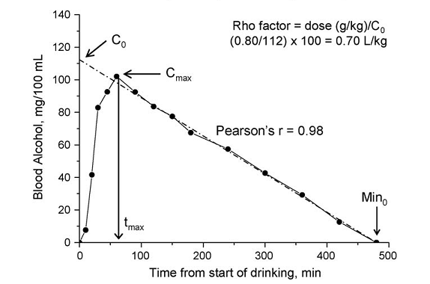
Alcohol pharmacokinetics
A typical blood-alcohol curve in a male subject who drank neat whisky (0.80 g ethanol/kg body weight) on an empty stomach. (.8g = .1 unit)
Elimination rates from blood is from 10 to 35 mg/100 mL/hour
Notes:
Zero order kinetics rather than first order kinetics
80kgs person would be 6.4 units 100 mgs/100 mls
Can use an app alcohol to calculate this.
AlcoDroid App allows you to estimate you alcohol blood level and when eliminated ( for interest – not to be recommended to use)

Slide 8
Blood alcohol and breath alcohol
Limit drink driving England
  80 milligrams per 100 millilitres of blood (Scotland is 50)
On some breath alcometer machines
  This will shown as 0.35 mg/L
  On other alcometer machines
  This will be shown as 80%
These systems are set to sample deep-lung air; this reflects the blood alcohol concentration
Notes:
35 Micrograms per 100 millilitres of breath (Scotland is 22)
107 Milligrammes per 100 millilitres of urine (Scotland is 67)
For the Lion brand where limit is 0.35 mg/L; top of the range is 2 mg/ L
Studies have shown that the blood/breath ratio (BBR) of alcohol for apprehended drivers in UK, Sweden and New Zealand varies from about 2,000:1 to 3,000:1
The average is about 2,400:1, whereas the statutory limit in the UK was set on the assumption of a BBR of 2,300:1.
Jones, A. W. (2010). The relationship between blood alcohol concentration (BAC) and breath alcohol concentration (BrAC): a review of the evidence. Road safety web publication, 15, 1-43.

Slide 9
Neuropharmacology
GABA and glutamate
  Chronic alcohol intake reduce GABA inhibitory function and increase NMDA-glutamatergic activity
  When alcohol-dependent individual stops drinking this results in brain overactivity after a few hours
    Results in unpleasant withdrawal symptoms such as anxiety, sweating, craving, seizures and hallucinations
  Alcohol stimulates endogenous opioids, which are thought to be related to the pleasurable, reinforcing effects of alcohol
  Opioids in turn stimulate the dopamine system in the brain
National Institute for Health and Care Excellence. (2011). Alcohol use disorders: diagnosis, assessment and management of harmful drinking and alcohol dependence CG 115. London: National Institute for Health and Care Excellence.

Slide 10
Brain imaging studies
A range of a neuropsychological deficits identified
  E.g., working memory and executive function )
Abnormalities using brain structural and functional techniques
  Frontal lobe regions
    Magnetic resonance imaging studies have shown differences between people with AUD ( alcohol use disorder) relative to controls such as volume deficits low rates of glucose metabolism and task related depressed BOLD responses
  Frontocerebellar circuits
    Structural MRI has shown smaller volumes of the pons, thalamus, cerebellar hemispheres, and cerebellar vermis
  Frontolimbic circuits
    For social drinkers, acute alcohol reduces the response to fearful stimuli in limbic regions
  Frontostriatal system
    Several fMRI studies in AUD have shown the basal ganglia including the putamen, nucleus accumbens, and medial PFC, responding more intensely to alcohol images compared to other images
Zahr, N. M., Pfefferbaum, A., & Sullivan, E. V. (2017). Perspectives on fronto-fugal circuitry from human imaging of alcohol use disorders. Neuropharmacology, 122, 189-200.
Notes:
AUD – alcohol use disorder
Frontal lobe regions
Correlations between volumes of frontal lobes and neuropsychological tests are not clear-cut
Frontocerebellar circuits
Recruitment of functionally intact cerebellar loops in AUD may compensate for impaired performance on tasks such as visuospatial or working-memory skills
This may mean overall capacity for conducting multiple tasks is reduced
Frontolimbic circuits
In AUD participants, amygdala activity inversely correlated with increased lateral PFC activity as a function of behavioral deficits
PFC activity as a compensation for blunted limbic activity suggests that in AUD, the brain uses frontal instead of temporal areas to manage emotional /social challenging situations
Frontolimbic circuits
The ventral striatum shows greater activation in response to alcohol cues but lower activation during anticipation of monetary gain in AUD relative to control individuals.
Suggest brain activation in individuals with AUD may be biased towards responding to alcohol-associated cues.
May also support a theory relating to the transition from casual to compulsive, uncontrolled consumption of alcohol by a shift from goal-directed behaviors executed by regions of the PFC to more automatic, habitual behaviors driven by appetitive regions such as the caudate and putamen

Slide 11
ICD 10 Dependence
A definite diagnosis of dependence should usually be made only if three or more of the following have been present together at some time during the previous year:
A strong desire or sense of compulsion to take the substance
Difficulties in controlling substance-taking behaviour in terms of its onset, termination, or levels of use
A physiological withdrawal state when substance use has ceased or have been reduced, as evidenced by: the characteristic withdrawal syndrome for the substance; or use of the same (or closely related) substance with the intention of relieving or avoiding withdrawal symptoms
Notes:
In 1964 a WHO Expert Committee introduced the term ‘dependence’ to replace the terms ‘addiction’ and ‘habituation’.
ICD 11
The features are usually evident over a period of at least 12 months but the diagnosis may be made if alcohol use is continuous (daily or almost daily) for at least 1 month

Slide 12
ICD 10 Dependence
Evidence of tolerance, such that increased doses of the psychoactive substance are required in order to achieve effects originally produced by lower doses (clear examples of this are found in alcohol- and opiate-dependent individuals who may take daily doses sufficient to incapacitate or kill non tolerant users)
Progressive neglect of alternative pleasures or interests because of psychoactive substance use, increased amount of time necessary to obtain or take the substance or to recover from its effects
Persisting with substance use despite clear evidence of overtly harmful consequences, such as harm to the liver through excessive drinking, depressive mood states consequent to periods of heavy substance use, or drug-related impairment of cognitive functioning; efforts should be made to determine that the user was actually, or could be expected to be, aware of the nature and extent of the harm

Slide 13
ICD 10 Harmful use
The diagnosis requires that actual damage should have been caused to the mental or physical health of the user
Harmful patterns of use are often criticized by others and frequently associated with adverse social consequences of various kinds. The fact that a pattern of use or a particular substance is disapproved of by another person or by the culture, or may have led to socially negative consequences such as arrest or marital arguments is not in itself evidence of harmful use
Acute intoxication, or “hangover” is not in itself sufficient evidence of the damage to health required for coding harmful use
Harmful use should not be diagnosed if dependence syndrome, a psychotic disorder, or another specific form of drug- or alcohol-related disorder is present
Notes:
ICD 11 Harmful pattern of use
A pattern of alcohol use that has caused damage to a person’s physical or mental health or has resulted in behaviour leading to harm to the health of others. The pattern of alcohol use is evident over a period of at least 12 months if substance use is episodic or at least one month if use is continuous. Harm to health of the individual occurs due to one or more of the following: (1) behaviour related to intoxication; (2) direct or secondary toxic effects on body organs and systems; or (3) a harmful route of administration. Harm to health of others includes any form of physical harm, including trauma, or mental disorder that is directly attributable to behaviour related to alcohol intoxication on the part of the person to whom the diagnosis of Harmful pattern of use of alcohol applies.

Slide 14
ICD 10 Hazardous use
A pattern of substance use that increases the risk of harmful consequences for the user
In contrast to harmful use, hazardous use refers to patterns of use that are of public health significance despite the absence of any current disorder in the individual user
The term is used currently by WHO but is not a diagnostic term in ICD-10
Notes:
A pattern of substance use that increases the risk of harmful consequences for the user. Some would limit the consequences to physical and mental health (as in harmful use); some would also include social consequences. In contrast to harmful use, hazardous use refers to patters of use that are of public health significance despite the absence of any current disorder in the individual user. The term is used currently by WHO but is not a diagnostic term in ICD-I0.

Slide 15
Other relevant
ICD 10 codes
F10.4 Withdrawal state with delirium
  Alcohol induced delirium tremens
F10.5 Psychotic disorder
  Psychotic disorder usually within 48 hours
  Onset needs to be within 2 weeks of substance use
  Includes alcoholic hallucinosis
F10.6 Amnesic syndrome
  Includes Korsakoff’s syndrome
F10.7 Residual and late onset psychotic disorder
ICD -11 new codes
  E.g. Alcohol-induced mood disorder
  Amnestic disorder due to use of alcohol ( excludes Korsakoff Syndrome – listed separately)
Notes:
F10.5 Psychotic disorder
Typically partially resolves within 1 month and fully within 6 months
F10.6 Amnesic syndrome
Memory impairment
Absence of defect in immediate recall
History of drug use
Personality changes may be present
F10.7 Residual and late onset psychotic disorder
Directly related to the use of alcohol
Changes of cognition, affect, personality or behaviour persist beyond the period during which a direct substance-related effect might reasonably be assumed to be operating
Onset more than 2 weeks after substance use
Change from or marked exaggeration of prior and normal state of functioning
Disorder should persist beyond any period of time during which the direct effects of the psychoactive substance might be assumed to be operative.

Slide 16
Assessment
Current Alcohol Use
  Assess length of time using alcohol; type of alcohol; frequency; any breaks; timeline for starting and increase to current levels; binges along with usual alcohol use; stabilising / destabilising factors
  Calculate total daily units of alcohol used (1 unit of alcohol = 10 ml = 8 g)
    Formula is ( alcohol by volume x volume in ml) /1000
    Rule of thumb - 1 litre of cider (6% alcohol by volume) is 6 Units
  Check for features of dependence / harmful use
  Check previous treatment – Self reduction/outpatient assisted withdrawals/ inpatient assisted withdrawals/ emergency admissions (physical or mental health complications)/ periods in Rehabilitation ( community or residential)/Use of AA/SMART/local services
  How long was previous abstinence / what were factors for relapse?
Withdrawals
  Current or previous – sweating/ agitation/ seizures/hallucinations/ liver failure
Other drug use
  Any other previous or current drug use
    Sedating drugs - cannabis/benzodiazepines /opioids/pregabalin/ketamine GBH
    Stimulants – cocaine / amphetamine/ highly concentrated caffeine drinks

Slide 17
Assessment
Medication
  Prescribed by drug or alcohol services or GP
  Thiamine /acamprosate/ disulfiram/ naltrexone/ nalmefene currently or previously
  Proton pump inhibitor/ diuretics
  Sedating medication /benzodiazepines/opioids
Physical health
  Liver disease / Hepatitis C
  CNS - Epilepsy/Seizures/Confusion/ Myopathy/ Neuropathy/ Space Occupying Lesions
  Cancer screen – GI/ Breast cancer
  Endocrine – Diabetes
Mental Health
  Depression/Anxiety/Psychosis/Bipolar Affective disorder/ Personality disorder/DSH/Suicide
  Dementia screen
Social Issues
  Homelessness/ Living Alone/Family Spport
Risks / Forensic
  Driving/Children/Safe Storage/Criminal Justice system/Violence

Slide 18
Investigations
AUDIT C
  Positive Scores : When 4 or more for men or 3 or more for women then complete full AUDIT
AUDIT (Alcohol Use Disorders Identification Test )
  10 items – each item scored 0-4; Min= 0, Max= 40
  Between 8 and 15 - Simple advice on the reduction of hazardous drinking
  Between 16 and 19 - Brief counselling and continued monitoring.
  20 and above – Specialist assessment
SADQ (Severity of Alcohol Dependence Questionnaire)
  20 items- each item scored 0 – 3; Min = 0 Max = 60
  Significant concern if more than 30
CIWA-Ar (Clinical Institute Withdrawal Assessment of Alcohol Scale, Revised)
  10 items; Min = 0 ; Max= 67
  Between 10 and 19- Mild to Moderate Withdrawals
  20 and above - Severe Withdrawals
; t6vn58rjd
Babor, T. F., Higgins-Biddle, J. C., Saunders, J. B., & Monteiro, M. G. (2001). The alcohol use disorders identification test. Geneva: World Health Organization
Notes:
The Alcohol Use Disorders Identification Test Guidelines for Use in Primary Care
S e c o n d E d i t i o
CIWA-Ar
10 items: 9 range from 0 to 7; one item ranges from 0 to 4;

Slide 19
Investigations
Full blood count
  Low Haemoglobin
    E.g, variceal bleeding / GI ulcer / Malignancy
  Low White cell count
    Impaired neutrophil development
  Low Platelets count can be due to direct effect from alcohol and also from enlarged liver – this can make person at risk of bleeding
Urea and Electrolytes
  Creatinine higher than 120 may mean unable to use acamprosate – high levels may indicate problems with kidney function; see also eGFR
  Low Sodium can be due to alcohol and antidepressants
  Low Potassium can be due to effect of alcohol – can also be due to anorexia.
Ballard, H. S. (1997). The hematological complications of alcoholism. Alcohol health and research world, 21(1), 42.
Newsome, P. N., Cramb, R., Davison, S. M., Dillon, J. F., Foulerton, M., Godfrey, E. M., ... & Mackie, A. (2018). Guidelines on the management of abnormal liver blood tests. Gut, 67(1), 6-19.
Notes:
AST and ALT are enzymes present in hepatocytes and are released into the blood stream in response to hepatocyte injury or death (hepatitis).
ALT more liver specific than AST
Alkaline phosphatase (ALP) is produced mainly in the liver (from the biliary epithelium) but is also found in abundance in bone and in smaller quantities in the intestines, kidneys and white blood cells. Levels are physiologically higher in childhood, associated with bone growth, and in pregnancy due to placental production. Pathologically increased levels occur mainly in bone disease (eg, metastatic bone disease and bone fractures) and cholestatic liver disease.
γ-Glutamyltransferas ((GGT) found in the liver and also present in the kidney, intestine, prostate and pancreas but not in bone
Therefore it can be useful in confirming that an elevated ALP is of liver and not bony origin
GGT is most commonly elevated as a result of obesity, excess alcohol consumption or may be induced by drugs

Slide 20
Investigations
Liver function tests
  Bilirubin and PT important in Maddrey’s discriminant function
    Score above 32 indicates poor prognosis
  Bilirubin,INR, creatinine, dialysis status important in MELD score
    12 or more indicates that the person is at high risk of complications of cirrhosis
  Bilirubin, Albumin (lower values results in increased risk), INR, Ascites, Encephalopathy used in Child Pugh score
    Three Classes A (5-6),B (7-9),C (10 -15); C indicates greatest risk
  ALT and Alkaline phosphatase important for consideration of aetiology of liver disease – may not always be alcohol related
Calcium phosphate magnesium
  Low Mg due to poor diet absorption problems and renal dysfunction due to alcohol
  Low Mg can occur with diuretics and Proton Pump Inhibitor
Diabetes screening
  HBA1c – alcohol assisted withdrawal may complicate diabetes
Vitamin B12 and Folate
  Can be factor for anaemia and can be related to poor diet
Al Alawi, A. M., Majoni, S. W., & Falhammar, H. (2018). Magnesium and human health: perspectives and research directions. International Journal of Endocrinology, 2018
Newsome, P. N., Cramb, R., Davison, S. M., Dillon, J. F., Foulerton, M., Godfrey, E. M., ... & Mackie, A. (2018). Guidelines on the management of abnormal liver blood tests. Gut, 67(1), 6-19.
Notes:
AST and ALT are enzymes present in hepatocytes and are released into the blood stream in response to hepatocyte injury or death (hepatitis).
ALT more liver specific than AST
Alkaline phosphatase (ALP) is produced mainly in the liver (from the biliary epithelium) but is also found in abundance in bone and in smaller quantities in the intestines, kidneys and white blood cells. Levels are physiologically higher in childhood, associated with bone growth, and in pregnancy due to placental production. Pathologically increased levels occur mainly in bone disease (eg, metastatic bone disease and bone fractures) and cholestatic liver disease.
γ-Glutamyltransferas ((GGT) found in the liver and also present in the kidney, intestine, prostate and pancreas but not in bone
Therefore it can be useful in confirming that an elevated ALP is of liver and not bony origin
GGT is most commonly elevated as a result of obesity, excess alcohol consumption or may be induced by drugs
The effect of ethanol in decreasing the Na+,K+-ATPase activity in the proximal tubular cells may result in a decrease in the tubular reabsorption
of calcium
The suppressed secretion of PTH resulting from acute alcohol consumption or hypomagnesemia could further contribute to the decreased
tubular reabsorption of calcium.
Patients with chronic pancreatitis could have vitamin D3 deficiency due to its decreased intestinal absorption – thereby resulting in Ca deficiency
Low thiamine – not usually tested

Slide 21
Markers of alcohol use
Gamma-glutamyl transferase (GGT)
  Sensitivity of 50 to 70% in the detection of high levels of alcohol consumption in the last 1 to 2 months and a specificity of 75 to 85%
  False positive with hepatitis, cirrhosis, cholestatic jaundice, metastatic carcinoma, treatment with simvastatin and obesity
Mean corpuscular volume
  Sensitivity of 25 to 52% and specificity of 85 to 95% in the detection of alcohol misuse. It remains elevated for 1 to 3 months after abstinence
  False positives in vitamin B12 and folate deficiency, pernicious anaemia, pregnancy and phenytoin
Carbohydrate-deficient transferrin (CDT)
  Greater specificity (80 to 98%) than other biomarkers for heavy alcohol consumption
  Only a few causes of false positive results (severe liver disease, chronic active hepatitis)
National Institute for Health and Care Excellence. (2011). Alcohol use disorders: diagnosis, assessment and management of harmful drinking and alcohol dependence CG 115. London: National Institute for Health and Care Excellence

Slide 22
Examination
Breath alcohol reading recording,
PR, BP, Temperature, Oxygen saturation
Full Physical examination
Mental state examination
Cognitive examination –ACE III/MOCA
Notes:
Montreal Cognitive Assessment
ADDENBROOKE’S COGNITIVE EXAMINATION – ACE-III
UK Version A (2012)

Slide 23
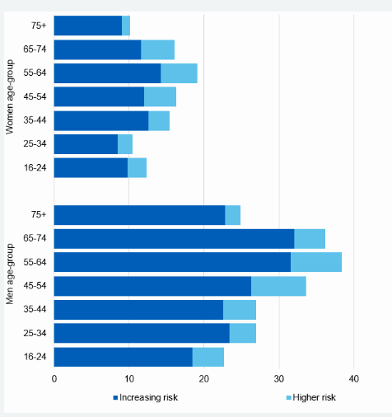
Proportion of adults (aged 16 and over) drinking at high higher or increased risk levels
Most common among men and women aged 55 to 64 (38% and 19% respectively).
Increasing risk is more than 14 units per week for men and women
Higher risk ( Men more than 50 units per week and women more than 35 units per week)
Estimated number of adults in England with alcohol dependence was 595,131; 1.393% of the adult population
Statistics on Alcohol, England 2020
https://digital.nhs.uk/data-and-information/publications/statistical/statistics-on-alcohol/2020/part-4
Pryce, R., Buykx, P., Gray, L., Stone, T., Drummond, C., & Brennan, A. (2017). Estimates of alcohol dependence England based on APMS 2014, including estimates of children living in a household with an adult with alcohol dependence. Prevalence, trends and amenability to treatment. London: Public Health England
Notes:
In 2016, new guidelines on low risk drinking were published
Men and women should not regularly drink more than 14 units a week.
People are also advised to spread their drinking over three or more days.

Slide 24
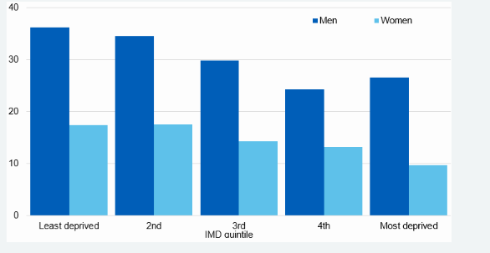
Proportion of adults drinking at increased or higher risk of harm, by Index of Multiple Deprivation and sex
Adults in least deprived areas more likely to drink over 14 units in a usual week (27%) than those in most deprived areas (18%).
Statistics on Alcohol, England 2020
https://digital.nhs.uk/data-and-information/publications/statistical/statistics-on-alcohol/2020/part-4

Slide 25
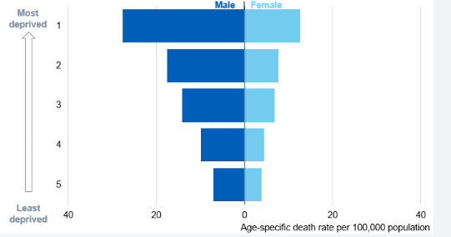
Alcohol-specific deaths by Index of Multiple Deprivation quintile
Compare with pattern of alcohol use by index of multiple deprivation
Least deprived area more likely to drink over 14 units per week
Statistics on Alcohol, England 2020
https://digital.nhs.uk/data-and-information/publications/statistical/statistics-on-alcohol/2020/part-4
Notes:
Death rates were highest in the most deprived areas and lowest in the least deprived areas

Slide 26
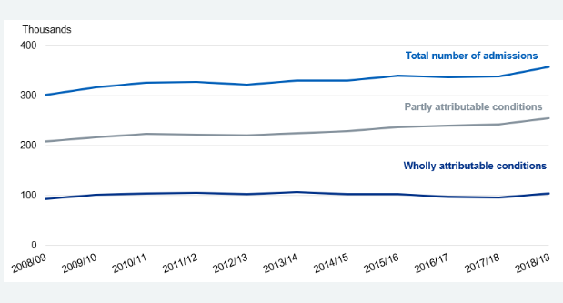
Estimated alcohol-related hospital admissions – narrow measure
In 2018/19 there were 358 thousand estimated admissions where the main reason
for admission to hospital was attributable to alcohol (narrow measure).
This is 6% higher than 2017/18 and 19% higher than 2008/09
This represents 2.1% of all hospital admissions
Notes:
The narrow measure estimates the number of hospital admissions which are primarily due to alcohol consumption and provides the best indication of trends in alcohol-related hospital admissions. These are admissions where an alcohol-related disease, injury or condition was the primary reason for a hospital admission or an alcohol-related external cause was recorded in a secondary diagnosis field.
Broad measure
There were almost 1.3 million estimated admissions where the primary reason for hospital admission or a secondary diagnosis was linked to alcohol
This represents 7.4% of all hospital admissions

Slide 27
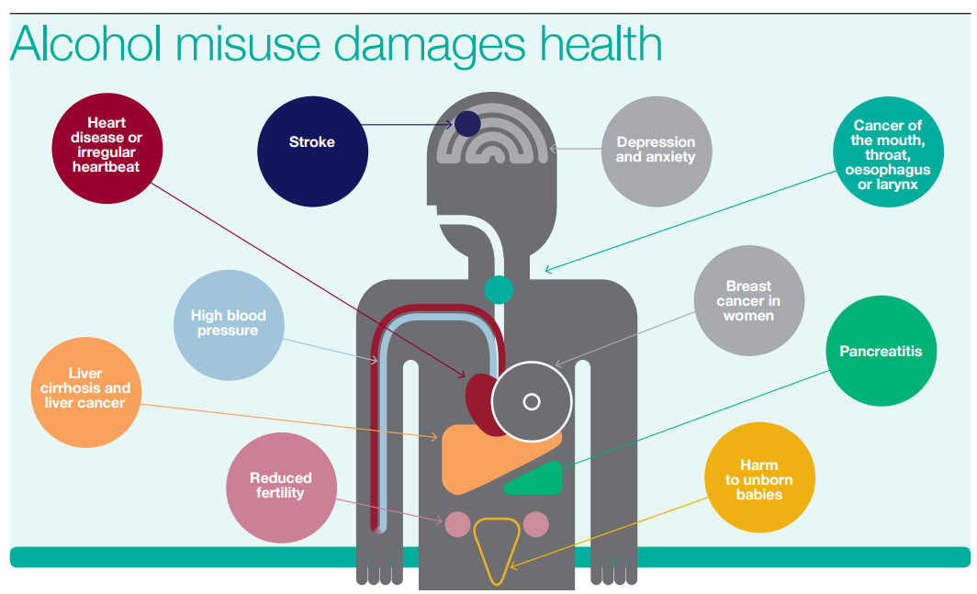
Effects of alcohol
https://publichealthmatters.blog.gov.uk/2015/06/17/alcohol-some-encouraging-trends

Slide 28
Effects of alcohol
Holmes, J., Angus, C., Buykx, P., Ally, A., Stone, T., Meier, P., & Brennan, A. (2016). Mortality and morbidity risks from alcohol consumption in the UK: analyses using the Sheffield Alcohol Policy Model (v. 2.7) to inform the UK Chief Medical Officers’ review of the UK lower risk drinking guidelines. Sheffield: ScHARR, University of Sheffield.
Notes:
Blue = male
Red =pink for women

Slide 29
Interventions for harmful drinking and mild alcohol dependence
For harmful drinkers and people with mild alcohol dependence, offer a psychological intervention (such as cognitive behavioural therapies, behavioural therapies or social network and environment-based therapies) focused specifically on alcohol-related cognitions, behaviour, problems and social networks
National Institute for Health and Care Excellence. (2011). Alcohol use disorders: diagnosis, assessment and management of harmful drinking and alcohol dependence CG 115. London: National Institute for Health and Care Excellence

Slide 30
Assessment for assisted alcohol withdrawal
For service users who typically drink over 15 units of alcohol per day, and/or who score 20 or more on the AUDIT, consider offering:
  An assessment for and delivery of a community-based assisted withdrawal
  Assessment and management in specialist alcohol services if there are safety concerns about a community-based assisted withdrawal
National Institute for Health and Care Excellence. (2011). Alcohol use disorders: diagnosis, assessment and management of harmful drinking and alcohol dependence CG 115. London: National Institute for Health and Care Excellence

Slide 31
Consider inpatient if one or more of following present
Drink over 30 units of alcohol per day
Have a score of more than 30 on the SADQ
Have a history of epilepsy, or experience of withdrawal-related seizures or delirium tremens during previous assisted withdrawal programmes
Need concurrent withdrawal from alcohol and benzodiazepines
Drink between 15 and 30 units of alcohol per day and have:
  A significant learning disability or cognitive impairment
  Significant psychiatric or physical comorbidities (for example, chronic severe depression, psychosis, malnutrition, congestive cardiac failure, unstable angina, chronic liver disease)
Consider a lower threshold for inpatient or residential assisted withdrawal in vulnerable groups, for example, homeless and older people
SADQ = Severity of Alcohol Dependence Questionnaire
National Institute for Health and Care Excellence. (2010). Alcohol use disorders: diagnosis and clinical management of alcohol related physical complications CG 100. London: National Institute for Health and Care Excellence.

Slide 32
Regimes to use
Fixed-dose or symptom-triggered medication regimens can be used in assisted withdrawal programmes in inpatient or residential settings
If a symptom-triggered regimen is used, all staff should be competent in monitoring symptoms effectively and the unit should have sufficient resources to allow them to do so frequently and safely
Prescribe and administer medication for assisted withdrawal within a standard clinical protocol. The preferred medication for assisted withdrawal is a benzodiazepine (chlordiazepoxide or diazepam)
Local guidelines will vary in treatments used
National Institute for Health and Care Excellence. (2010). Alcohol use disorders: diagnosis and clinical management of alcohol related physical complications CG 100. London: National Institute for Health and Care Excellence.

Slide 33
Typical Chlordiazepoxide regime
DATE | 9am | 1pm | 6pm | 10pm | Total
 | 20mg | 20mg | 20mg | 20mg | 80mg
 | 20mg | 20mg | 20mg | 20mg | 80mg
 | 20mg | 20mg | 20mg | 20mg | 80mg
 | 15mg | 15mg | 15mg | 15mg | 60mg
 | 10mg | 10mg | 10mg | 10mg | 40mg
 | 5mg | 5mg | 5mg | 5mg | 20mg
 | Nil | 5mg | Nil | 5mg | 10mg

Slide 34
Other medications
Ensure that Chlordiazepoxide 10-20mg PRN max QDS is available
Seizures – Diazepam per rectum 10–20 mg, repeated once after 10–15 minutes if required /Buccal Midazolam (10 mg, repeated once after 10 minutes if necessary)
Consider Zopiclone 7.5mg nocte PRN for insomnia. This should be for a maximum of 4 days to avoid risk of misuse or dependence
Medication to treat nausea and vomiting (e.g. Prochlorperazine (see BNF), diarrhoea (Loperamide 2-4mg, max 16mg daily) or skin itching (Loratadine 10mg od) may be required
Notes:
Treating prolonged or repeated seizures and convulsive status epilepticus ( 2016)
Give immediate emergency care and treatment to children, young people and adults who have
prolonged (lasting 5 minutes or more) or repeated (3 or more in an hour) convulsive seizures in
the community.
Only prescribe buccal midazolam or rectal diazepam for use in the community for children,
young people and adults who have had a previous episode of prolonged or serial convulsive
seizures.
Nice Alcohol guidelines (2010)
In people with alcohol withdrawal seizures, consider offering a quick-acting benzodiazepine (such as lorazepamj) to reduce the likelihood of further seizures.
Prochlorperazine
Nausea and vomiting, acute attack
By mouth
For Adult
Initially 20 mg, then 10 mg after 2 hours
Nausea and vomiting, prevention
By mouth
For Adult
5–10 mg 2–3 times a day.

Slide 35
Some potential complications during alcohol detoxification
Seizures
Delirium Tremens
Wernicke encephalopathy- Korsakoff syndrome
Hepatic encephalopathy
Liver disease /Cirrhosis complications (see supplementary slides)

Slide 36
Seizures
Highest risk in first 72 hours after stopping drinking
Prevention is better than cure so ensure adequate dosing with Chlordiazepoxide and regular monitoring
Administer appropriate first aid and undertake necessary actions to maintain client’s airway and general safety in the event of a seizure
If the seizure continues for longer than 5 minutes can use Diazepam per rectum 10–20 mg, repeated once after 10–15 minutes if required /Buccal Midazolam (10 mg, repeated once after 10 minutes if necessary)
If the seizure continues for longer than a further 5 minutes, or there are other concerns call the crash team / ambulance.
To prevent further seizures review and increase if necessary the dose of Chlordiazepoxide

Slide 37
Delirium Tremens
Highest risk around 72 hours after stopping drinking
An acute confusional state and medical emergency therefore refer urgently to medical colleagues for medical admission
Offer oral Lorazepam in the first instance. If symptoms persist or medication is refused consider parenteral Lorazepam, Haloperidol or Olanzapine (NICE recommended but unlicensed indications for these medications)
Ensure Pabrinex is given to treat any underlying Wernicke’s encephalopathy

Slide 38
Wernicke encephalopathy and Korsakoff syndrome
Wernicke encephalopathy is an acute, potentially reversible neurological disorder
Deficiency/depletion of thiamine
Incidence rates in Western countries—up to 12.5% in patients with alcohol problems
When untreated about 80% of patients with this condition develop Korsakoff syndrome
Korsakoff syndrome characterised by global amnesia.
  Patients have severe deficits in memory for new material (despite sparing of general intelligence) and in gait and balance, short-term memory and visuoperceptual implicit learning
  May also have prefrontal dysfunction – difficulties with problem solving, working memory, cognitive flexibility, perseverative responding, and self-regulation
Zahr, N. M., Kaufman, K. L., & Harper, C. G. (2011). Clinical and pathological features of alcohol-related brain damage. Nature Reviews Neurology, 7(5), 284.

Slide 39
Symptoms of Wernicke Encephalopathy
Classic triad is ocular motor abnormalities, cerebellar dysfunction, and altered mental state
Only 20% of patients present with the full triad
  30% of those only presented with altered mental state
Altered mental state occurs in 80%
  mental sluggishness, apathy, impaired awareness of an immediate situation, an inability to concentrate, confusion or agitation, hallucinations, behavioral disturbances mimicking an acute psychotic disorder, or coma
Ocular motor abnormalities occur in 30%
  nystagmus or ophthalmoplegia
Cerebellar dysfunction occur in 25% of patients
  loss of equilibrium, incoordination of gait, trunk ataxia, dysdiadochokinesia and, occasionally, limb ataxia or dysarthria
Zahr, N. M., Kaufman, K. L., & Harper, C. G. (2011). Clinical and pathological features of alcohol-related brain damage. Nature Reviews Neurology, 7(5), 284.

Slide 40
Use of thiamine
Offer prophylactic oral thiamine to harmful or dependent drinkers:
  if they are malnourished or at risk of malnourishment or
  if they have decompensated liver disease or
  if they are in acute withdrawal or
  before and during a planned medically assisted alcohol withdrawal.
Offer prophylactic parenteral thiamine followed by oral thiamine to harmful or dependent drinkers:
  if they are malnourished or at risk of malnourishment or
  if they have decompensated liver disease
and in addition
  attend an emergency department or are admitted to hospital acutely
Offer parenteral thiamine to people with suspected Wernicke’s encephalopathy
  Parenteral thiamine should be given for a minimum of 5 days, unless Wernicke’s encephalopathy is excluded. Oral thiamine should follow parenteral therapy
National Institute for Health and Care Excellence. (2010). Alcohol use disorders: diagnosis and clinical management of alcohol related physical complications CG 100. London: National Institute for Health and Care Excellence.

Slide 41
Alcohol Related Brain Disease
Five stage Rehabilitation
Phase | Characterization | Duration
1. Stabilization | Acute management of encephalopathy, thiamine supplementation | Variable: dependent on physical health
2. Psycho-social assessment | Evidence of fairly rapid improvement in cognitive and behavioural profile | May last up to 3 months.
3. Therapeutic rehabilitation | Period of more gradual improvement in cognitive and behavioural skills | May last up to 3 years. Can be complicated by co-morbid physical and mental illnesses
4. Adaptive rehabilitation | Social and physical environment is adapted to optimize independence | Duration will vary on personal circumstances and access to facilities
5. Social integration and relapse prevention | Building new social relationships, structured routines and alcohol relapse prevention | Long-term follow up required
Wilson, K., Halsey, A., Macpherson, H., Billington, J., Hill, S., Johnson, G., ... & Abbott, P. (2012). The psycho-social rehabilitation of patients with alcohol-related brain damage in the community. Alcohol and Alcoholism, 47(3), 304-311.

Slide 42
Hepatic encephalopathy summary
Caused by liver impairment or portosystemic shunting – resulted in high ammonia levels
Ammonia normally converted to urea in the liver
High ammonia levels can lead to cerebral oedema
Symptoms ranges from subtle changes in cognition to changes in intellect, behaviour, motor function and consciousness
Commonest complication of cirrhosis
Diagnosis should be made on clinical grounds
Treatment by addressing precipitant
  Consider diet, lactulose, neomysin, Rifaxamin (prevention)
Alcohol-use disorders: diagnosis and management of physical complications [CG100]
Cirrhosis in over 16s: assessment and management NICE guideline [NG50]
Ellul, M. A., Gholkar, S. A., & Cross, T. J. (2015). Hepatic encephalopathy due to liver cirrhosis. Bmj, 351, h4187.

Slide 43
Interventions for moderate and severe alcohol dependence
After a successful withdrawal for people with moderate and severe alcohol dependence consider
  Acamprosate
  Naltrexone
  These to be used with psychological intervention (cognitive behavioural therapies, behavioural therapies or social network and environment-based therapies) focused specifically on alcohol misuse
National Institute for Health and Care Excellence. (2011). Alcohol use disorders: diagnosis, assessment and management of harmful drinking and alcohol dependence CG 115. London: National Institute for Health and Care Excellence

Slide 44
Data from animal studies Acamprosate
Decreases the withdrawal evoked release of glutamate
Decreases ethanol-intake behaviour
Decrease is maintained over repeated cycles of ethanol exposure and withdrawal
Mutant mice with increased glutamate levels with higher ethanol consumption respond better to acamprosate than wild mice
Neurotoxicity in Hippocampal cell cultures obtained during ethanol withdrawal reduced by acamprosate
Oka, M., Hirouchi, M., Tamura, M., Sugahara, S., & Oyama, T. (2013). Acamprosate {monocalcium bis (3-acetamidopropane-1-sulfonate)} reduces ethanol-drinking behavior in rats and glutamate-induced toxicity in ethanol-exposed primary rat cortical neuronal cultures. European journal of pharmacology, 718(1-3), 323-331.

Slide 45
Use of disulfiram
After a successful withdrawal for people with moderate and severe alcohol dependence, consider offering disulfiram in combination with a psychological intervention to service users who:
  have a goal of abstinence but for whom acamprosate and oral naltrexone are not suitable, or
  prefer disulfiram and understand the relative risks of taking the drug
National Institute for Health and Care Excellence. (2011). Alcohol use disorders: diagnosis, assessment and management of harmful drinking and alcohol dependence CG 115. London: National Institute for Health and Care Excellence

Slide 46
Disulfiram
Irreversible inactivation of liver ALDH and hence the intracellular acetaldehyde concentration rises
High levels of acetaldehyde account for the symptoms of disulfiram-alcohol reaction
Disulfiram inhibits the conversion of dopamine to noradrenaline
Depletion of noradrenaline in the heart and blood vessels facilitates action of acetaldehyde (flushing tachycardia and hypotension)
https://www.medicines.org.uk/emc/product/11168/smpc

Slide 47
Naltrexone
Long acting specific opioid antagonist.
Competitively binds to receptors in CNS and PNS hence blocking effects of (endogenous and exogenous) opioids.
Assumption is that alcohol leads to stimulation of the endogenous opioid system and naltrexone affects this process
Nalmefene similar but also partial agonist activity at the κ receptor
https://www.medicines.org.uk/emc/product/6073/smpc
Notes:
The plasma-half-life of naltrexone hydrochloride is approximately 4
hours. The plasma-half-life of 6-beta-naltrexol is 13 hours.

Slide 48
Pharmacological treatments alcohol dependence summary
 | Lapsing to alcohol consumption | Relapse to heavy drinking | Other Effects
Acamprosate | Significant but small effect (RR 0.83) | Significantly less (RR 0.90)
Naltrexone | No significant effect | Significant but small effect (RR 0.83) | .
Disulfiram (Quality of evidence not as good compared to Acamprosate/ Naltrexone) | No significant effect | See descriptions in Other Effects column | (Compared with Acamprosate /Disulfiram) Increase Time until first drank any alcohol ( vs A) Time to first heavy drinking day ( vs N) Number of abstinent days ( vs N) Decrease The amount of alcohol consumed ( vs A) Number of drinking days ( vs A)
No clear advantage of combination of Acamprosate and Naltrexone over either drug alone
National Institute for Health and Care Excellence. (2011). Alcohol use disorders: diagnosis, assessment and management of harmful drinking and alcohol dependence CG 115. London: National Institute for Health and Care Excellence

Slide 49
Review
Pharmacology / Neuropharmacology
Classification
Assessment
Epidemiology
Health Consequences
Treatment issues

Slide 50
Substance Misuse
MCQs
1. Which of the following statements about Disulfiram is false:
  A. Previous history of CVA is a contraindication
  B. Disulfiram use will result in an decrease in accumulation of acetaldehyde in the blood stream
  C. A loading dose can be used for initiation
  D. Disulfiram may have a role in the treatment of cocaine dependence
  E. Hepatic cell damage is a recognised adverse effect of Disulfiram

Slide 51
Substance Misuse
MCQs
1. Which of the following statements about Disulfiram is false:
  A. Previous history of CVA is a contraindication
  B. Disulfiram use will result in an decrease in accumulation of acetaldehyde in the blood stream
  C. A loading dose can be used for initiation
  D. Disulfiram may have a role in the treatment of cocaine dependence
  E. Hepatic cell damage is a recognised adverse effect of Disulfiram
Notes:
Q1
B Disulfiram use will result in an increase in accumulation of acetaldehyde in the blood stream

Slide 52
Substance Misuse
MCQs
2. The following are true of Wernicke Encephalopathy except:
  A. Classic triad is ocular motor abnormalities, cerebellar dysfunction, and altered mental state
  B. Only 20% of patients present with the full triad
  C. Altered mental state occurs in 40%
  D. Altered mental state symptoms include: mental sluggishness, apathy, impaired awareness of an immediate situation, an inability to concentrate, confusion or agitation
  E. Ocular motor abnormalities occur in 30%

Slide 53
Substance Misuse
MCQs
2. The following are true of Wernicke Encephalopathy except:
  A. Classic triad is ocular motor abnormalities, cerebellar dysfunction, and altered mental state
  B. Only 20% of patients present with the full triad
  C. Altered mental state occurs in 40%
  D. Altered mental state symptoms include: mental sluggishness, apathy, impaired awareness of an immediate situation, an inability to concentrate, confusion or agitation
  E. Ocular motor abnormalities occur in 30%
Notes:
C answer is 80%

Slide 54
Substance Misuse
MCQs
3. Which of the following is not based on Nice Guidelines about the need to consider inpatient setting for alcohol detoxification:
  A. Drink over 50 units of alcohol per day
  B. Have a score of more than 30 on the Severity of Alcohol Dependence Questionnaire
  C. Have a history of epilepsy, or experience of withdrawal-related seizures or delirium tremens during previous assisted withdrawal programmes
  D. Need concurrent withdrawal from alcohol and benzodiazepines
  E. Consider a lower threshold for inpatient or residential assisted withdrawal in vulnerable groups, for example, homeless and older people

Slide 55
Substance Misuse
MCQs
3. Which of the following is not based on Nice Guidelines about the need to consider inpatient setting for alcohol detoxification:
  A. Drink over 50 units of alcohol per day
  B. Have a score of more than 30 on the Severity of Alcohol Dependence Questionnaire
  C. Have a history of epilepsy, or experience of withdrawal-related seizures or delirium tremens during previous assisted withdrawal programmes
  D. Need concurrent withdrawal from alcohol and benzodiazepines
  E. Consider a lower threshold for inpatient or residential assisted withdrawal in vulnerable groups, for example, homeless and older people
Notes:
A Should be that a person drinks over 30 units of alcohol per day (P206 NICE Alcohol-use disorders 2011)

Slide 56
Substance Misuse
MCQs
4. Features required for a diagnosis of dependence within ICD 10 include the following except:
  A. A strong desire or sense of compulsion to take the substance;
  B. Difficulties in controlling substance-taking behaviour in terms of its onset, termination, or levels of use;
  C. A physiological withdrawal state when substance use has ceased or have been reduced, as evidenced by: the characteristic withdrawal syndrome for the substance; or use of the same (or closely related) substance with the intention of relieving or avoiding withdrawal symptoms;
  D. Evidence of tolerance, such that increased doses of the psychoactive substance are required in order to achieve effects originally produced by lower doses
  E. Returning to substance use after a period of abstinence leads to more rapid reappearance of features of dependence than with non-dependent individuals

Slide 57
Substance Misuse
MCQs
4. Features required for a diagnosis of dependence within ICD 10 include the following except:
  A. A strong desire or sense of compulsion to take the substance;
  B. Difficulties in controlling substance-taking behaviour in terms of its onset, termination, or levels of use;
  C. A physiological withdrawal state when substance use has ceased or have been reduced, as evidenced by: the characteristic withdrawal syndrome for the substance; or use of the same (or closely related) substance with the intention of relieving or avoiding withdrawal symptoms;
  D. Evidence of tolerance, such that increased doses of the psychoactive substance are required in order to achieve effects originally produced by lower doses
  E. Returning to substance use after a period of abstinence leads to more rapid reappearance of features of dependence than with non-dependent individuals
Notes:
E is mentioned but not a feature required for diagnosis

Slide 58
Substance Misuse
MCQs
5. The following are correct calculation of units of alcohol (percentages are in vol/vol) corrected to nearest whole number:
  A. 750 mls of 11% wine is 8 units
  B. 6 Litres of 4.5% cider is 18 units
  C. 5 cans of 330 mls of 4.8% lager is 8 units
  D. 3 cans of 440 mls of 7.5% strong lager is 10 units
  E. 2 bottles of 700 mls of 17% fortified wine is 24 units

Slide 59
Substance Misuse
MCQs
5. The following are correct calculation of units of alcohol (percentages are in vol/vol) corrected to nearest whole number:
  A. 750 mls of 11% wine is 8 units
  B. 6 Litres of 4.5% cider is 18 units
  C. 5 cans of 330 mls of 4.8% lager is 8 units
  D. 3 cans of 440 mls of 7.5% strong lager is 10 units
  E. 2 bottles of 700 mls of 17% fortified wine is 24 units
Notes:
B should be obviously wrong = 27 units, no need to work out all the rest
Formula is (percent alcohol x volume in ml) /1000
Hence for 750 mls of 11% wine is (750 x 11)/1000 = 8.25 units
However a litre of x% vol/vol is x units
So a litre of 6% cider is 6 units
So 6 litres of 4% cider is 24 units, idea is rather than working them all out, should be able to scan them and identify incorrect number

Slide 60
Substance Misuse
EMIs
Drugs used in Alcohol Dependence:
A. Disulfiram
B. Acamprosate
C. Naltrexone
D. Baclofen
E. Diazepam
F. Oxazepam
G. Lorazepam
H. Vitamin B compound strong
I. Thiamine
J. Nalmefene
1a. Which medication should not be given if serum creatinine >120 micromol/L
1b. Which medication used for detoxification should be avoided in patients with impaired liver function
1c. Which medication acts as a selective GABA-B agonist
Notes:
Baclofen, a selective gamma-aminobutyric acid-B (GABA-B) receptor agonist,
De Beaurepaire, R., Sinclair, J., Heydtmann, M., Addolorato, G., Aubin, H. J., Beraha, E. M., ... & Garbutt, J. C. (2019). The use of baclofen as a treatment for alcohol use disorder: a clinical practice perspective. Frontiers in psychiatry, 9, 708.

Slide 61
Answers EMI1
1a. Which medication should not be given if serum creatinine >120 micromol/L? Answer Acamprosate. Acamprosate is primarily excreted in the urine and not significantly metabolised.
1b. Which medication used for detoxification should be avoided in patients with impaired liver function? Answer: Diazepam. This is due to its long half life.
1c. Which medication acts as a selective GABA-B agonist? Answer: Baclofen

Slide 62
Substance Misuse
EMIs
Investigations for people with alcohol use
A. Gamma-glutamyl transferase (GGT)
B. Mean corpuscular volume
C. Carbohydrate-deficient transferrin (CDT)
D. Total bilirubin
E. Albumin
F. INR
G. Magnesium
H. Globulin
I. Alkaline phosphatase
J. Platelet Count
2a. This marker has Sensitivity of 50 to 70% in the detection of high levels of alcohol consumption in the last 1 to 2 months but false positive with hepatitis, cirrhosis, cholestatic jaundice, metastatic carcinoma, treatment with simvastatin and obesity
2b. This is used in the calculation of the Maddrey's Discriminant Function for Alcoholic Hepatitis
2c. A reduction in this can lead to increased risk of seizures and can be related to use of proton pump inhibitors

Slide 63
Answers EMI 2
2a. This marker has Sensitivity of 50 to 70% in the detection of high levels of alcohol consumption in the last 1 to 2 months but false positive with hepatitis, cirrhosis, cholestatic jaundice, metastatic carcinoma, treatment with simvastatin and obesity. Answer: Gamma-glutamyl transferase (GGT)
2b. This is used in the calculation of the Maddrey's Discriminant Function for Alcoholic Hepatitis . Answer: Total bilirubin ( as well as Prothrombin Time)
2c. A reduction in this can lead to increased risk of seizures and can be related to use of proton pump inhibitors. Answer Magnesium.

Slide 64
Substance misuse module
Any Questions?
Thank you.

Slide 65
Supplementary slides
Diagnosis using ICD 11 and DSM V
Neuroimaging findings
Epidemiology
Hepatic encephalopathy
Deaths in alcohol related admissions

Slide 66
ICD 11 – similar to ICD-10
Time frames more specific
Harmful pattern of use
  damage to a person’s physical or mental health or has resulted in behaviour leading to harm to the health of others
  The pattern of alcohol use is evident over a period of at least 12 months if substance use is episodic or at least one month if use is continuous
Dependence
  The features are usually evident over a period of at least 12 months but the diagnosis may be made if alcohol use is continuous (daily or almost daily) for at least 1 month.
Notes:
ICD-11 will be presented at the World Health Assembly in May 2019 for adoption by Member States, and will come into effect on 1 January 2022.
ICD 11 Harmful pattern of use
A pattern of alcohol use that has caused damage to a person’s physical or mental health or has resulted in behaviour leading to harm to the health of others. The pattern of alcohol use is evident over a period of at least 12 months if substance use is episodic or at least one month if use is continuous. Harm to health of the individual occurs due to one or more of the following: (1) behaviour related to intoxication; (2) direct or secondary toxic effects on body organs and systems; or (3) a harmful route of administration. Harm to health of others includes any form of physical harm, including trauma, or mental disorder that is directly attributable to behaviour related to alcohol intoxication on the part of the person to whom the diagnosis of Harmful pattern of use of alcohol applies.

Slide 67
DSM V -Substance use disorder
Mild / Moderate /Severe
The diagnosis of a substance use disorder is based on a pathological pattern of behaviors
11 criteria
Mild – 2-3 symptoms
Moderate – 4-5 symptoms
Severe – 6 or more symptoms
Notes:
Consistent with ICD 10/11
Alcohol is often taken in larger amounts or over a longer period than was intended. (b ICD 10)
There is a persistent desire or unsuccessful efforts to cut down or control alcohol use.(b ICD 10)
A great deal of time is spent in activities necessary to obtain alcohol, use alcohol, or recovor from its effects.(e ICD 10)
Craving, or a strong desire or urge to use alcohol.(a ICD 10)
Recurrent alcohol use resulting in a failure to fulfill major role obligations at work, school, or home.(f ICD 10)
Continued alcohol use despite having persistent or recurrent social or interpersonal problems caused or exacerbated by the effects of alcohol.(f ICD 10)
Important social, occupational, or recreational activities are given up or reduced because of alcohol use. (e ICD 10)
Recurrent alcohol use in situations in which it is physically hazardous.( f icd10)
Alcohol use is continued despite knowledge of having a persistent or recurrent physical or psychological problem that is likely to have been caused or exacerbated by alcohol. (f ICD 10 )
Tolerance, as defined by either of the following:(d ICD 10)
a. A need for markedly increased amounts of alcohol to achieve intoxication or desired effect.
b. A markedly diminished effect with continued use of the same amount of alcohol.
Withdrawal, as manifested by either of the following: (c ICD 10)
a. The characteristic withdrawal syndrome for alcohol
b. Alcohol (or a closely related substance, such as a benzodiazepine) is taken to relieve or avoid withdrawal symptoms.

Slide 68
DSM V
Substance use disorder
Impaired control (4 criteria)
Alcohol is often taken in larger amounts or over a longer period than was intended.
There is a persistent desire or unsuccessful efforts to cut down or control alcohol use.
A great deal of time is spent in activities necessary to obtain alcohol, use alcohol, or recovery from its effects.
Craving, or a strong desire or urge to use alcohol.
Social impairment (3 criteria)
Recurrent alcohol use resulting in a failure to fulfill major role obligations at work, school, or home.
Continued alcohol use despite having persistent or recurrent social or interpersonal problems caused or exacerbated by the effects of alcohol.
Important social, occupational, or recreational activities are given up or reduced because of alcohol use.

Slide 69
DSM V
Substance use disorder
Risky use of the substance ( 2 criteria)
Recurrent alcohol use in situations in which it is physically hazardous.
Alcohol use is continued despite knowledge of having a persistent or recurrent physical or psychological problem that is likely to have been caused or exacerbated by alcohol.
Pharmacological criteria ( 2 criteria)
Tolerance, as defined by either of the following:
  A need for markedly increased amounts of alcohol to achieve intoxication or desired effect.
  A markedly diminished effect with continued use of the same amount of alcohol.
Withdrawal, as manifested by either of the following:
  The characteristic withdrawal syndrome for alcohol
  Alcohol (or a closely related substance, such as a benzodiazepine) is taken to relieve or avoid withdrawal symptoms.

Slide 70
Neuropsychological deficits Alcohol use disorder subjects versus Controls
A range of impairments evident
Men and women Largely similar for men and women
Zahr, N. M., Pfefferbaum, A., & Sullivan, E. V. (2017). Perspectives on fronto-fugal circuitry from human imaging of alcohol use disorders. Neuropharmacology, 122, 189-200.
Notes:
AUD subjects relative to healthy controls have been found to have mild to moderate impairments of component processes involving mild to moderate impairments of component processes involving executive function, working memory, declarative memory, visuospatial abilities, upper limb motor ability, and gait and balance

Slide 71
Frontal lobe deficits in Alcohol use disorder (AUD)
Older individuals with AUD have greater volume deficits in frontal gray and white matter relative to their younger controls independent of age of AUD onset
Postmortem studies of AUD brains have shown biochemical disturbances in frontal regions including effects on gene, protein, and receptor expression
Suggestive of how cognitive deficits may persist even with abstinence.
Magnetic resonance imaging studies have shown differences between AUD relative to healthy control individuals in frontal regions such as volume deficits low rates of glucose metabolism and depressed BOLD responses (e.g., during inhibition tasks),
MR spectroscopy studies in frontal regions have shown lower levels of the brain metabolite, N-acetylaspartate (NAA) in recently sober AUD subjects relative to healthy controls
Correlations between volumes of frontal lobes and neuropsychological tests are not clear-cut

Slide 72
Frontocerebellar Circuits
In adults with AUD compared to healthy controls, structural MRI has shown smaller volumes of the pons, thalamus, cerebellar hemispheres, and cerebellar vermis
Body sway, is far greater in AUD individuals, even after 1 month of sobriety, than in age-matched, low drinking individuals
A longer sway path during quiet standing in AUD is associated with a smaller volume of the anterior superior vermis of the cerebellum
Recruitment of functionally intact cerebellar loops in AUD may compensate for impaired performance on tasks such as visuospatial or working-memory skills
This may mean overall capacity for conducting multiple tasks is reduced
The frontocerebellar network with key nodes highlighted includes the prefrontal cortex (PFC), thalamus (T), pons (P), and cerebellum (Cbl).

Slide 73
Frontolimbic network
Compared with controls, Korsakoff Syndrome (KS) subjects show profound bilateral volume deficits of the mammillary bodies: non-amnesic individuals with AUD have milder mammillary bodies volume deficits.
Volumes deficits also found in thalamus and hippocampus region in those with KS. Same defiicts in those with AUD (though to a lesser extent than those with KS)
Inferior cingulate cortical volume appears to be spared in AUD and may compensate for other deficits
For social drinkers, acute alcohol reduces the response to fearful stimuli in limbic regions
Control subjects have been shown to have stronger activation in the amygdala and hippocampus when viewing faces with emotional relative to neutral expressions, AUD Individuals respond in an undifferentiated manner
This may be consistent with clinical evidence of interpersonal difficulties - could indicate a relapse factor
In AUD participants, amygdala activity inversely correlated with increased lateral PFC activity as a function of behavioral deficits
PFC activity as a compensation for blunted limbic activity suggests that in AUD, the brain uses frontal instead of temporal areas to manage emotional /social challenging situations.
The frontolimbic network with key nodes highlighted including the prefrontal cortex (PFC), insula (ins), anterior cingulate (AC), amygdala (amy), hippocampus (hip), mammillary bodies (MB), and thalamus (T).

Slide 74
Frontostriatal system
Volumes of the caudate, putamen, and nucleus accumbens shown to be smaller in AUD men than controls
Unclear whether smaller volumes / altered activation patterns in reward-related regions can predict higher risk for AUD
Binge drinking men showed smaller prefrontal, striatal, and medial temporal lobe volumes relative to non-binge drinking men, but binge drinking women showed the inverse pattern of larger volumes of these areas relative to non-binge drinking women
Several visual cue-reactivity fMRI studies in AUD showing brain regions, particularly the basal ganglia including the putamen, nucleus accumbens, and medial PFC, responding more intensely to alcohol images compared to other images.
The ventral striatum shows greater activation in response to alcohol cues but lower activation during anticipation of monetary gain in AUD relative to control individuals.
Suggest brain activation in individuals with AUD may be biased towards responding to alcohol-associated cues.
May also support a theory relating to the transition from casual to compulsive, uncontrolled consumption of alcohol by a shift from goal-directed behaviours executed by regions of the PFC to more automatic, habitual behaviours driven by appetitive regions such as the caudate and putamen
The frontostriatal network with key nodes highlighted including the prefrontal cortex (PFC), striatum (Str), globus pallidus (GP), and ventral tegmental area (VTA).

Slide 75
Alcohol dependence
 | Male 18-24 | 25-34 | 35-54 | 55+
Male (N) | 59,382 | 123,404 | 221,404 | 52,024
Percent of population | 2.362% | 3.330% | 3.029% | 0.712%
Female (N) | 33,176 | 30,315 | 54,170 | 21,256
Percent of population | 1.378% | 0.815% | 0.729% | 0.255%
Estimated number of adults in England with alcohol dependence was 595,131 which was 1.393% of the adult population
Males more likely to have alcohol dependence, e.g., aged 25-54.
Pryce, R., Buykx, P., Gray, L., Stone, T., Drummond, C., & Brennan, A. (2017). Estimates of alcohol dependence England based on APMS 2014, including estimates of children living in a household with an adult with alcohol dependence. Prevalence, trends and amenability to treatment. London: Public Health England.
Notes:
Obtained using a mathematical model using AUDIT and SADQ score

Slide 76
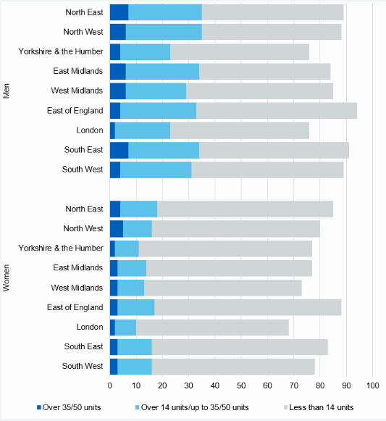
Weekly alcohol consumption region + sex
For men and women
  Highest percent of non-drinkers were London (28%)
  Lowest proportions in the East of England (9%).
Statistics on Alcohol, England 2020
https://digital.nhs.uk/data-and-information/publications/statistical/statistics-on-alcohol/2020/part-4

Slide 77
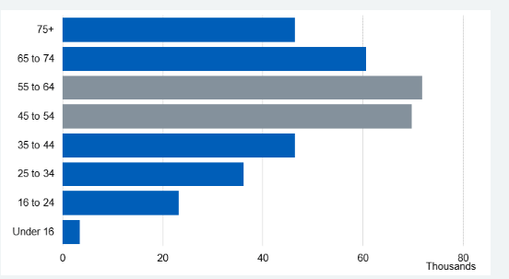
Hospital admissions
The number of admissions rises with age up until 55-64 and then falls.
40% of patients were aged between 45 and 64.

Slide 78
Effects of alcohol
Holmes, J., Angus, C., Buykx, P., Ally, A., Stone, T., Meier, P., & Brennan, A. (2016). Mortality and morbidity risks from alcohol consumption in the UK: analyses using the Sheffield Alcohol Policy Model (v. 2.7) to inform the UK Chief Medical Officers’ review of the UK lower risk drinking guidelines. Sheffield: ScHARR, University of Sheffield.

Slide 79
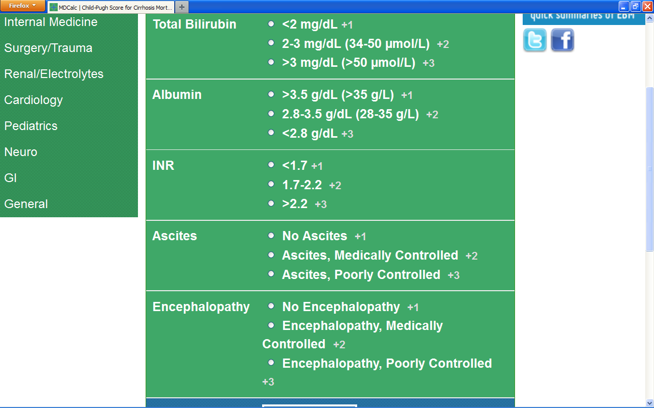
NICE guidelines monitoring liver disease
Maddrey’s discriminant function* of 32 or more indicate that people with severe alcohol-related hepatitis may need corticosteroid treatment
Complete Model for End‑Stage Liver Disease (MELD**) score every 6 months for people with compensated cirrhosis.
MELD score of 12 or more indicates that the person is at high risk of complications of cirrhosis
*4.6 x [prothrombin time – control time (seconds)] + bilirubin in mg/dl.
**Includes creatinine / INR/Bilirubin/history of dialysis (www.mdcalc.com)
National Institute for Health and Care Excellence. (2010). Alcohol use disorders: diagnosis and clinical management of alcohol related physical complications CG 100. London: National Institute for Health and Care Excellence.
National Institute for Health and Care Excellence. (2016). Cirrhosis in over 16s: assessment and management. NG 50. London: National Institute for Health and Care Excellence.
Notes:
www.Mdcalc.com also has calculator function for MELD

Slide 80
Hepatic encephalopathy
Caused by liver impairment or portosystemic shunting;
Ranges from subtle changes in cognition to clinically obvious changes in intellect, behaviour, motor function and consciousness.
Commonest complication of cirrhosis
Risk for the first episode of hepatic encephalopathy is 5–25% within 5 years after the diagnosis of cirrhosis
Alcohol-use disorders: diagnosis and management of physical complications [CG100]
Cirrhosis in over 16s: assessment and management NICE guideline [NG50]
Ellul, M. A., Gholkar, S. A., & Cross, T. J. (2015). Hepatic encephalopathy due to liver cirrhosis. Bmj, 351, h4187.

Slide 81
Hepatic encephalopathy
– pathogensis
Related to the effects of waste products on the brain, particularly ammonia and glutamine
Glutamine is metabolised by glutaminase to ammonia and glutamate in the small intestine; Ammonia then converted to urea in the liver
High ammonia levels can lead to cerebral oedema along with an inflammatory response cause can cortical dysfunction
With Cirrhosis, portosystemic shunting allows ammonia and other neurotoxins to bypass the liver and enter the systemic circulation
  This can also occur with transjugular intrahepatic portosystemic shunting TIPS
Alcohol-use disorders: diagnosis and management of physical complications [CG100]
Cirrhosis in over 16s: assessment and management NICE guideline [NG50]
Ellul, M. A., Gholkar, S. A., & Cross, T. J. (2015). Hepatic encephalopathy due to liver cirrhosis. Bmj, 351, h4187.

Slide 82
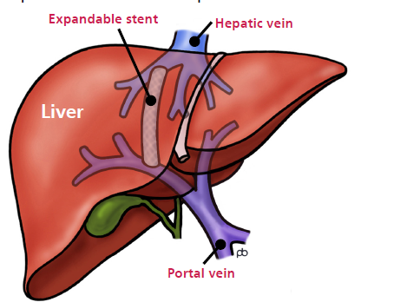
Transjugular Intrahepatic Portosystemic Shunt
Internal ‘bypass’ between the portal vein and the hepatic veins
https://www.leedsth.nhs.uk/assets/Uploads/adada69f98/LN002264.pdf

Slide 83
Hepatic encephalopathy
– diagnosis
No specific test for hepatic encephalopathy,
The diagnosis should be made on clinical grounds
Arterial or venous ammonia levels correlate poorly with the grade of hepatic encephalopathy
Electroencephalography may show characteristic triphasic waves
Neuropsychological assessments can also be used to help with diagnosis
Alcohol-use disorders: diagnosis and management of physical complications [CG100]
Cirrhosis in over 16s: assessment and management NICE guideline [NG50]
Ellul, M. A., Gholkar, S. A., & Cross, T. J. (2015). Hepatic encephalopathy due to liver cirrhosis. Bmj, 351, h4187.

Slide 84
Hepatic encephalopathy
– Treatment
Treat precipitant such as gastrointestinal bleeding, infection, diuretic overdose
Diet - care with protein diet – e.g., use small amounts throughout the day
Lactulose
  a non-absorbable disaccharide
  metabolised to lactic and acetic acid in the colon
  reducing the pH and promoting the excretion of ammonia
Neomycin reaches high concentrations in the gut and acts as a glutaminase inhibitor
Rifaximin is a semisynthetic antibiotic derived from rifamycin. can be use for the prevention of episodes of overt hepatic encephalopathy
  may inhibit the division of urea-deaminating bacteria, thereby reducing the production of ammonia
Alcohol-use disorders: diagnosis and management of physical complications [CG100]
Cirrhosis in over 16s: assessment and management NICE guideline [NG50]
Ellul, M. A., Gholkar, S. A., & Cross, T. J. (2015). Hepatic encephalopathy due to liver cirrhosis. Bmj, 351, h4187.

Slide 85
Cirrhosis
Risk factors for Cirrhosis
  misuse alcohol
  have hepatitis B/ hepatitis C virus infection
  are obese (BMI of 30 kg/m2 or higher)or have type 2 diabetes
Offer transient elastography to diagnose cirrhosis for:
  people with hepatitis C virus infection
  men who consumed over 50 units of alcohol per week and women who drink over 35 units of alcohol per week for several months
  people diagnosed with alcohol-related liver disease
Do not use routine laboratory liver blood tests to rule out cirrhosis.
Refer people diagnosed with cirrhosis to a specialist in hepatology
Calculate the Model for End-Stage Liver Disease (MELD) score every 6 months for people with compensated cirrhosis.
a MELD score of 12 or more suggests a person is at high risk of complications of cirrhosis.
Cirrhosis in over 16s: assessment and management NICE guideline [NG50]
Notes:
Nature of population we see could have all of these – apart from hepatitis B
Do not offer tests to diagnose cirrhosis for people who are obese (BMI of 30 kg/m2 or higher) or who have type 2 diabetes, unless they have NAFLD and advanced liver fibrosis (as diagnosed by a score of 10.51 or above using the ELF test). Also see the assessment for advanced liver fibrosis section in NICE's NAFLD guideline.

Slide 86
Review of patients who died in hospital with a diagnosis of alcohol-related liver disease (ARLD)
2454 patients identified as dying of a diagnosis of ARLD
Mean age for men was 56.1 for women 58.0
62% had an admission in the two years for prior to final admission
In sub-sample analyses
  24% were shown to have had no previous admission to the hospital in which they finally died in the five years preceding their final admission
  Ascites, Jaundice, Chronic liver disease most common presentation
  Sepsis in 34% and Acute Alcohol hepatitis in 29%
  53% had alternate cause of liver disease excluded
Juniper, M., Smith, N., Kelly, K., & Mason, M. (2013). Measuring the units–a review of patients who died with alcohol-related liver disease. London: National Confidential Enquiry into Patient Outcome and Death.
Notes:
Hospital participation
National Health Service hospitals in England, Wales and Northern Ireland were expected to participate as well as hospitals in the independent sector and public hospitals
in the Isle of Man, Guernsey and Jersey.
Study population
All patients who died in hospital with a diagnosis of
alcohol-related liver disease during the six-month study
period, 1st January 2011 to 30th June 2011 inclusive.
There were no age restrictions for inclusion. The included
ICD10 codes were:
K70 Alcoholic liver disease
K70.0 Alcoholic fatty liver
K70.1 Alcoholic hepatitis
K70.2 Alcoholic fibrosis and sclerosis of liver
K70.3 Alcoholic cirrhosis of liver
Alcoholic cirrhosis NOS
K70.4 Alcoholic hepatic failure
Alcoholic hepatic failure:
· no other specified
· acute
· chronic
· subacute
· with or without hepatic coma
K70.9 Alcoholic liver disease, unspecified

Slide 87
Review of patients who died in hospital with a diagnosis of alcohol-related liver disease (ARLD)
Concerns about initial management related to fluid management ; renal dysfunction and sepsis
25% were not currently using alcohol
One in four patients (25%; 117/467) were never seen by a gastroenterologist or hepatologist.
Only 15% (56/373) of patients were reviewed by a specialist nurse.
Thiamine was omitted in more than one in ten cases (39/343; 11%).
Juniper, M., Smith, N., Kelly, K., & Mason, M. (2013). Measuring the units–a review of patients who died with alcohol-related liver disease. London: National Confidential Enquiry into Patient Outcome and Death.
Notes:
Hospital participation
National Health Service hospitals in England, Wales and Northern Ireland were expected to participate as well as hospitals in the independent sector and public hospitals
in the Isle of Man, Guernsey and Jersey.
Study population
All patients who died in hospital with a diagnosis of
alcohol-related liver disease during the six-month study
period, 1st January 2011 to 30th June 2011 inclusive.
There were no age restrictions for inclusion. The included
ICD10 codes were:
K70 Alcoholic liver disease
K70.0 Alcoholic fatty liver
K70.1 Alcoholic hepatitis
K70.2 Alcoholic fibrosis and sclerosis of liver
K70.3 Alcoholic cirrhosis of liver
Alcoholic cirrhosis NOS
K70.4 Alcoholic hepatic failure
Alcoholic hepatic failure:
· no other specified
· acute
· chronic
· subacute
· with or without hepatic coma
K70.9 Alcoholic liver disease, unspecified

