Slide 1

MRCPsych Old Age Module
Cognition

Slide 2
OA Module: Cognitive Assessment
Aims and Objectives
The aim is for the trainee to gain an overview of the main cognitive domains and their assessment.
By the end of the session trainees should:
  Understand the brain regions involved in the various cognitive domains.
  Appreciate the concept and theory of a bedside cognitive assessment.
  Have an awareness and understanding of the most common cognitive syndromes.
  Be able to reflect on the limitations of cognitive assessment and screening tools.

Slide 3
OA Module: Cognitive Assessment
To achieve this
Case Presentation
Journal Club
555 Presentation
Expert-Led Session
MCQs
Please sign the register and complete the feedback

Slide 4
OA Module: Cognitive Assessment
Expert Led Session
Cognitive Assessment
Dr Mark Worthington
Consultant Old Age Psychiatrist
Lancashire Care NHS Foundation Trust

Slide 5
Outline
Brain landmarks
Cognitive domains
Functional anatomy
Cognitive assessment

Slide 6
Key brain landmarks
Central Sulcus (Rolandic fissure)
Parietal lobe
Parieto-occipital sulcus
Frontal lobe
Occipital lobe
Lateral sulcus (Sylvian fissure)
Pre-occipital notch
Temporal lobe
Supramarginal gyrus
Notes:
Frontal lobe comprises 1/5 of all neocortex
Supramarginal gyrus….(sensory association area L parietal lobe): (Brodmann area 40)
Astereognosis; idemotor apraxia; conduction aphasia; Gerstmanns’s
Lesions of R supramarginal gyrus – constructional apraxia

Slide 7
Brodmann areas
Supramarginal gyrus
Wernicke’s area
Auditory cortex
Notes:
German anatomist Korbinian Brodmann studied the cellular architecture and organisation of the brain using a special time of staining.
He divided this brain into different areas based on his work.
Brodmann’s classification has been criticised but specific areas do closely match their function.
KEY AREAS:
Area 4 – Precentral gyrus / motor cortex
Area 3, 1&2 – Post-central gyrus (sensory cortex)
Area 39 – Angular gyrus, considered by some to be part of Wernicke's area
Area 40 – Supramarginal gyrus considered by some to be part of Wernicke's area
Area 44 – Pars opercularis, part of the inferior frontal gyrus and part of Broca's area
Area 45 – Pars triangularis, part of the inferior frontal gyrus and part of Broca's area
Area 46 – DLPFC (important role in WM / maintaining attention)

Slide 8
Brodmann areas
Cingulate cortex
Fusiform gyrus (Face area)
Primary visual cortex (V1)
Notes:
Primary visual cortex (V1) - Information from V1 splits into 2 pathways:
The ventral stream begins with V1 travelling through V2, V4 and to the the inferior temporal cortex.
The ventral “what” stream is associated with object recognition (semantic knowledge).
The dorsal stream: from V1 travels throught dorsal V2 on route to the posterior parietal cortex.
This dorsal "Where Pathway" is associated with motion and visuospatial representation of objects and assists in control of the limbs and eyes when visual information is needed to coordinate arm or eye movements (saccades).
Area 17 – Primary visual cortex
Area 18 – Secondary visual cortex (v2) / pre-striate cortex
Area 19 – Visual association area
Area 37 – Occipitoremporal area / fusiform face area

Slide 9
Cognitive Domains
Sensation
Perception
Motor and constructional
Attention and concentration
Memory
Executive
Processing
Language

Slide 10
Cerebral dominance
Assessed by:
  Wada test (amobarbital)(Wada & Rasmussen 1960)
  fMRI
  Functional transcranial Doppler sonography (fTCD)
  Dichotic listening – different auditory stimuli presented to each ear
Right handed people:
  92% left hemisphere dominant
  6% right hemisphere; 2% bilateral
Left-handers:
  85% left hemisphere
  15% right or bilateral dominance (Rasmussen & Milner 1977)
Notes:
Dominance for language.
T. Rasmussen, B. Milner, The role of early left brain injury in determining lateralization of cerebral speech functions, Annals of the New York Academy of Sciences 299 (1977) 355 – 369.
Extrapolation of these results (from a Wada test) to the general population are uncertain as most studies have been performed in people with underlying brain damage / disease.
The Annett Handedness Questionnaire (Annett, 1970) can be used to assess handedness of individuals.

Slide 11
Left-brain / right-brain
Left hemisphere:
Role in language, arithmetic, verbal memory & visual recognition
Right hemisphere:
Non-verbal perceptual tasks such as visuospatial recognition, emotional expression & elements of speech such as prosody

Slide 12
What is attention?
Ability to concentrate & focus on specific stimuli
Sustained attention (vigilance): concentration
Selective attention: selective focus / ignore irrelevant e.g. conversation at party.
Divided attention: focus on >1 task simultaneously e.g. preparing meal whilst on telephone
Alternating attention: cognitive flexibility, shifting attention between tasks
Notes:
ATTENTION - Ability to concentrate & focus on specific stimuli
Simple/sustained attention – slight decline. Sustained attention also refers to ability to maintain attention for long periods. Doesn’t really seem to be affected by age.
Selective attention – declines with age
Divided attention – declines with age
Switching (Ability to switch focus) is also another important aspect of attention
Sustained attention - Sustained attention is "the ability to direct and focus cognitive activity on specific stimuli."
Best tested with non-automatic tasks e.g. serial 7s; months in reverse; WORLD backwards etc…
Attention can be tested by checking orientation / digit span / serial 7s.

Slide 13
Neurobiology of attention
Executive function - diffuse networks involving:
Top-down systems (“orienting system”)
  Prefrontal cortex
  Frontal eye fields
  Inter-parietal areas
  Acetylcholine involved (basal forebrain)
Bottom-up systems (“alerting system”)
  Reticular activating system
  Thalamus
  Norepinephrine involved (locus coeruleus)
Notes:
Basal forebrain – ACh released by Nucleus Basalis of Meynert and medial septal nucleus
Locus coeruleus found in pons
Arousal and vigilance are fundamental bottom up processes

Slide 14
Attention – bedside assessment
Digit span (6±1)
Serial 7s (elderly often struggle)
Count backwards from 20→0
Months of the year in reverse
Notes:
Digit span is a good test of attention. It is dependent on WM.
It can be impaired in delirium / left hemisphere damage / moderate-severe dementia
It will usually be in intact in patients with amnestic disorders
Remember not always testing single domain – Serial 7s for example will also be assessing calculation and memory

Slide 15
Types of memory
Declarative (Explicit)
Episodic
Non-declarative (implicit)
Procedural
Semantic
Working memory
(20-30 seconds)
Verbal
Spatial
Conditioning
Priming
Long-term
Notes:
Declarative: can be articulated / is in conscious awareness
Non-declarative – the knowing is expressed by performance (something that is enacted) not in conscious recollection. Learned responses not available to conscious access. Procedural: e.g. riding a bike / emotional memory, fear responses
Working / STM: Working memory refers to information that is kept “online” and in constant rehearsal. Can be disrupted by interference. Depends on frontal executive structures (DLPFC) directing attention & posterior areas. At the bedside can be tested by using digit span forwards (6+/-1) & backwards (5+/-1).
LTM formation depends on integrity of limbic regions e.g. hippocampus, MTL structures, thalamus
Retrograde verbal memory – can be assessed by going back over a patient’s history
Anterograde verbal memory – can be assessed using 3 items / address etc?
Semantic memory is memory for facts, word meanings & general knowledge > VF / naming / verbal knowledge / reading of regular & irregular words
Procedural memory based in different brain regions including cerebellum (classical conditioning) & basal ganglia
Conditioning (e.g. classical condition) – simple phobias etc / Pavlov’s dog
Priming – unconscious associations
PROSPECTIVE MEMORY is also described but is not really a separate memory system – it relies on episodic

Slide 16
History
Anterograde memory loss can be elicited by asking about:
Increasing use of lists
Forgetting appointments / medication
Repetition
Losing items
Difficulty keeping up with storylines / TV
Retrograde memory lost can be elicited by asking about:
Past events & personal history (education; employment; major events)
Notes:
With retrograde memory, collateral information is important –for example people who have had a stroke or have Korsakoff’s might have clear memories of early life events, but have poor temporal awareness of the last 10 years
(e.g. the person themselves might think they moved into their house in the last year, whilst a family member might correct them to state that it was say 8 years ago).

Slide 17
Neurobiology of memory
Working memory – depends on frontal executive structures involved in attention and posterior areas related to the memory being rehearsed
LTM – dependent on limbic regions (Circuit of Papez)
Episodic: limbic-diencephalic system & frontal connections
Semantic: Anterior temporal lobe
Non-declarative (implicit) memory based in brain structures such as cerebellum (conditioning) & basal ganglia
Notes:
NB – Papez circuit was originally described as having role in emotion; now recognised to play more important role in memory.
WM:
Baddeley (1986) described WM as having 3 components:
1 – Central executive (controls attention; supervises & coordinates components 2 and 3)
2 – Articulatory phonological loop (stores speech-based information)
3 – Visuo-spatial sketch pad (manipulates visual & spatial information – right hemisphere)
Goldman-Rakic (1988)
DLPFC holds information “online” while it is processed
Hypothesis confirmed by functional imaging studies
See also:
Baddeley A. Working memory: looking back and looking forward. Nature Reviews: Neuroscience 2003; 4:829-837.

Slide 18
Disorders affecting memory
Amnestic syndromes:
Memory loss markedly affected compared with other cognitive domains
Alzheimer’s, vascular dementia, other dementias, hippocampal anoxia, herpes simplex encephalitis (hippocampal damage), Korsakoff’s, bilateral thalamic infarction, drugs eg benzodiazepines
Transient global amnesia (TGA):
Marked anterograde amnesia > variable retrograde deficit
Seen in older adults with sudden onset profound but transient amnesia
General abilities & orientation to self maintained during episode
Transient epileptic amnesia (TEA):
Recurrent brief episodes
“Lacunes” of memory loss
Notes:
TGA - The underlying cause of transient global amnesia is unknown. There is a link with migraines which increases the risk of suffering from TGA.

Slide 19
Testing verbal memory
Remember 3 items
“I am going to say 3 words which I would like you to repeat after me. Try and remember them because I will ask you again later…”
Ensure adequate registration
Poor registration may indicate deficits of attention or executive dysfunction
Can also assess memory for recent events (how they got to hospital / recent hospital admission)
Notes:
Can also assess memory for recent events
How did you get to hospital today?

Slide 20
Testing visual memory
Copy and recall shapes
“Hide and seek”
Notes:
Copy and recall of geometric shapes or use of Rey-Osterreith complex figure etc.
Can hide a number of objects around room and ask patient to look for them 5 minutes later.

Slide 21
Semantic memory
Famous events, e.g.
“Please tell me the name of the current prime minister”
“When was World War 2?”
Autobiographical memory
- Need corroboration

Slide 22
Language
Not just speech:
Comprehension
Repetition
Reading
Writing
Naming

Slide 23
Speech disorders (Aphasias)
Broca’s area (frontal lobe; area 44):
Non-fluent speech
Effortful, halting, & telegraphic (“cat sat mat”)
Paraphrasias (phonemic) can occur e.g. “sitter” (sister); “hen” (pen) “incollect” (incorrect)
Comprehension relatively preserved
Wernicke’s area (dominant temporal; area 22)
Fluent; lack of content; circumlocutions
Phonemic & semantic (words close in meaning) (e.g. dad for husband) paraphrasias; neologisms
Poor comprehension
Notes:
Lesions to Broca’s area (44) (lateral premotor cortex) result in loss of verbal expresion.
More extensive damage including to insula and motor cortex result in motor speech disorder and apraxia of the face, lips & tongue.
Broca’s
Decreased speech output
Effortful – grimacing
Dysprosody
Telegraphic – prepositions and adjectives are ommitted (e.g. cat sat mat)
Repetition markedly impaired
Naming can be poor but benefits from prompts
Reading/writing are often affected
Associated features – contralateral hemiplegia and ipsilateral apraxia.
Wernicke’s
Speech is fluent but comprehension impaired
Lack of content; circumlocutions
Phonemic & semantic (words close in meaning) paraphrasias
Neologisms may be seen
Logorrhoea may be seen
Jargon aphasia – rapid unintelligible speech
Articulation & length of phrases normal
Naming is impaired – prompting not helpful
Writing & reading also impaired

Slide 24
Is their speech fluent?
NO
“Non-fluent aphasias”
1 Transcortical motor
Repetition intact
2 Broca’s (primary motor aphasia)
Repetition impaired
3 Global aphasia
Repetition & comprehension impaired
YES
Is comprehension intact?
NO
“Receptive speech disorders”
1 Transcortical sensory aphasia
Repetition intact but poor comprehension
2 Wernicke’s (primary sensory aphasia)
Repetition & comprehension impaired
YES
Conduction aphasia
A selective impairment of repetition
(Damage to arcuate fasciculus which conducts information between Wernicke’s & Broca’s areas)
Is repetition intact?
NO
YES
Anomia only
Notes:
Speech disorders:
GLOBAL APHASIA
Results from a widespread lesion/damage.
TRANSCORTICAL APHASIAS
Repetition is not affected.
Transcortical aphasias can affect either:
Speech production (although noticeably not on repetition)
Comprehension
Due to damage outside perisylvia areas and can result from watershed infarctions.
CONDUCTION APHASIA
Damage to arcuate fasciculus (curved/bow-shaped bundle) – connects posterior part of temporal junction with the frontal cortex (part of superior longitudinal fasciculus)
Connects Broca’s & Wernicke’s area in the dominant hemisphere
Speech and comprehension is intact
ANOMIA or NOMINAL APHASIA
Impairment of naming to confrontation far exceeds any other deficits
As with most cognitive functions – lower frequency / less common objects are affected more severely.
Can make semantic errors / substitutions e.g. chair for table
Patients typically use circumlocutions
Early symptom of dementia (esp AD)
Can be a residual symptom of a recovered broader aphasia.

Slide 25
Reading
Alexia: acquired inability to comprehend written language caused by brain damage (Jacobson et al, 2007)
Dyslexia: Partial loss of reading abilities (also applies to development impairments)
Two forms of alexia:
Alexia with agraphia (parieto-temporal)
Alexia without agraphia (occipital)- “pure alexia” – letter by letter reading
Notes:
Jacobson et al 2007 (Seminars in General Adult Psychiatry)
Alexia without agraphia (it is a peripheral alexia rather than central language based alexia)
Reading is impaired
Writing and spelling intact
Therefore a patient can’t read the words they have just written.

Slide 26
Reading & Alexia
Peripheral dyslexia:
The impairment is in visual perception – the language centres remain intact
Can result from impaired acuity / visual neglect / eye movement abnormalities
Central dyslexia:
Impairment of language centres

Slide 27
“Peripheral” dyslexia
Neglect dyslexia:
Difficulty in reading initial part of word
Right hemisphere damage
    SISTER → SISTER
    TRACTOR → TRACTOR
    COMPUTER → COMPUTER
Alexia without agraphia (rare) (“pure word blindness”)
Very specific form of visual agnosia
Disconnection syndrome
Can write words seen but not read words back
Caused by lesions to occipital lobe / posterior fibres of corpus callosum (splenium)
Notes:
Neglect dyslexia
Attentional deficit rather than pure visual
R hemipshere damage
Alexia without agraphia is also known as letter by letter dyslexia
Patients can recognised words spelt to them
The fact that the patient can still write words seen demonstrates that the pathway from V1 to motor cortex for writing is preserved
Visualised words can’t access Wernicke’s area resulting in alexia
Letter by letter reading – slow in reading.

Slide 28
“Central” dyslexia
Surface dyslexia (L inferior temporo-parietal)
Difficulty with irregular words (e.g. pint / sew / thyme)
Phonologically plausible errors
Breakdown in links between word and meaning
Deep dyslexia (L hemisphere damage)
Loss of sound-based reading (deficits in grapheme-phoneme conversion)
Problems reading non-words (rint / glint / deak)
Associated deficits in working memory
Semantic errors (bird/pheasant for goose)
Notes:
Surface dyslexia (seen in semantic dementia and temporo-parietal damage)
Results from a semantic deficit
Deep dyslexia – patients only able to read via word meaning not by using letter-letter sounds.
Phonological dyslexia
Difficulties with unfamiliar or non-words
Similar to deep dyslexia but no semantic errors

Slide 29
Writing & dysgraphia
Requires coordination of central (spelling) and peripheral (formation of letters) abilities. Affected more commonly than reading
Central dysgraphia – impairment of written AND oral spelling
Peripheral dysgraphia - Intact oral spelling with impaired written spelling suggests a writing dyspraxia (dyspraxic dysgraphia) or a neglect dysgraphia (a peripheral dysgraphia)
  Neglect dysgraphia:
  Initial parts of word misspelt
  Seen with other non-dominant parietal lobe deficits
Notes:
Peripheral dysgraphia - Intact oral spelling with impaired written spelling suggests writing dyspraxia or neglect dysgraphia (a peripheral dysgraphia)

Slide 30
Classification – as per dyslexia
Surface dysgraphia (Left temporo-parietal)
Difficulty spelling irregular words
Phonologically plausible errors
Deep dysgraphia (Left hemisphere damage)
Breakdown of sound-based route for spelling
Unable to spell non-words
Semantic errors

Slide 31
Language
Comprehension:
Simple commands
“Please point to the ceiling”
“Point to the pen…....”(etc)
More complex (3-stage) commands
Graded sentences
Repetition:
Single words: e.g. Hippopotamus, caterpillar, specificity
Phrases: e.g. “A stitch in time saves nine”; “no ifs, ands, or buts”.
Listen carefully for errors in speech sounds (articulation) or phonemic paraphrasias
Notes:
Usual to start assessments in graded manner… starting with simple words before moving onto polysyllabic words and THEN sentences
Asking further information about the objects can also be used to assess semantic knowledge and speech.
When assessing speech take note of qualities such as:
Rate & flow
Dysarthria / problems with articulation
Content
Comprehension
Naming problems / word-finding – resulting in some hesitancy
Incorrect words / paraphrasias
Use of grammar / is sentence structure simplified (telegraphic)?
IS there any perseveration:
Echolalia – repetition of phrases spoken by you?
Palilalia – perseveration of words….. E.g. I cam here by car today…today..today..

Slide 32
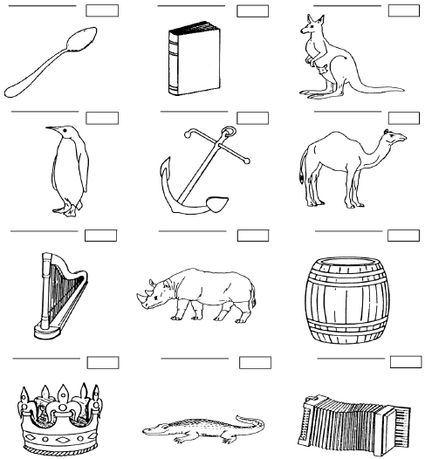
Language
Naming
Anomia (word-finding)
Naming errors
Paraphrasias
Frequency effect (less common items harder)
May identify agnosia
Objects from Addenbrooke’s Cognitive Examination (ACE-III)
Notes:
Posterior lesions (e.g. angular gyrus) can produce marked anomia for visually recognised objects – may be associated with alexia.

Slide 33
Language
Reading
In simplest form:
“Please follow this instruction”…..[CLOSE YOUR EYES]
and/or
Ask to read aloud a paragraph from newspaper
Can be tested (if necessary) using list of regular and irregular words
Notes:
Listen carefully for errors in articulation and speech sounds (or dysarthria)

Slide 34
Language
Writing
Write a sentence
Write a dictated sentence
What errors are there? (see ealier cognitive domain slides)
Is oral spelling preserved? (suggests peripheral dysgraphia)

Slide 35
Apraxia
An inability to perform skilled previously learned actions despite intact understanding, sensory & motor systems

Slide 36
Apraxia
Requires both a conceptual knowledge and an ability to ”produce” and control the necessary movements
Ideational: loss of conceptual knowledge
Ideomotor: impaired production of action
Some confusion around terms & inconsistent use
Best described by region (e.g. limb vs orobuccal)
Brain regions:
Limited localising value – involvement of frontal & parietal lobes of dominant hemisphere
Notes:
Ideational apraxia – damage to conceptual system – causes impairment of gesture comprehension & discrimination AND impaired producction. Patients are impaired in performing to command and imitation. May make errors in tool selection – e.g. using screwdriver as hammer (although will stil be able to correctly identify the tool and name it).
Idemotor apraxia can be differentiated from ideational as gesture comprehension and discrimination between gestures is intact in ideomotor apraxia.
Ideomotor – inability to perform gestures / imitate / mime tool use on command. Can get errors of spatial and temporal timing.
Most commonly seen with lesions affecting premotor cortex.
Usually left parietal lobe lesions but can also occur with R parietal / frontal lobe and subcortical structures (e.g. basal ganglia)
Motor representations stored in parietal lobe, but premotor cortex (including SMA) translates these motor engrams into movement & assist with motor sequence performance and so FL lesions can result in apraxia.

Slide 37
Apraxia – testing:
Imitation of gestures:
Wave / salute / thumbs up / “ok”
Meaningless gestures
Miming (use of objects)
Pretend to comb hair / brush teeth
Shouldn’t use body part as object
Orobuccal movements: (Insular/L inferior frontal lesions)
Ask to blow out imaginary match
Cough
Lick lips
Motor sequencing
e.g. Luria (also forms part of frontal / executive assessment)
Notes:
Remember to test on both sides
Most common causes or apraxia are stroke and dementias such as Alzheimer’s disease and especially CBD (typically marked unilateral dyspraxia)

Slide 38
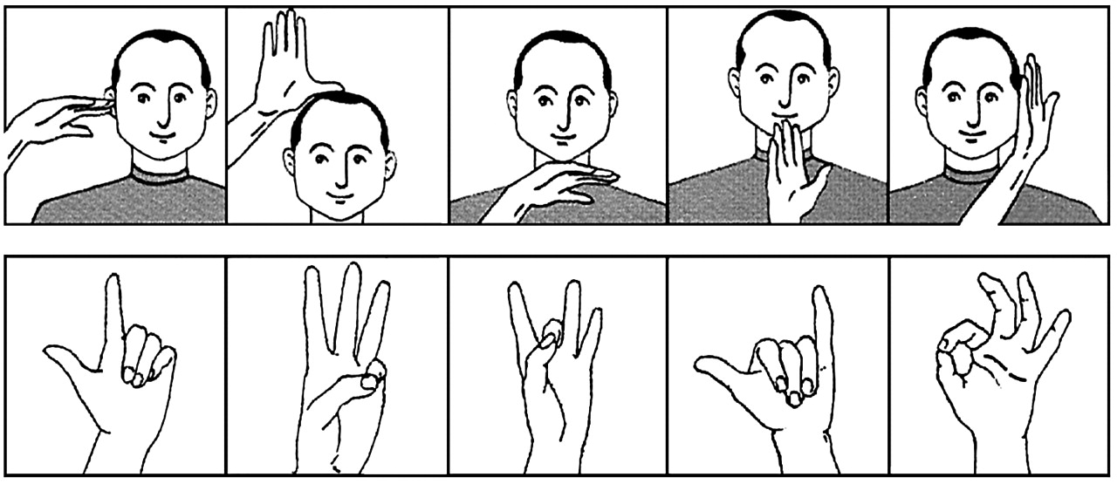

Hand movements in apraxia
Kipps C M , and Hodges J R J Neurol Neurosurg Psychiatry 2005;76:i22-i30
©2005 by BMJ Publishing Group Ltd
Notes:
Hand movements in apraxia. Reproduced from: Goldberg G. Imitation and matching of hand and finger postures. Neuroimage 2001;14:S132–6, with permission from Elsevier.

Slide 39
Visuospatial

Slide 40
Deficits
Visual agnosia - failure of object recognition
Visual neglect
Visual inattention / sensory extinction
Dressing & constructional dyspraxia – technically not dyspraxia but visuospatial impairment
Topographical disorientation (novel environments)

Slide 41
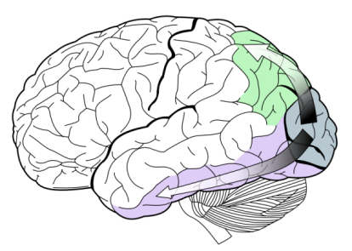
Vision
Signals pass from the retina to the lateral geniculate nucleus and then to primary visual cortex (V₁)(striate cortex) – specific parts of cortex map to specific parts of visual field (“retinotopic”)
Extra-striate areas are organised by function – e.g. detection of motion or colour
Visual information passes in 2 “streams” – a dorsal (occipitoparietal) stream and a ventral (occipitotemporal) stream from V₁
to the visual association areas
Dorsal stream: spatial processing
Ventral stream: object recognition
Notes:
Visual field back to front and upside down…
Damage to V1 areas therefore cause specific visual field deficits (scotoma)
Damage to extrastriate areas results in damage to specific modalities.
Two processing streams emerge from visual cortex. The ventral stream runs below the calcarine (calca: spur) fissure into the medial temporal lobe. The dorsal stream passes superiorly and laterally to the occipitoparietal and temporo-parieetal-occipital areas.
(The primary visual cortex is divided into 6 layers. Layers four receives the information transmitted from the lateral geniculate nuclei).

Slide 42
Visual object agnosia
(associative or semantic visual agnosia)
Most commonly encountered form of agnosia
Perception intact: images of objects can be copied & drawn
Due to impairment of semantic knowledge – can affect any modality – visual agnosia refers to inability to access by vision. (NB - Associative agnosia usually refers to more generalised semantic loss).
Lesions of anterior left temporal lobe
Tests: Pyramid & Palms Test
Notes:
Patients with semantic dementia will be unable to name the picture or demonstrate any knowledge of the object regardless of the modality. They have central loss of knowledge.
Associative visual agnostics CAN match pictures hence Pyramid & Palms Test – CHECK!***
Patients with anomia will be demonstrate intact recognition but not be able to name, “it’s used for…… can’t think of it’s name…”

Slide 43
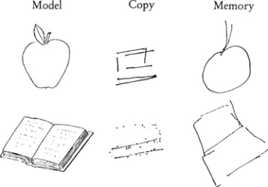
Apperceptive visual agnosia
Objects not seen as whole or meaningful - impairment of perception
(can name objects by description; knowledge retained)
Difficulty copying images but do better when draw pictures from memory
Struggle on tests of object matching
Tests: incomplete letters, VOSP
Notes:
Lesion of superior visual pathway
Seen in bilateral occipito-temporal lesions (e.g. watershed infarcts; Posterior cortical atrophy)

Slide 44
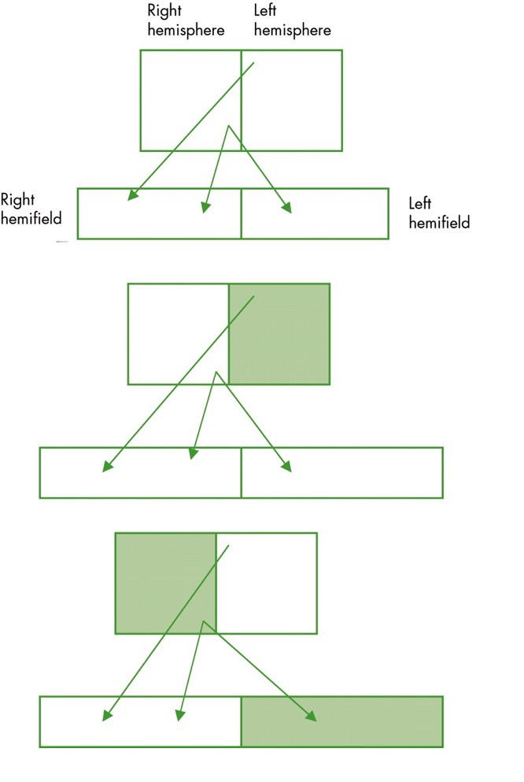
Visual neglect
Deficit of visual attention to external space/body
Usually left-sided (lack of bilateral representation)
Left hemisphere damage results in no visual field deficit, while right hemisphere damage results in neglect to the left
J D W Greene J Neurol Neurosurg Psychiatry 2005;76:v25-v34
©2005 by BMJ Publishing Group Ltd (Modified)
Notes:
Left hemisphere damage results in no visual field deficit, while right hemisphere damage results in neglect to the left.
Neglect can occur in up to 4/5 of R hemisphere stroke in the acute stage.
The degree of neglect can FLUCTUATE in patients within the same day – thought to be due to changes in arousal (affected in R hemisphere strokes).
Patients may also perform differently on individual tests of neglect and therefore it is more sensitive/comprehensive to perform a battery.

Slide 45
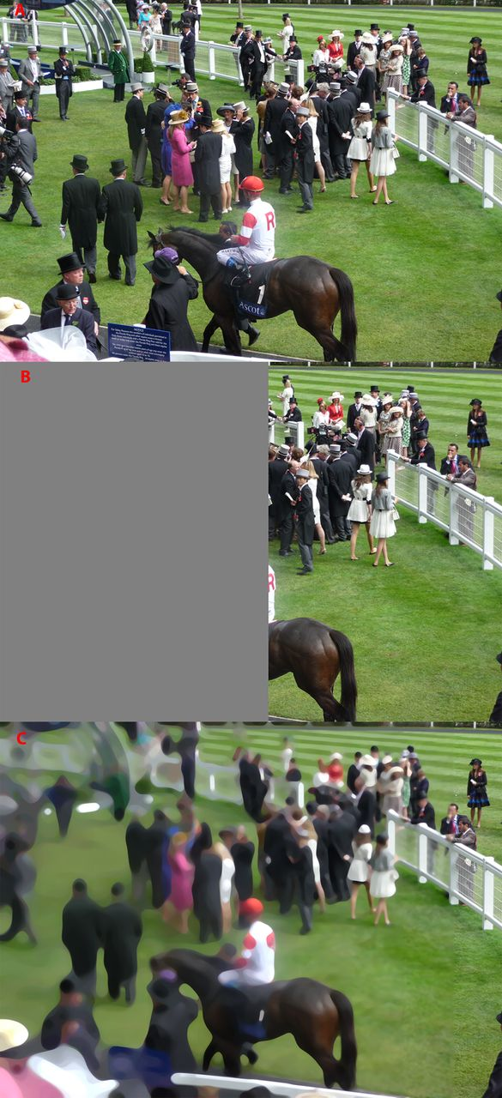

Schematic representation of how a visual scene might appear to people with left homonymous hemianopia (middle panel) and left neglect (bottom panel).
Hemianopia obeys the midline and affects only the contralesional visual field.
Neglect affects parts of the ipsilesional field in addition to the contralesional field – so there is a lateralised bias of attention towards the side of the lesion.
Korina Li, and Paresh A Malhotra Pract Neurol doi:10.1136/practneurol-2015-001115
©2015 by BMJ Publishing Group Ltd
Notes:
Schematic representation of how a visual scene might appear to people with left homonymous hemianopia (middle panel) and left neglect (bottom panel). Whereas

Slide 46
Sensory inattention
Sensory inattention (“extinction”) – related sign
Test by bilateral stimulation of visual fields (moving one or both fingers) – ipsilesional stimulus “extinguishes” the other stimulus from conscious awareness (ensure visual fields intact before testing)
Bedside tests of neglect:
Line bisection
Clock face
Double-headed daisy
Letter cancellation task
X
X
X
Notes:
Sensory inattention IS NOT THE SAME as neglect: an individual only fails to attend to one hemi-field in the presence of a competing visual stimulus in the contralateral (ipsilesional) hemi-field.
Can exist together but patients can continue to display inattention even after frank visual neglect has resolved.
TESTS OF NELECT (see slide) – in very severely affected patients they may not be able to fixate on a contralesional stimulus such as a person talking to them. They may eat only food from one side of the plate or fail to groom one side of their body. This can affect reading (as seen in language section) omitting words on one side of the page or display neglect dyslexia (see dyslexia slides).

Slide 47
Other perceptual deficits
Anosognosia – inability to recognise disability (typically left hemiplegia)
Usually non-dominant parietal lobe lesions
Disorder of attention
Constructional (& dressing) dyspraxia
Technically not an apraxia
Due to impairments in VS processing
Left hemisphere damage – simplified drawings
Right hemisphere damage – misaligned/expanded

Slide 48
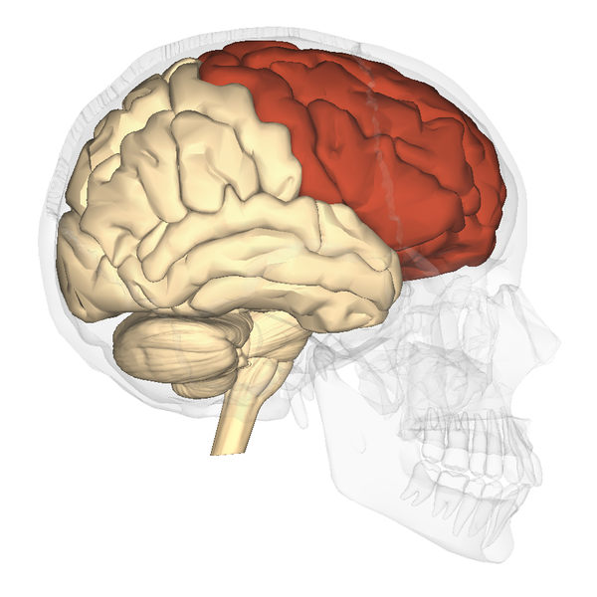
Frontal lobes
Motor
Speech
Personality
“Executive function”
3 clinical syndromes typically described
Notes:
Patients with frontal lobe damage may display disinhibition (including sexual), overfamiliarity, lack of appropriate social conduct, overtalkative,& have aggressive outburts.
Damage to frontal lobes usually cause a range of symptoms rather than focal deficits. Lesions may also be clinically silent. Frontal lobe lesions cause more dramatic changes than unilateral.
Causes of frontal lobe injury include – traumatic head injury, vascular disease, tumours, MS, dementia.
POSITIVE SYMPTOMS (Change in function):
Disinhibition
Vulgarity
Impulsivity
Irritable
Labile
Inappropriate laughter/crying
Inappropriate social behaviour – including telling inappropriate jokes .
Childlike excitement or joviality (“moria”)
An episodeic elevation of mood (shallow & fatuous rather than manic type elevation)
NEGATIVE (Loss of function):
Apathy
Abulia
Reduced interest in daily activities/self-care
Akinetic mutism
Social withdrawal

Slide 49
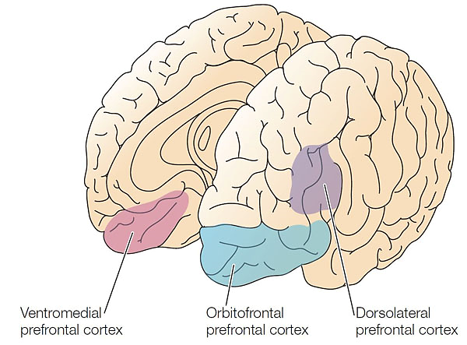
Dorsolateral PFC
“Disorganised”
Poor attention
Poor judgement
Poor planning
Poor insight
Rigidity (concrete)
Notes:
DLPFC inolved in attention / working memory / organisation of thought and behaviour.
Also plays role in deploying movement although not part of motor cortex
Frontal convexity syndrome:
Apathetic / brief aggressive outbursts
Impairment with motor sequencing
Poor word list generation
Poor performance on abstraction
Psychomotor retardation
Stimulus-bound behaviours
Motor perseveration & impersistence

Slide 50
Orbitofrontal PFC
“Pseudo-psychopathic”
Disinhibited
Poor impulse control
Explosive outburst
Inappropriate behaviour
Notes:
Regulation of social behaviour
OFC lesions associated with personality changes including:
Inappropriate laughter
Emotional lability
Disibhibition & impulsive behaviour
Environmental dependency syndrome may be seen (including imitation/echolalia & utilisation behaviour due to excess response to environmental stimuli (bilateral lessions).
Frontal lobe tumours affecting OFC may be associated with forced utilisation.

Slide 51
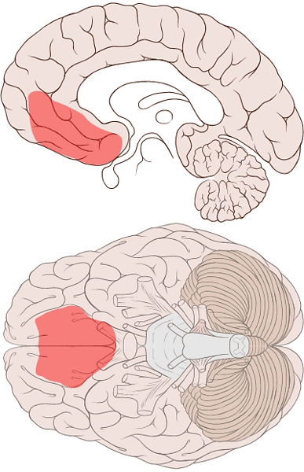
Ventromedial PFC
“Pseudo-depressive”
Apathetic
Lack of initiation
Poverty of speech
Lack of social knowledge
Notes:
Medical PFC including anterior cingulate closely connected to limbic system – integrates motivation & arousal with cognitive function.
Paucity of sponteneous movmenet & gesture – akinesia
Sparse verbal output
Lower extremity weakness & loss of sensation
Incontinence
Akinetic mutism → disorder of the frontal regions (e.g. cinguate gyrus; medial frontal regions) → patients unable to talk/move.

Slide 52
Executive Function
Abilities that allow us to plan, adapt, solve, initiate, organise & monitor our thoughts & behaviours

Slide 53
Executive function
Executive dysfunction is not synonymous with frontal lobe but PFC is essential for normal EF.
May see environmental dependency:
Perseveration of speech: Palilalia
Repetition of speech heard: Echolialia
Utilisation behaviours
Primitive reflexes:
Grasp reflex
Pout reflex (tap spatula placed on lips)
Notes:
Not synonymous with frontal lobe dysfunction as impairment can arise from damaged outside the frontal lobes.
Environmental dependency syndrome may be seen (including imitation/echolalia & utilisation behaviour due to excess response to environmental stimuli (bilateral lesions).

Slide 54
Executive Function Tests
Luria task
(motor sequencing)
Go-no-go & conflicting instructions (inhibitory control)
Cognitive estimates (abstraction)
Letter (& category) fluency
(initiation; perseveration)
Similarities (conceptualisation/ abstraction)
Alternating sequences
(Set-shifting; perseveration)
Notes:
LURIA – (Left frontal lobe task). Demonstrate (x3) “Look what I’m doing…now can you join in.... And continue please”.
Or ALTERNATING HAND SEQUENCES (Stretch out arms and alternately open and close one hand; asking patient to complete after demonstration)
GO-NO-GO: tests impulsivity/response inhibition (orbitofrontal cortex). “When I tap once, you tap once; don’t tap when I tap twice” or “tap once when I tap twice; don’t tap when I tap once”.
CONFLICTING INSTRUCTIONS (Sensitivity to interference; set shifting). Undertake series (e.g. 1-1-2-1-2-2-2-1-1-2-2-1-1)
ALTERNATING SEQUENCES/PATTERNS (square and triangles) (tests ability to switch set; response inhibition and perseveration.
LETTER AND CATEGORY FLUENCY:
Letter (verbal fluency) – around 15 is normal; <10 abnormal. Generate as many words as possible in 1 minute (letters commonly used include F/A/S/P etc). Can’t include names or places or words with same stem (e.g. save; saves; saved). “I’m going to give you a minute and I want you to give me as many words as you can beginning with the letter P; but not names of places or animals”.
Measures – rule adherence; speed(initiation;maintenance); perseveration; intrusions; inhibition.
Category fluency – “name as many animals as you can in one minute”. <15 poor; <10 abnormal. Up to 20 expected in young adults.
Typically described that patients with FL impairment score poorly on both measures but especially letter fluency; poor performance on category fluency can be seen in AD or semantic dementia. Can be made harder by asking for specific subtypes of animals (e.g. breeds of dogs).
SIMILARITIES: Ask how two related items are alike or similar (e.g. apple/orange; table/chair; plate/cup; train/boat; love/hate; poem/statue) – abnormal responses will be concrete (rigid) or the patient will insist the items are not similar.
As in any cognitive test we start with easier items before moving to harder items. Explanation/clarification needs to be given with first pairing so patient understand the desired response.
COGNITIVE ESTIMATES: “How tall is the average Englishman?”.(May give bizarre responses such as 10 feet tall). “How fast does a racehorse run”. “How many people live in Manchester?”. “How tall is the Eiffel Tower?”.
Proverb interpretation can be used but is dependent on pre-morbid intellectual ability and cultural background.
PREHENSION BEHAVIOUR (UTILISATION/AUTONOMY):
“Do not take my hands” – ask patient to put hands out with palms up. Place hands above and touch patients palms. If patient grabs, do again but say “Do not take my hands”.
Environmental utilisation behaviours
PRIMITIVE REFLEXES
Frontal lesions (typically in dementias) can result in a return of primitive reflexes:
Grasp reflex
Sucking
Groping

Slide 55
Temporal lobes
Impaired verbal memory
Visual agnosia
Wernicke’s aphasia
Contralateral upper quadrantanopia
Anomia
Impaired non-verbal memory
Prosopagnosia
Alexia
Anterograde & retrograde memory
Notes:
Temporal lobes are involved in perception & recognition of auditory information, language production and memory.
When testing verbal memory (new learning) name and address is more sensitive than 3 items (e.g. as in MMSE).
Upper contralateral homonymous quadrantanopia seen with temporal lobe lesions – important sign of temporal lobe lesion.
Prosopagnosia – inability to recognise a person from their face. May still be able to recognise individuals by other means such as their voice or way they walk / characteristic clothes etc.
Non-dominant temporal lobe lesions may not display clear signs/deficits.

Slide 56
Temporal lobe syndromes
Klüver-Bucy Syndrome:
Hyperphagia / Hypersexuality / Hyperorality / Hypermetamorphosis / Docility / Visual agnosia
Bilateral temporal lobe damage (including amygdalae).
Amnesic syndrome (e.g. Korsakoff’s)
Anterograde memory impairment; variable retrograde
Preserved digit span and ability to learn new skills (but won’t remember learning)
Can result from malnutrition, infection (HSV), vascular lesions, head injury, hypoxia (including CO poisoning), or tumours etc.
Temporal lobe epilepsy
Autonomic sensations / dysphasia / forced thinking / lip smacking / absences
Panoramic memory / depersonalisation
Déjà vu & jamais vu
Notes:
Klüver–Bucy syndrome - results from bilateral lesions of the medial & lateral temporal lobes (including amygdaloid nucleus).
May present with hyperphagia, hypersexuality, hyperorality, hypermetamorphosis (impulse to touch objects in sight), visual agnosia & docility.
HM - famous patient who underwent bilateral MTL resection to treat intractable seizures. He developed severe anterograde and retrograde memory impairment.
Symptoms of temporal lobe epilepsy (TLE) include autonomic sensations / Dysphasia / Forced thinking / Panoramic memory / Depersonalisation / Déjà vu and jamais vu / absences / lip smacking /
Personality disturbances may occur in TL damage:
Emotional instabilty, aggresion & paranoid states are common and derpersonalisation and sexual disorders may occur. (Jacobson et al. From Seminars in General Adult Psychiatry, 2007, Ch20, p488-525).
Psychoses are well recognised in temporal lobe lesions.

Slide 57
Parietal lobes
Neglect / inattention
Constructional apraxia
Dyscalculia*
Dysgraphia*
R-L disorientation*
Topographical disorientation
Tactile agnosia (astereognosis)
Homonymous lower quadrantanopia
Finger agnosia*
Anosognosia
Dyspraxia
Notes:
Dominant parietal lobe
Receptive dysphasia – posterior lesions (also conduction aphasia or andomia)
Apraxia
Gerstmann syndrome is characterized by four primary symptoms:
Dysgraphia: deficiency in the ability to write
Dyscalculia: difficulty in learning or comprehending mathematics (inability to perform simple calculations is technically called anarithmetrica)
Finger agnosia: inability to distinguish the fingers on the hand
Disorientation (to left-right)
This disorder is often associated with brain lesions in the dominant (usually left) hemisphere including the angular and supramarginal gyri near the temporal and parietal lobe junction.
Angular gyrus is involved in translating visual patterns of letters and words into meaningful information.
*Full assessment of alcalculia would require person to read, write and copy numbers and then perform oral & written calculations.
NON-DOMINANT LESIONS ASSOCIATED WITH:
Neglect / inattention
Anosognosia (denial of disability) – inability to consciously recognise dysfunction of limbs (e.g. hemiplegia). Usually non-dominant lesions. Regarded as disorder of attention rather than perception.
Constructional apraxia
Topographical disorientation (navigation in new places) / spatial disorientation / topographagnosia (NB- can occur with lesions to either lobe but more common from non-dominant lobe)
Dressing apraxias
Non-dominant lesions can also cause disturbance of body image and external space. Patients may not recognise own limbs (typically left) or disown them or believe they are absent (hemisomatognosia).
BILATERAL”
Agraphagnosia / agraphaesthesia – trace letter on patients hand (with their eyes closed)
Astereognosis – recognition by touch (result from lesions close to sensory cortex)
Posterior parietal lesions cause a contralat

Slide 58
Occipital lobe syndromes
Contralateral homonymous hemianopia
Prosopagnosia (ventral stream defect)
Bálint's syndrome (dorsal stream defect):
Simultagnosia
Optic ataxia
Optic apraxia
ANTON syndrome (Anton-Babinski):
Cortically blind
Visual anosognosia (with confabulation)
Notes:
PROSOPAGNOSIA – seen in temporal and occipital lobe involvement (usually bilateral or right sided).
People with prosopagnosia have difficulty in recognising familiar faces. May relie on other features to identify a person (e.g. clothing; voice; way they walk)
Not always specific to faces and may affect ability to identify other categoes. Can describe features of faces/objects and there underlying knowledge about a person is maintained (Semantic knowledge) however it is a deficit in ability to link visual and semantic information (inferior occipitotemporal lesions).
Balint’s - bilateral damage to parieto-occipital cortex (e.g. watershed infarcts; PCA)
Simultagnosia – difficulty attending to more than one item of a complex scene at a time
Optic ataxia - unable to direct hands to target using vision
Oculomotor apraxia – inability to voluntarily direct eye movement to target
Results from bilateral damage to superior-parieto-occipital region causing damage to doral stream. Seen with CO poisoning, infarctions, PCA of AD.
Anton syndrome:
Visual agnosia
Patient denies deficits and may attempt to navigate despite being cortically blind.
Occipital lobe pathology may also result in visual illusions / hallucinations / alexia without agraphia

Slide 59
Cognitive Assessment

Slide 60
Cognitive assessment tools
More than just a MMSE, MOCA or ACE
Screening tools with limitations
Need to take into account educational attainment and what is “normal” function for an individual
Remember – don’t replace formal neuropsychological assessment
MMSE©
MOCA
ACE-III (& Mini-ACE)
6-CIT
AMTS
Terms to understand!
Face validity
Construct validity
Inter-rater reliability
Test-retest reliability

Slide 61
Selected brief tools
Mini-Mental State Examination (MMSE) (Folstein, Folstein & Hugh, 1975)
Quick / widely used / copyright
Poor assessment of memory, VS, executive function / ceiling/floor
Sensitivity 0.51-0.79; specificity 0.95 (Brooke & Bullock, 1999; Hancock & Warner, 2011)
Montreal Cognitive Assessment (MOCA)
Scored out of 30 (≤25/30)
Sensitivity 0.94-1; specificity 0.5-0.84 (Smith & Holmes, 2007; Nasreddine et al, 2005)
Abbreviated Mental Test Score (AMTS) (Hodkinson 1972)
10-item scale (4-item version AMT-4 used in A&E/AMU) and in 4-AT (delirium test) Cutoff <8
Sensitivity 0.81; specificity 0.84 (Incalzi et al, 2003)
6-item cognitive impairment test (6-CIT)
Inverse scoring (≥8/24)
Validated in primary care
Sensitivity 0.9; specificity 1 (Brooke & Bullock, 1999)
No cultural bias
Notes:
MMSE:
Hancock, P. and Larner, A.J., 2011. Test Your Memory test: diagnostic utility in a memory clinic population. International journal of geriatric psychiatry,26(9), pp.976-980.
AMTS:
Hodkinson, H.M., 1972. Evaluation of a mental test score for assessment of mental impairment in the elderly. Age and ageing, 1(4), pp.233-238.
Antonelli Incalzi, R., Cesari, M., Pedone, C., Carosella, L. and Carbonin, P.U., 2003. Construct validity of the abbreviated mental test in older medical inpatients. Dementia and geriatric cognitive disorders, 15(4), pp.199-206.
MOCA:
Smith, T., Gildeh, N. and Holmes, C., 2007. The Montreal Cognitive Assessment: validity and utility in a memory clinic setting. Canadian Journal of Psychiatry, 52(5), p.329.
Nasreddine ZS, Phillips NA, Bdirian V, et al. The Montreal Cognitive Assessment, MoCA: a brief screening tool for mild cognitive impairment. J Am Geriatr Soc. 2005;53:695–699.
6-CIT:
Brooke, P. and Bullock, R., 1999. Validation of a 6 item cognitive impairment test with a view to primary care usage. International journal of geriatric psychiatry, 14(11), pp.936-940.
NB – all sensitivities need to be interpreted with caution as depend on specific cut-offs used and what we are trying to detect (e.g. mild dementia vs all dementia; e.g. 6-CIT will score lower on sensitivity assessment for detection of mild dementia).
General:
Woodford, H.J. and George, J., 2007. Cognitive assessment in the elderly: a review of clinical methods. Qjm, 100(8), pp.469-484.
Sheehan, B., 2012. Assessment scales in dementia. Therapeutic advances in neurological disorders, p.1756285612455733.

Slide 62
Clock drawing test
Clock drawing is a useful supplement to a brief bedside cognitive assessment
Most information obtained by asking subject to:
draw clock face
copy a clock face
Clock drawing assesses executive (planning) function as well as visuospatial processing
Type of errors can yield useful information, e.g.:
Evidence of neglect
People with AD typically draw larger clocks compared to HD patients (Eknoyan et al, 2012)
Notes:
Eknoyan, D., Hurley, R.A. and Taber, K.H., 2012. The clock drawing task: common errors and functional neuroanatomy. The Journal of neuropsychiatry and clinical neurosciences.

Slide 63
Selected neuropsychological tests
ESTIMATED PREMORBID FUNCTIONING
Test of Premorbid Functioning (TOPF)
National Adult Reading Test (NART)
CURRENT INTELLECTUAL FUNCTIONING
Wechsler Adult Intelligence Scale -4th Edition (WAIS-IV)
Ravens Matrices
ATTENTION/CONCENTRATION
Digit Span (WAIS-IV) Forwards, Backwards and Sequencing (or if not available the WMS-III subtest).
Test of Everyday Attention (TEA)
LANGUAGE
Graded Naming Test
Boston Naming Test
WORKING MEMORY
Digit span backwards and sequencing (WAIS-IV)
MEMORY
Wechsler Memory Scale – 4th Edition (WMS-IV)
Rivermead Behavioural Memory Test –3rd Edition (RBMT III)
Notes:
EXAMPLES OF NEUROPSYCH TESTS ONLY
Stroop test demonstrates that reading is an automatic prepotent response.
Stroop test (1935) measures reading speed; inhibition; selective attention.
Trail-making test meaures:
Set-shifting
Self-monitoring (rule adherence)
Speed
Perseveration

Slide 64
Selected neuropsychological tests
PERCEPTUAL/VISUOSPATIAL SKILLS AND CONSTRUCTIONAL ABILITIES
Visual Object and Space Perception Battery (VOSP):
Clock drawing
Star/Letter Cancellation (Behavioural Inattention test) – tests of neglect
INFORMATION PROCESSING SPEED
Symbol Search (WAIS-IV)
EXECUTIVE FUNCTION
Initiation
Verbal fluency
Sequencing
Letter Sequencing/Number Sequencing (Trail Making test (TMT); DKEFS)
Inhibition
Stroop test
Rule Shifting
Card Sorting tests e.g., WCST
Planning and organising / Problem Solving
Key Search/Zoo Map (Behavioural Assessment of the Dysexecutive Syndrome, BADS).
Tower of London

Slide 65
Useful resources
Montreal Cognitive Assessment (MOCA) available at: www.mocatest.org
https://www.alz.org/professionals/health-systems-clinicians/cognitive-assessment
http://www.psychiatrycpd.co.uk/ Bedside assessment of cognition.
Rascovsky, K., 2016. A primer in neuropsychological assessment for dementia. PRACTICAL NEUROLOGY. http://v2.practicalneurology.com/pdfs/pn0716_CF_Neuropsych.pdf

Slide 66
Acknowledgements
Please provide feedback/suggestions on this presentation to
Anthony.Peter@lancashirecare.nhs.uk

Slide 67
OA Module: Cognitive Assessment
Any Questions?
Thank you…... MCQs are next....

Slide 68
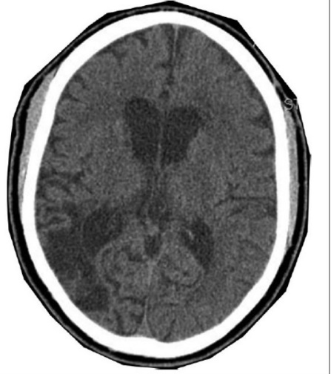
OA Module: Cognitive Assessment
MCQs
1. A 67 year old left handed male suffered from a cerebral infarct 5 weeks ago. Here is his CT brain scan result.
Which of the following tests is most likely to detect the related cognitive deficits?
Abstract thinking
Go-No-Go
Cognitive estimates
Stroop test
Copying a cube

Slide 69
OA Module: Cognitive Assessment
MCQs
1. A 67 year old left handed male suffered from a cerebral infarct 5 weeks ago. Here is his CT brain scan result.
Which of the following tests is most likely to detect the related cognitive deficits?
Abstract thinking
Go-No-Go
Cognitive estimates
Stroop test
Copying a cube

Slide 70
OA Module: Cognitive Assessment
MCQs
2. A 54 year old woman has been falling out with friends and her relationship with her husband is increasingly strained. She has been saying things in social situations that she would have previously found mortifying. Her driving has also become more erratic, often jumping red lights. She has also been involved in a couple of road rage incidents which is very unusual for her.
MOCA
6-CIT
Cornell
MUST
MMSE
Which of the following screening tools would be most helpful in picking up associated cognitive deficits?

Slide 71
OA Module: Cognitive Assessment
MCQs
2. A 54 year old woman has been falling out with friends and her relationship with her husband is increasingly strained. She has been saying things in social situations that she would have previously found mortifying. Her driving has also become more erratic, often jumping red lights. She has also been involved in a couple of road rage incidents which is very unusual for her.
MOCA
6-CIT
Cornell
MUST
MMSE
Which of the following screening tools would be most helpful in picking up associated cognitive deficits?

Slide 72
OA Module: Cognitive Assessment
MCQs
3. A 62 year old woman was referred as the GP was concerned she was depressed. She presents with loss of volition, blunting of affect, axial rigidity and problems with vision. She denies feeling depressed. An MRI brain scan demonstrates the ‘hummingbird sign’. What combination of deficits would you be likely to observe on a cognitive profile?
Constructional apraxia and prosopagnosia.
Impaired episodic memory an object knowledge.
Visuospatial deficits and impaired naming.
Dyscalculia and tactile agnosia.
Impaired trail making and effortful, halting speech.

Slide 73
OA Module: Cognitive Assessment
MCQs
3. A 62 year old woman was referred as the GP was concerned she was depressed. She presents with loss of volition, blunting of affect, axial rigidity and problems with vision. She denies feeling depressed. An MRI brain scan demonstrates the ‘hummingbird sign’. What combination of deficits would you be likely to observe on a cognitive profile?
Constructional apraxia and prosopagnosia.
Impaired episodic memory an object knowledge.
Visuospatial deficits and impaired naming.
Dyscalculia and tactile agnosia.
Impaired trail making and effortful, halting speech.

Slide 74
OA Module: Cognitive Assessment
MCQs
4. In Wernicke’s aphasia, an assessment of language is most likely to demonstrate:
Effortful speech
Telegraphic speech
Intact repetition
Impaired comprehension
Echolalia

Slide 75
OA Module: Cognitive Assessment
MCQs
4. In Wernicke’s aphasia, an assessment of language is most likely to demonstrate:
Effortful speech
Telegraphic speech
Intact repetition
Impaired comprehension
Echolalia

Slide 76
OA Module: Cognitive Assessment
MCQs
5. A 58 year old gentleman presents with early stages of a semantic variant primary progressive aphasia. Previously a keen amateur cook, he now struggles in the kitchen and keeps asking his wife what various kitchen utensils are for. Cognitive tests show fluent speech and intact repetition. However, the content of their speech is vague with obvious word omissions and substitutions. Which brain region has been affected by pathological change?
  Medical temporal lobe
  Hippocampus & entorhinal cortex
  Anterior inferior temporal lobe
  Dorsolateral prefrontal cortex
  Cerebellum

Slide 77
OA Module: Cognitive Assessment
MCQs
5. A 58 year old gentleman presents with early stages of a semantic variant primary progressive aphasia. Previously a keen amateur cook, he now struggles in the kitchen and keeps asking his wife what various kitchen utensils are for. Cognitive tests show fluent speech and intact repetition. However, the content of their speech is vague with obvious word omissions and substitutions. Which brain region has been affected by pathological change?
  Medical temporal lobe
  Hippocampus & entorhinal cortex
  Anterior inferior temporal lobe
  Dorsolateral prefrontal cortex
  Cerebellum

Slide 78
OA Module: Cognitive Assessment
MCQs
6. A 65 year old woman has been referred to the memory assessment service with forgetfulness causing her significant distress. Her mother had a history of Alzheimer’s dementia. She is not sleeping very well and struggles to enjoy her usual hobbies. Her MOCA score was 20/30. During the assessment she often responded with ‘I don’t know’ or gave approximate answers.
Which would be the most appropriate next step?
  Re-do the MOCA in 1 week with the support of relatives.
  Prescribe low dose benzodiazepines.
  Complete a MADRS scale and consider a trial of antidepressants.
  Arrange an MRI brain scan.
  Complete and ACE-III to look at the cognitive profile in more detail.

Slide 79
OA Module: Cognitive Assessment
MCQs
6. A 65 year old woman has been referred to the memory assessment service with forgetfulness causing her significant distress. Her mother had a history of Alzheimer’s dementia. She is not sleeping very well and struggles to enjoy her usual hobbies. Her MOCA score was 20/30. During the assessment she often responded with ‘I don’t know’ or gave approximate answers.
Which would be the most appropriate next step?
  Re-do the MOCA in 1 week with the support of relatives.
  Prescribe low dose benzodiazepines.
  Complete a MADRS scale and consider a trial of antidepressants.
  Arrange an MRI brain scan.
  Complete and ACE-III to look at the cognitive profile in more detail.

Slide 80
OA Module: Cognitive Assessment
Any Questions?
Thank you

