Slide 1

MRCPsych Child and Adolescent Psychiatry Module
CAMHS Assessment

Slide 2
CAMHS Assessment
Aims and Objectives
The overall aim is for the trainee to gain an overview of the assessment in CAMHS
By the end of the session trainees should:
  Undertake assessments of children and young people; to communicate effectively with children and young people across the age range; to take a developmental history; to formulate and prepare a plan and identify appropriate interventions.
  Describe how the emphasis of assessments in CAMHS may be different to that in Adult Mental Health.

Slide 3
CAMHS Assessment
To achieve this
Case Presentation
Journal Club
555 Presentation
Expert-Led Session
MCQs
Please sign the register and complete the feedback

Slide 4
CAMHS Module
Expert Led Session
Assessment in CAMHS
Dr Tim Morris
Consultant Child and Adolescent Psychiatrist
East Lancashire Child & Adolescent Service

Slide 5
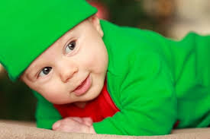
Notes:
Stock photo – cute or dangerous.
What's your assessment of this child?

Slide 6
What Is Child And Adolescent Psychiatry?
Notes:
Management of emotions and behaviour lying outside the normal range for age and sex and causing distress
Interferes with emotional development, social relationships and academic progress
Association with adult mental illness
In infancy the child’s temperament and quality of relationship with the main carer is important for mental well being
Later, relationships with family and peers (e.g bullying) and school success - important factors
Early traumatic experiences including physical illness and developmental delay all increase the risk of childhood psychiatric disorder

Slide 7
How Do We Work?
The service is typically delivered in a multidisciplinary style on an out-patient, day-patient or in-patient basis from hospital departments or the community
Important members of the Professional MDT include:
  Psychiatrists, nurses, social workers, clinical psychologists, specialized therapist with some extended teams including OT and SALT with links to other professionals’ eg teachers, voluntary agencies, paediatricians, probation services.
Clinical assessment and diagnosis is based on the clinician’s integration of subjective information including direct observation and reports from parents, teachers and young people and the MDT.
A developmental perspective must be taken.

Slide 8
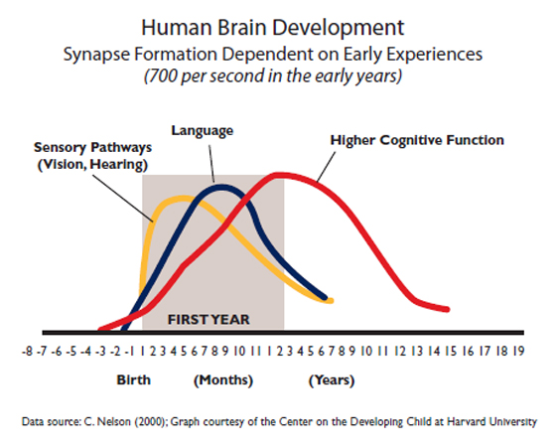
Brain Development - The Critical Years
First 2 years - baby’s brain grows from 25% to 80% of adult size
Development continues in childhood learning empathy, trust and community
Notes:
This is why the first 1000 days are critical, and when assessing young people remember they are in a rapid stage of development so keep changing – so may need re-assessment.
Development of the brain is thought to continue until at least the mid 20’s and probably longer.

Slide 9
Summary of Parallel Developments During Adolescence

Slide 10
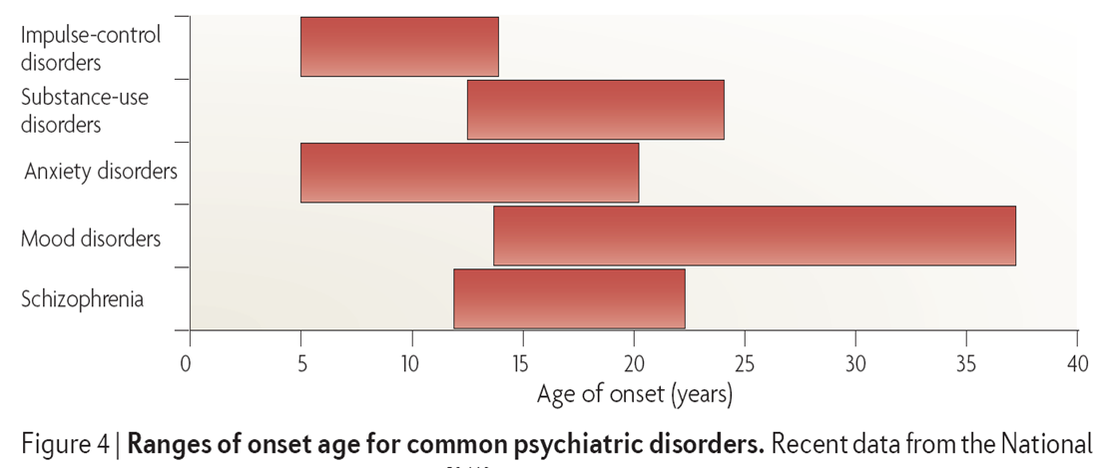
Types of disorder
Classification systems - World Health Organisation (ICD 10 – ICD 11 by 2022) and DSM 5 (also think RDoC)
Many disorders seen in adults present for the first time in childhood.
Notes:
The Research Domain Criteria (RDoC) is a research framework for new approaches to understanding and treating mental disorders. This conceptual framework was designed to integrate various types of information including genetics, molecules, cells, circuitry, behavior, physiology, and self-report. The Research Domain Criteria (RDoC) project is an initiative being developed by US National Institute of Mental Health. In contrast to the Diagnostic and Statistical Manual of Mental Disorders maintained by the American Psychiatric Association, RDoC aims to be a biologically-valid framework for understanding mental disorders: "RDoC is an attempt to create a new kind of taxonomy for mental disorders by bringing the power of modern research approaches in genetics, neuroscience, and behavioral science to the problem of mental illness. https://en.wikipedia.org/wiki/Research_Domain_Criteria
Children and adolescents can be affected by disorders more typical of adults e.g. obsessive compulsive disorder, adjustment disorders, depressive episodes, anorexia nervosa, sleep disorders, schizophrenia and substance abuse etc but there are conditions occurring first or only in childhood

Slide 11
History taking
Foundation for a thorough assessment is to take a detailed history (as in the rest of psychiatry).
You have transferrable skills from assessment in adult psychiatry, but the emphasis may be different.
The history is often predominantly obtained from an informant (parent) but don’t forget to ask the child and young person as well. May have a different emphasis.
Presenting complaint – ? from whose perspective
  E.g. parent may complain of disruptive behavior and young person may describe being low in mood and irritable.

Slide 12
First Interview with Patient & Family
The first interview may take up to l½ hours
It is important to meet with both parents if possible, along with the child initially
If assessing an adolescent, you may wish to see the adolescent before seeing the parents (but should see on own at some point)
A younger child may not wish to separate from their parents at the first interview
The first appointment should help the clinician have an appreciation of:
  The presenting difficulties, their severity and impact on the family or wider society e.g. school
  What factors may have triggered, exacerbated or maintained the presenting problems
  The strengths of the family and child and whether they are motivated to working on the issues
  The expectations and ideas that the family have about being seen by CAMHS (goals of coming)

Slide 13
Recent behaviour /emotional state
Being disobedient, destructive, defiant, having temper-tantrums, telling lies, fire setting, stealing, taking drugs or alcohol, smoking, cruelty to animals/young children.
Happy or miserable, crying often worries
Anxious, school refusal
Suicidal thoughts or acts of self-harm
Routines, rituals, obsessions, fussy
Does this occur at home or outside (school) or both.
Solitary or accompanied
How is it dealt with?

Slide 14
Health/Past Medical History
Is he/she off school at all?
Generally healthy?
ROS
  Asthma, headaches, stomachaches, eyesight, hearing, fainting, fits, absences
  Childhood infections and Immunisations
  Allergies, drugs, food
Eating difficulties
  Food refusal, faddiness, feeding problems
Sleeping problems
  settling, waking, nightmares, sleeping arrangements, when slept alone
PMH
  Illnesses, operations, hospitalisations

Slide 15
Family History
Persons in home
  age, religion, occupation, education, current mental/ physical illness, personality, seen by psychiatrist
Details of parents own childhood and family support network
Family history of psychiatric disorders or other illness
Family life and relationships
  Parental relationships
  how do they get on? How do they spend evenings, weekends? To what extent do they both participate in childcare, discipline etc?
  Parent-child interaction
  Child’s participation in family activities
  helps at home etc.
  Rules and routines at home.
Domestic conflict or violence/extent of childhood exposure to violence

Slide 16
Personal History/Developmental History
Pregnancy
  planned, complications, alcohol, smoking, drugs (previous pregnancies)
Delivery
  spontaneous/induced, place, date, labour, presentation, mode of delivery, gestation, birth weight, complications, resuscitation/SCBU
Mother’s health during and after pregnancy - depression (PND)
Neonatal period
  breathing, feeding, convulsions, jaundice, and infections, how long in hospital?
Infancy
  feeding, weaning, sleep pattern, placid or active, irritable, easy or difficult temperament. Any behavioral difficulties e.g. tantrums as a toddler

Slide 17
Personal History
Milestones
  sitting unsupported, walking unaided, first word with meaning, first 2 word phrases, and comparison with siblings, pointing
Bladder and bowel control
  dry by day and night, bowel control.
Separations
  apart from parents. How child reacted on separation for nursery/toddler playgroup, children's parties
Interactions with peers as a young child
Useful to use links to specific ages e.g. 4-5 years “when they started infant school how did things go?”

Slide 18
School
Present & Previous Schools
  happy, progress, and contact with school
  Attendance
  Academic strengths & weaknesses.
  Non-academic skills, independence
  Social relationships,
  Behaviour Support or learning support service, SENCO Educational Psychologist.
Relationships
  with other adults, with teachers, other children, opposite sex

Slide 19
Social history
Home circumstances
  description of the house, sleeping arrangements, community, overcrowding.
Other care arrangements
  Child minder, baby sitter
Finances
  any difficulties
Neighbourhood
  description of area, house moves, community violence, neighbour disputes

Slide 20
Personality/Temperament
Meeting new people – other adults, children, shy, clingy, how quickly does he/she adapt to change?
New situations
  new places, new tools, explore or hand back.
Emotional expression
  introvert, extrovert, generally happy/miserable
Affection & Relationships
  how does he/she show feelings, affectionate, confiding, friendships: school, at home
Sensitivity
  response to person/animal hurt, reaction if told off, did something wrong
Interests, hobbies

Slide 21
Interview with Child & MSE
Determined by the child’s age and developmental level
Provide the right materials (crayons, paper, books) and a safe and private environment
Initially, talk about neutral topics or things which the child or adolescent is interested in
It is important that you explain to the child that the interview is confidential and the limits of that confidentiality
With younger children you may wish to encourage the child to play with toys, draw or describe their family, friends or school
Approach discussion of feelings later on
With an adolescent, the interviewer may involve more direct questions and more of a verbal interchange
By the end of the interview you should have a reasonable idea about the child’s understanding of why they are being seen and some idea of their emotional state

Slide 22
Mental state examination
Appearance and behaviour: dress, physical appearance, motor activity, co-ordination, involuntary movements
  Social response to interviewer: humour, rapport, eye contact, empathy, and co-operation, shy, confident
  Social interaction with parents
Language: expression, comprehension, speech – spontaneous, quantity, rate, rhythm, and complexity
Mood: subjective, objective, symptoms/signs of depression, suicidal feelings, anxiety, panic, anger, aggression, and irritability
Abnormal beliefs, experiences, thought content, hallucinations, delusions, worries, fears, preoccupations, obsessions, fantasies or wishes
Cognition: attention span/distractibility, draw a person (note grip, handedness), write name, give days of week, months of year, counting, simple arithmetic, orientation, memory, general knowledge, reading skills/level of attainment

Slide 23
*Other sources of Information
School with appropriate consent
Undertaking school assessment with appropriate consent
Undertaking home observations

Slide 24
Assessment Tools- there are many
Questionnaires
  SDQ/RCADS
  Connors/SNAP IV/ CBCL
  Psychometrics - WISC
  Observational – ADOS
  Structures interviews KIDDIE SADS/ADI/DISCO
Notes:
Broad to narrow

Slide 25
Risk Assessment
Factors
  Historical – what has happened in the past
  Clinical – what disorder the child has
  Social – deprivation/family/school/drugs
  Demographic – gender/age
  Developmental – stage/delay

Slide 26
Trauma is HIGHLY PREVALENT
Psychological - 11.1%
Physical – 10.8%
Sexual – 22%
Witnessed domestic violence to mother – 12.5%
Most common: substance use in household – 25.6%
Overall response rate to any category – 52.1%

Slide 27
Clinical trauma Screening
“What is the scariest thing that has ever happened to you?”
  “Has anything scary or upsetting happened since our last visit?” (add to your family/child if asking parents)
  “Do you know of any traumatic experiences your child has gone through?”
  “Has there ever been a time when you were (your child was) scared for your (his or her) life?”
  “Has anyone ever touched you in ways you did not want to be touched?”
“Does [known traumatic event] ever bother or upset you these days?”

Slide 28

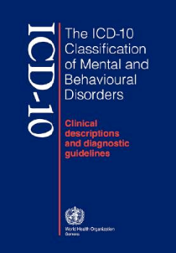
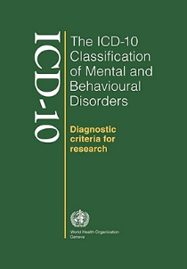
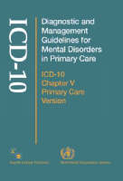
What is a diagnosis?
Diagnosis
Is it real?
Is it useful?
Is it flexible?
Is it defensible or reproducible?
Does it predict treatment?
Notes:
Assessment can lead to a diagnosis – but ??
Diagnostic classification systems
ICD-10
Behavioral & Emotional Disorders with Onset Usually Occurring in Childhood & Adolescence
Hyperkinetic Disorders
Conduct disorders
Mixed Disorder of Conduct
Emotional Disorders with Onset Specific to Childhood
Separation Anxiety ,Phobic Anxiety Disorder, Sibling Rivalry Disorder
Disorders of Social Functioning with Onset Specific To Childhood
Elective Mutism, Attachment Disorders
Tic Disorders
Transient Tic Disorder, Tourette’s syndrome
Other Behavioural and Emotional Disorders with Onset Specific to Childhood
Non-organic Enuresis, Non-organic Encopresis, Feeding disorder Pica of infancy
Disorders of Psychological Development
ASD
Autism Asperger’s Syndrome, Rett’s Syndrome
Specific Developmental Disorders of Speech and Language Specific Developmental Disorders of Scholastic Skills
Specific Reading Disorder, Specific Spelling Disorder
Specific Developmental Disorder of Motor Function
‘Disorder is not an exact term, but it is used here to imply the existence of a clinically recognisable set of symptoms or behaviour associated in most cases with distress and with interference with personal functions.
Social deviance or conflict alone, without personal dysfunction, should not be included in mental disorder as defined here.’
International classification of Diseased
(ICD - 10) The World Health Organisation

Slide 29
Formulation
This is a brief description of the child’s presenting problems. It helps to consider the factors under:
  BIOLOGICAL
  PSYCHOLOGICAL
  SOCIAL
PREDISPOSING / PRECIPITATING / MAINTAINING / PROTECTIVE
The formulation is useful in helping to highlight areas for intervention and producing a management plan with a description of the likely prognosis

Slide 30
CAMHS Module
Any Questions?
MCQs on the next slide

Slide 31
CAMHS Module
MCQs
Patient should routinely have a neurological examination if they present with all except:
History of an episode of fainting
History of seizures
Developmental delay
Dysmorphic features
Abnormal gait

Slide 32
CAMHS Module
MCQs
Patient should routinely have a neurological examination if they present with all except:
History of an episode of fainting
History of seizures
Developmental delay
Dysmorphic features
Abnormal gait
Notes:
A - History of an episode of fainting. A solitary episode of a simple faint would not necessarily warrant the need for a neurological examination unless other risk factors are present. However presence of history of seizures, developmental delay, dysmorphic features or abnormal gait should prompt you to perform/refer for a neurological examination.

Slide 33
CAMHS Module
MCQs
A physical risk assessment for patients with Anorexia Nervosa should include all except:
Assessment of BMI and weight
Assessment of heart rate
Assessment of temperature
Assessment of hydration status
Assessment of body fat percentage abnormalities

Slide 34
CAMHS Module
MCQs
A physical risk assessment for patients with Anorexia Nervosa should include all except:
Assessment of BMI and weight
Assessment of heart rate
Assessment of temperature
Assessment of hydration status
Assessment of Body fat percentage
Notes:
E - Assessment of EEG abnormalities. ECG (not EEG) assessment should be part of the routine physical parameters checked when a patient presents with symptoms consistent with a diagnosis of Anorexia Nervosa (AN); this patient group are more at risk of abnormal heart rhythms. Patients with AN who are severely physically unwell may have signs of bradycardia, hypothermia and dehydration as well as low weight. (Junior Marsipan guidelines p 16).
Body fat may be useful but not as part of a risk assessment

Slide 35
CAMHS Module
MCQs
During an assessment of a 14 year old patient with depression in primary care, which of the following would prompt you to refer to tier 2 or 3 CAMHS:
Mild depression in those who have not responded to interventions in tier 1 after 2-3 months
Active suicidal plans
Referral requested by the young person
Moderate to severe depression
All of the above

Slide 36
CAMHS Module
MCQs
During an assessment of a 14 year old patient with depression in primary care, which of the following would prompt you to refer to tier 2 or 3 CAMHS:
Mild depression in those who have not responded to interventions in tier 1 after 2-3 months
Active suicidal plans
Referral requested by the young person
Moderate to severe depression
All of the above
Notes:
E - All of the above. (NICE guidelines depression in children and adolescents).

Slide 37
CAMHS Module
MCQs
Assessment of ADHD commonly include all except:
ADOS
School observations
History from parents/carers
Connors assessment
History from patient

Slide 38
CAMHS Module
MCQs
Assessment of ADHD commonly include all except:
ADOS
School observations
History from parents/carers
Connors assessment
History from patient
Notes:
A - ADOS assessment. ADOS (Autism Diagnostic Observation Schedule) assessments are usually reserved for patients in which a diagnosis of Autistic Spectrum Disorder (ASD) is being considered and would not routinely be performed in children with „straightforward‟ ADHD. Collateral information from family and school as well as observing the patient in school will form the bulk of your assessment and you may ask parents and teachers to complete a Connors assessment of their typical behaviours.

Slide 39
CAMHS Module
MCQs
Mental state examination of a 15 year old patient should include all the following except:
Assessment of appearance and behaviour
Family history
Assessment of speech
Assessment of insight
Assessment of cognition

Slide 40
CAMHS Module
MCQs
Mental state examination of a 15 year old patient should include all the following except:
Assessment of appearance and behaviour
Family history
Assessment of speech
Assessment of insight
Assessment of cognition
Notes:
B - Family history. Mental state examinations of older adolescents are very similar to those in adults and should follow the same template (appearance and behaviour, speech, mood, thoughts form and thought content, perceptions, cognition and insight). Whilst it will be
important as part of your overall assessment to get details about the family history, it does not form part of the MSE. In much younger patients, a formal MSE is not always useful.

Slide 41
CAMHS Module
MCQs
An assessment of a 3 year old with suspected Autistic Spectrum Disorder must include:
A home visit
A detailed mental state examination
Observation of the child interacting with others
All of the above A-C
None of the above A-C

Slide 42
CAMHS Module
MCQs
An assessment of a 3 year old with suspected Autistic Spectrum Disorder must include:
A home visit
A detailed mental state examination
Observation of the child interacting with others
All of the above A-C
None of the above A-C
Notes:
C - Observation of the child interacting with others. Since ASD is largely a disorder of communication and social interaction, it is imperative to gain an understanding of this by
observing how the child interacts. Usually this is done both in the clinic and at school. Home visits may be arranged in some circumstances but are not always essential. Although you will need to gain a lot of important information on appearance, behaviour and speech, the other aspects of mental state examination will be difficult to attain in a patient of this age and therefore a detailed MSE will not be useful.

Slide 43
CAMHS Module
MCQs
CAMHS assessments in patients with speech delay should routinely include all except:
Family tree
Family history of ASD/Aspergers
Developmental history
Details of whether the patient had the combined MMR vaccine
Medical history

Slide 44
CAMHS Module
MCQs
CAMHS assessments in patients with speech delay should routinely include all except:
Family tree
Family history of ASD/Aspergers
Developmental history
Details of whether the patient had the combined MMR vaccine
Medical history
Notes:
D - Details of whether the patient had the combined MMR vaccines. It will be vital as part of a comprehensive CAMHS assessment into speech delay to obtain detailed information about other members of the family, including a family tree and history of similar speech delay, ASD or Aspergers amongst family members. Whilst it may be helpful to know about the child‟s immunisation status in general, previous reports that autism is linked to the MMR vaccine have repeatedly been discredited and it is not a risk factor.

Slide 45
CAMHS Module
MCQs
The presence of a disorder can be explained in terms of all except:
Predisposing factors
Precipitating factors
Perpetuating factors
Petulant factors
Protective factors

Slide 46
CAMHS Module
MCQs
The presence of a disorder can be explained in terms of all except:
Predisposing factors
Precipitating factors
Perpetuating factors
Petulant factors
Protective factors
Notes:
D - Petulant factors. Most of the causes in child and adolescent psychiatry are best thought of as risk factors which work together to make an outcome more likely (with some obvious exceptions such as genetic disorders). For example, not all academically high achieving girls will develop anorexia nervosa. However, the combination of this, with a family history of
eating disorders, a naturally guilty or anxious disposition and parental divorce may work together to make it more likely that an individual will develop AN. It can be helpful to think about these issues as predisposing (i.e.: family history, anxious predisposition), precipitating (parental break up), perpetuating (current exam stress) and presence or absence of protective
factors (supportive family or teachers). (Child and Adolescent Psychiatry Goodman and Scott, third edition Wiley Blackwell, p9).

Slide 47
CAMHS Module
MCQs
In regards to initial CAMHS assessment of children under 5 with speech delay:
You should not see them without the presence of their parent/carer in the room
You should aim to get the child sat down in a chair for the majority of the assessment
You should observe them playing and play too if appropriate
You should avoid difficult topics
You should use more directed questioning

Slide 48
CAMHS Module
MCQs
In regards to initial CAMHS assessment of children under 5 with speech delay:
You should not see them without the presence of their parent/carer in the room
You should aim to get the child sat down in a chair for the majority of the assessment
You should observe them playing and play too if appropriate
You should avoid difficult topics
You should use more directed questioning
Notes:
C - You should observe them playing and play too if appropriate. It is a good idea to see all patients without their parents/carers, even if only for a short time, as you may uncover information that you may have missed if they were not present. For example information regarding domestic violence or abuse. This may not always be possible if for example the child becomes extremely distressed or agitated when their parent leaves the room. The importance of the initial assessment with children is to gather as much useful information as possible and play is an excellent way to do this in the under 5s, it is not really important whether they sit down for the whole of the assessment although you can make a comment
about this in your observations. Whilst it is important to handle difficult topics (such as abuse
or violence) sensitively, missing it out altogether may mean you miss out on vital information. If it is not appropriate discuss this in the first session, further sessions can be arranged. Children under 5 are less likely to respond well to a lot of direct questioning. (Child and Adolescent Psychiatry Goodman and Scott, third edition Wiley Blackwell, p15).

Slide 49
Mental health in the classroom

Slide 50
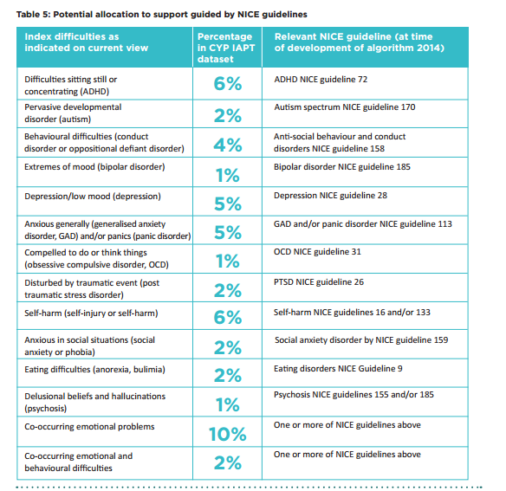
Typical case mix of cases presenting to CAMHS
28% of CYP had mild problems or one moderate that doesn't fit NICE guidance.
25% of CYP had multiple or severe problems that don’t fit easily into NICE guidance.
Martin, P., Davies, R., Macdougall, A., Ritchie, B., Vostanis, P., Whale, A., & Wolpert, M. Developing a case mix classification for child and adolescent mental health services: the influence of presenting problems, complexity factors, and services on number of appointments. Considers impact of problems and complexity factors on service use
Notes:
n = 31,037 cases ; current view completed within 56 days of the recorded start of therapy .

Slide 51
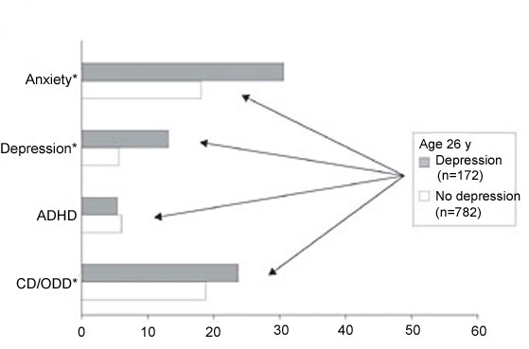
Prevalence (%) of childhood psychiatric disorders among those with and without a diagnosis of depression at 26 years of age
* p <.05
*Kim-Cohen, Caspi, Moffitt et al. (2003), Arch Gen Psychiat, 60, 709-717

Slide 52
The Burden of Childhood Mental Disorder
Between 1:10 and 1:8 children and adolescents suffer from mental disorder severe enough to result in functional impairment
World Health Organisation Report:
  Mental disorders will become one of the 5 most common causes of morbidity, mortality and disability among children

Slide 53
The Burden of Childhood Mental Disorder
Childhood mental disorders
  Reduce the quality of children’s life
  Diminish their productivity in later life
  75% of adult mental disorder anticipated by childhood disorder
  No other illness damage so many children so seriously
Stigma continues to be a significant barrier to mental health treatment for children and their families despite public education

Slide 54
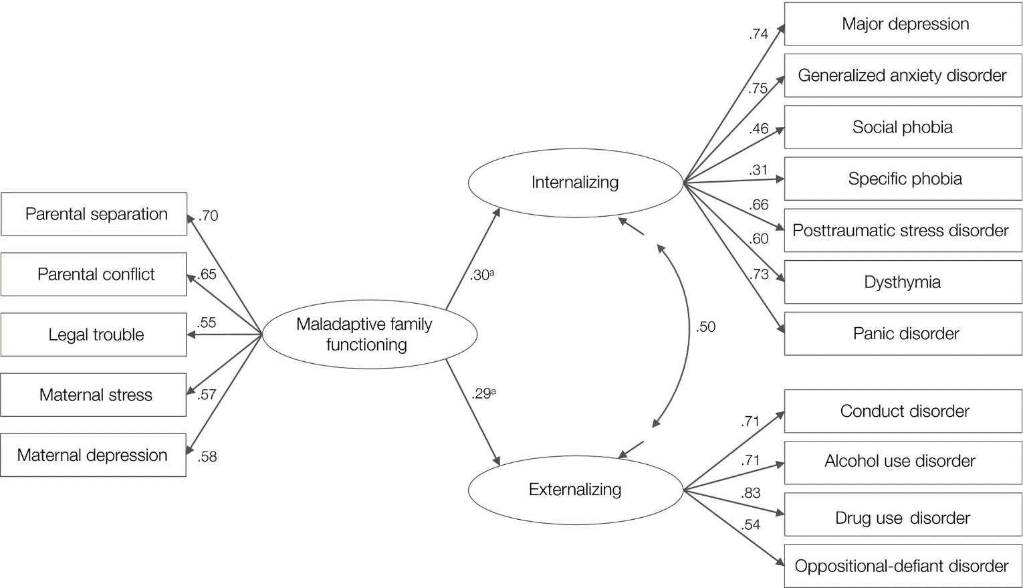
Transdiagnostic pathways from early social stress to psychopathology: a 20‐year prospective study
Transdiagnostic pathways from early social stress to psychopathology: a 20‐year prospective study, Volume: 59, Issue: 8, Pages: 855-862, First published: 08 January 2018, DOI: (10.1111/jcpp.12862)
Notes:
Prospectively assessed Maladaptive Family Functioning during early childhood predicts Internalizing and Externalizing liabilities. Single‐headed arrows flowing from latent variables to their indicators represent factor loadings, which were all statistically significant at p < .001. The double‐headed arrow represents a residual correlation, which was also significant at p < .001. Single‐headed arrows leading from Family Adversity to the Internalizing and Externalizing latent variables represent regression paths. All factor loadings, correlations, and regression coefficients are fully standardized. Sex was included as a covariate (see main text), but not included here for clarity of presentation. aRegression coefficients were significant at p < .001
IF THIS IMAGE HAS BEEN PROVIDED BY OR IS OWNED BY A THIRD PARTY, AS INDICATED IN THE CAPTION LINE, THEN FURTHER PERMISSION MAY BE NEEDED BEFORE ANY FURTHER USE. PLEASE CONTACT WILEY'S PERMISSIONS DEPARTMENT ON PERMISSIONS@WILEY.COM OR USE THE RIGHTSLINK SERVICE BY CLICKING ON THE 'REQUEST PERMISSIONS' LINK ACCOMPANYING THIS ARTICLE. WILEY OR AUTHOR OWNED IMAGES MAY BE USED FOR NON-COMMERCIAL PURPOSES, SUBJECT TO PROPER CITATION OF THE ARTICLE, AUTHOR, AND PUBLISHER.

Slide 55
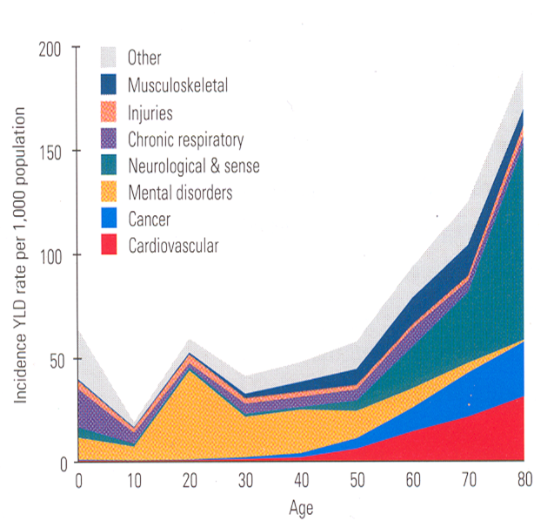
When do mental health disorders emerge?

Slide 56
CAMHS Module
Any Questions?
Thank you

